Slide 1

My New Class
2026 - 2027

Slide 2
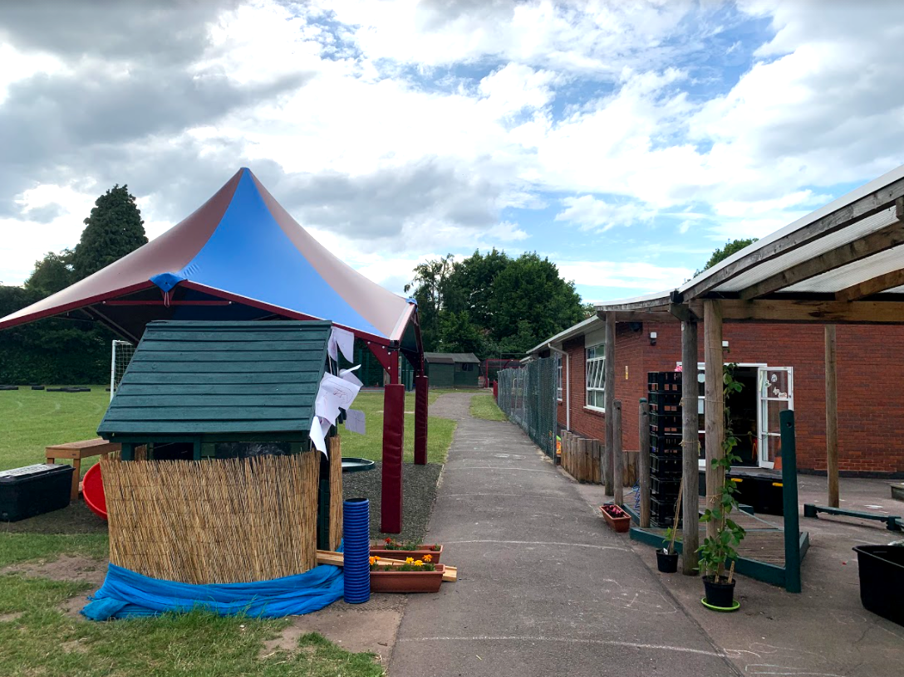
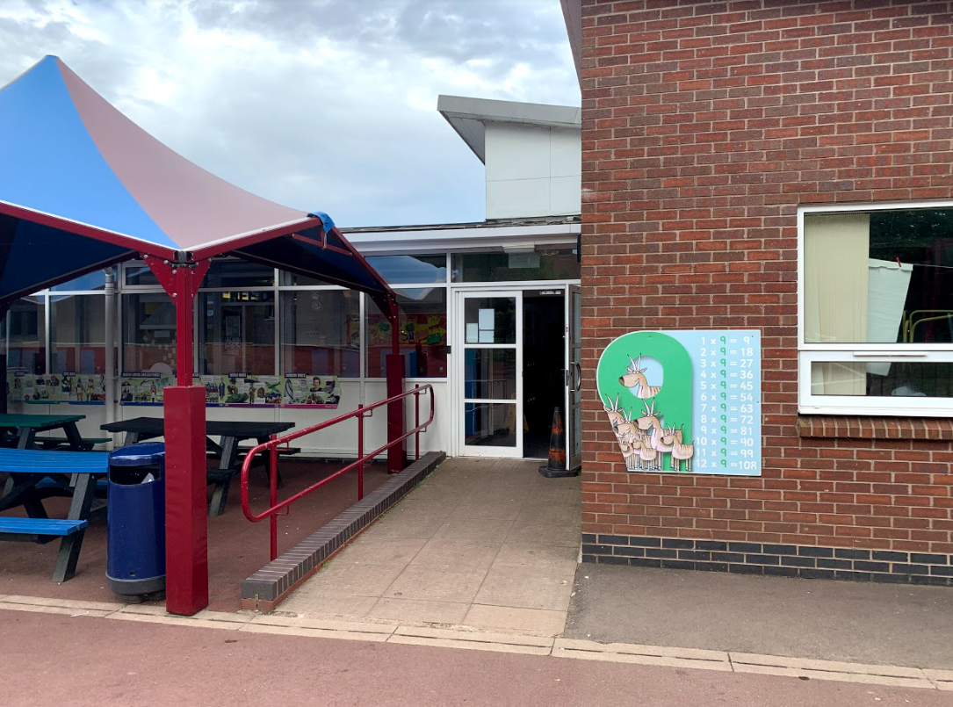
After the summer holidays I will enter school this way each morning:

Slide 3
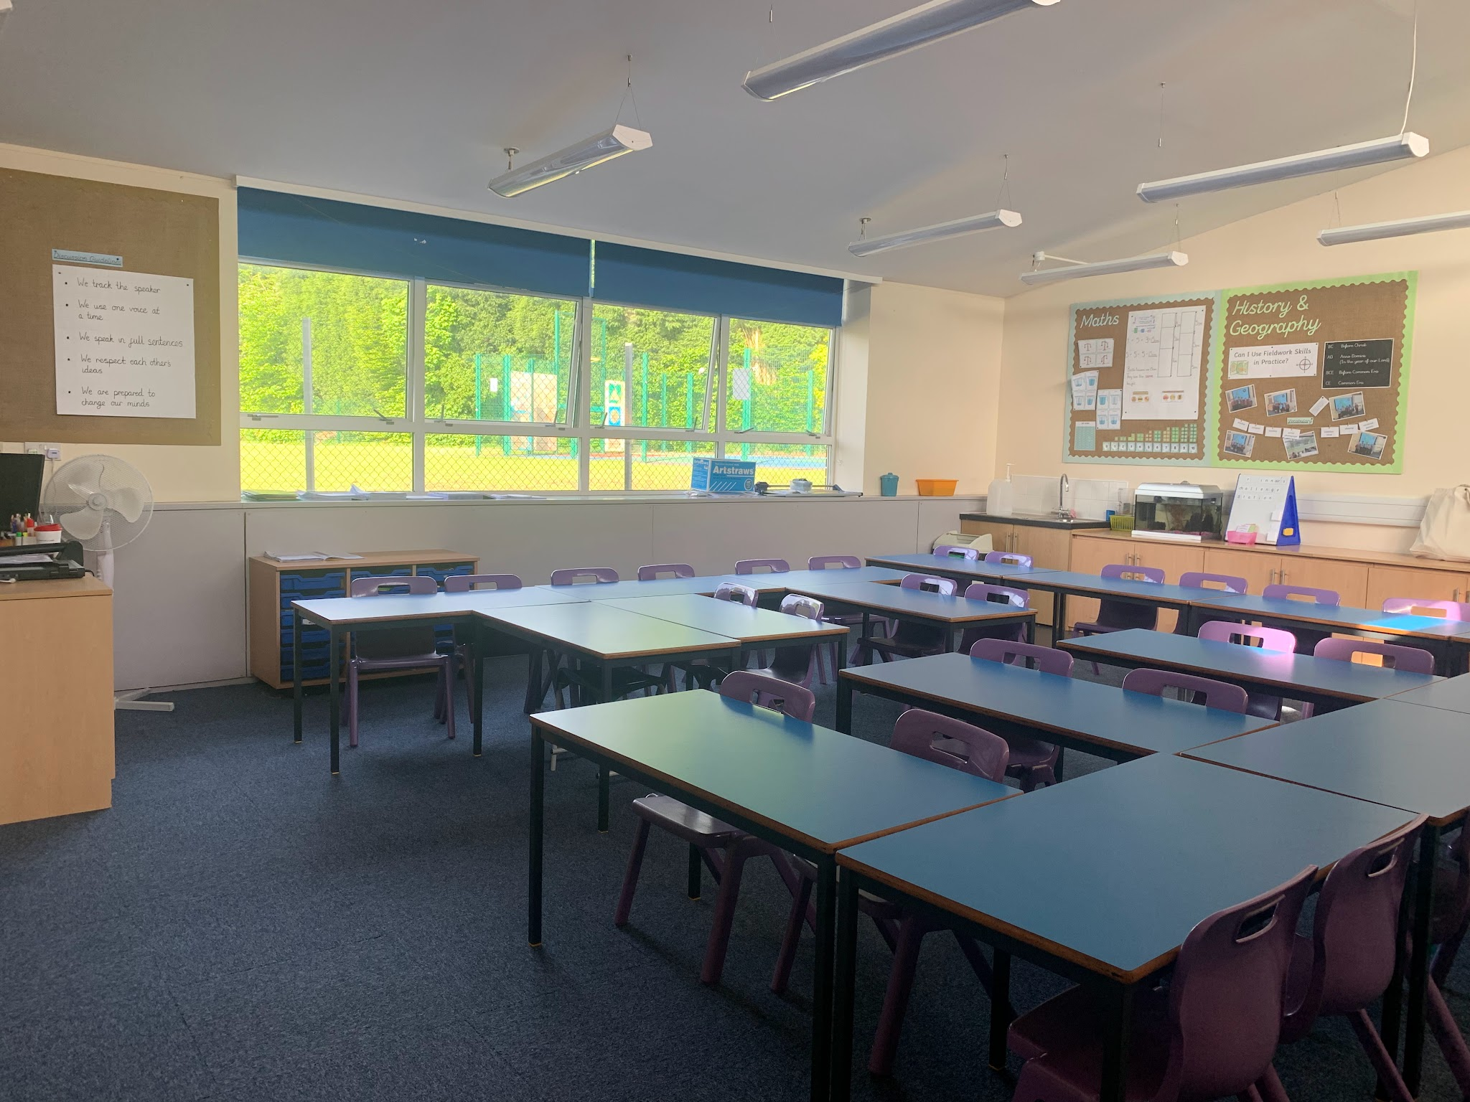
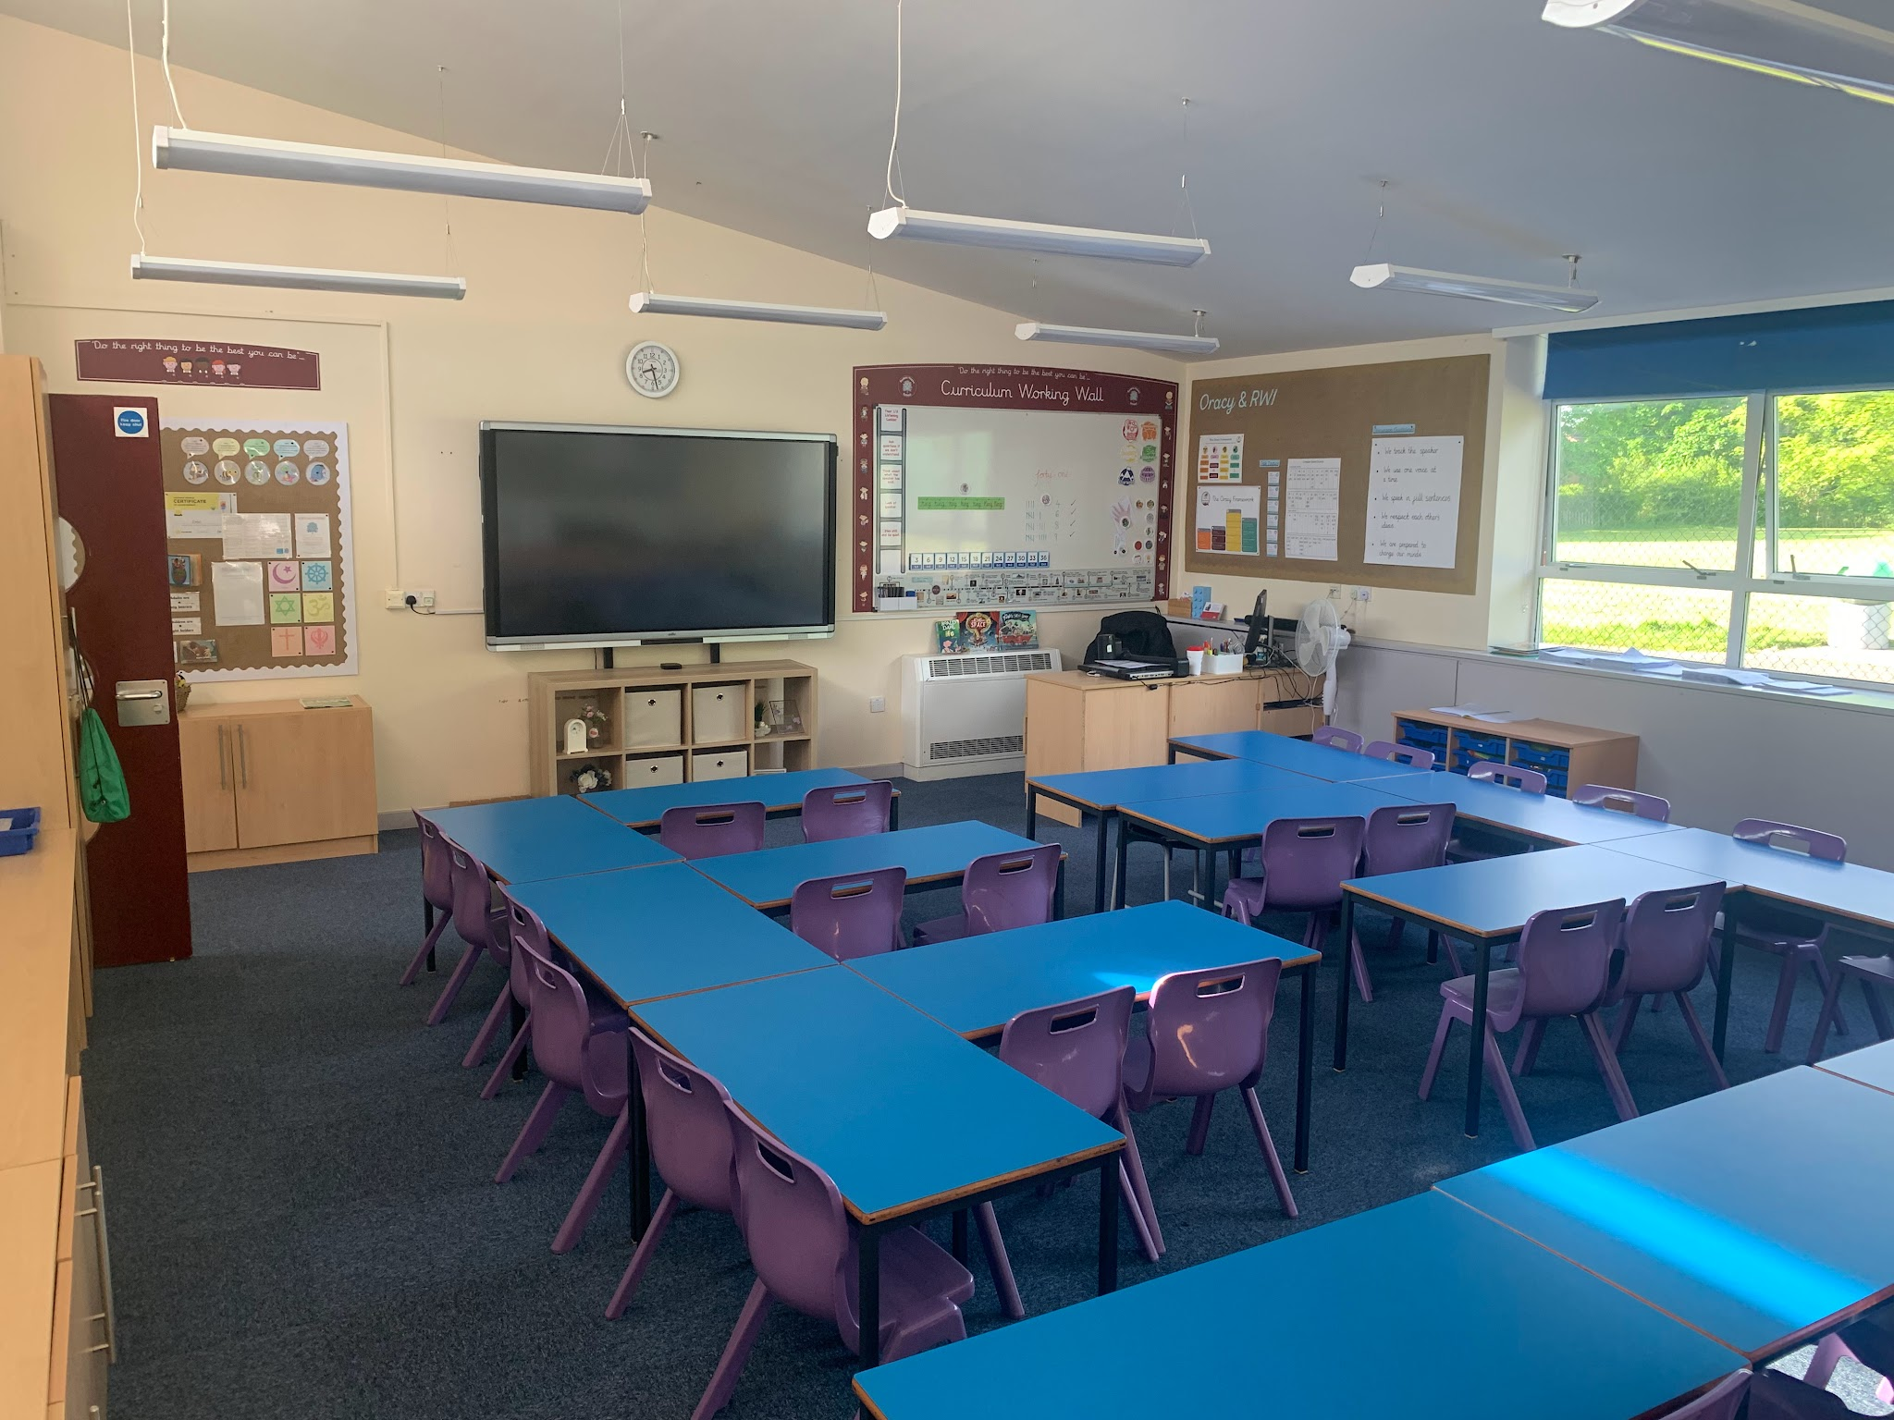
After the summer holidays, I will be in a new classroom.
This will be my new classroom:

Slide 4
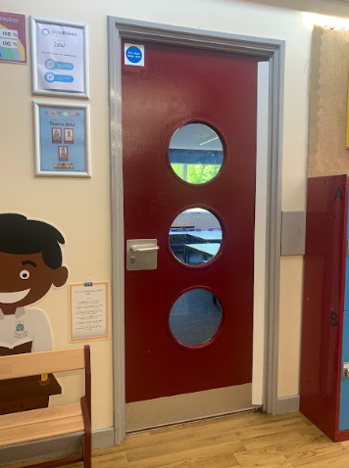
This will be my new classroom door:

Slide 5
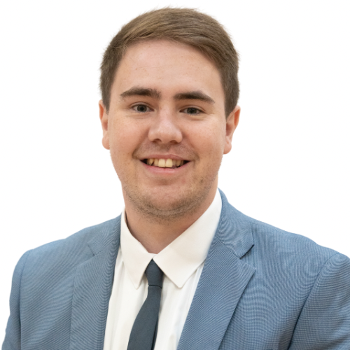
This is my new teacher, Mr Kinnair.
My new class is called 2K.
Mr Kinnair
Class Teacher for 2K

Slide 6
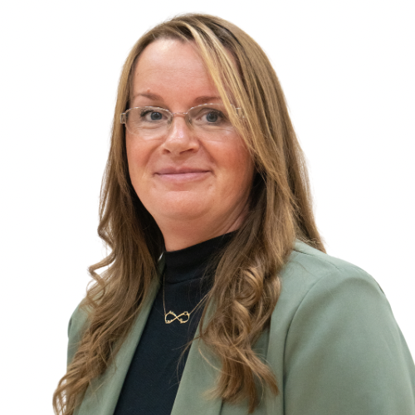
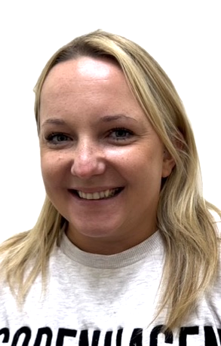
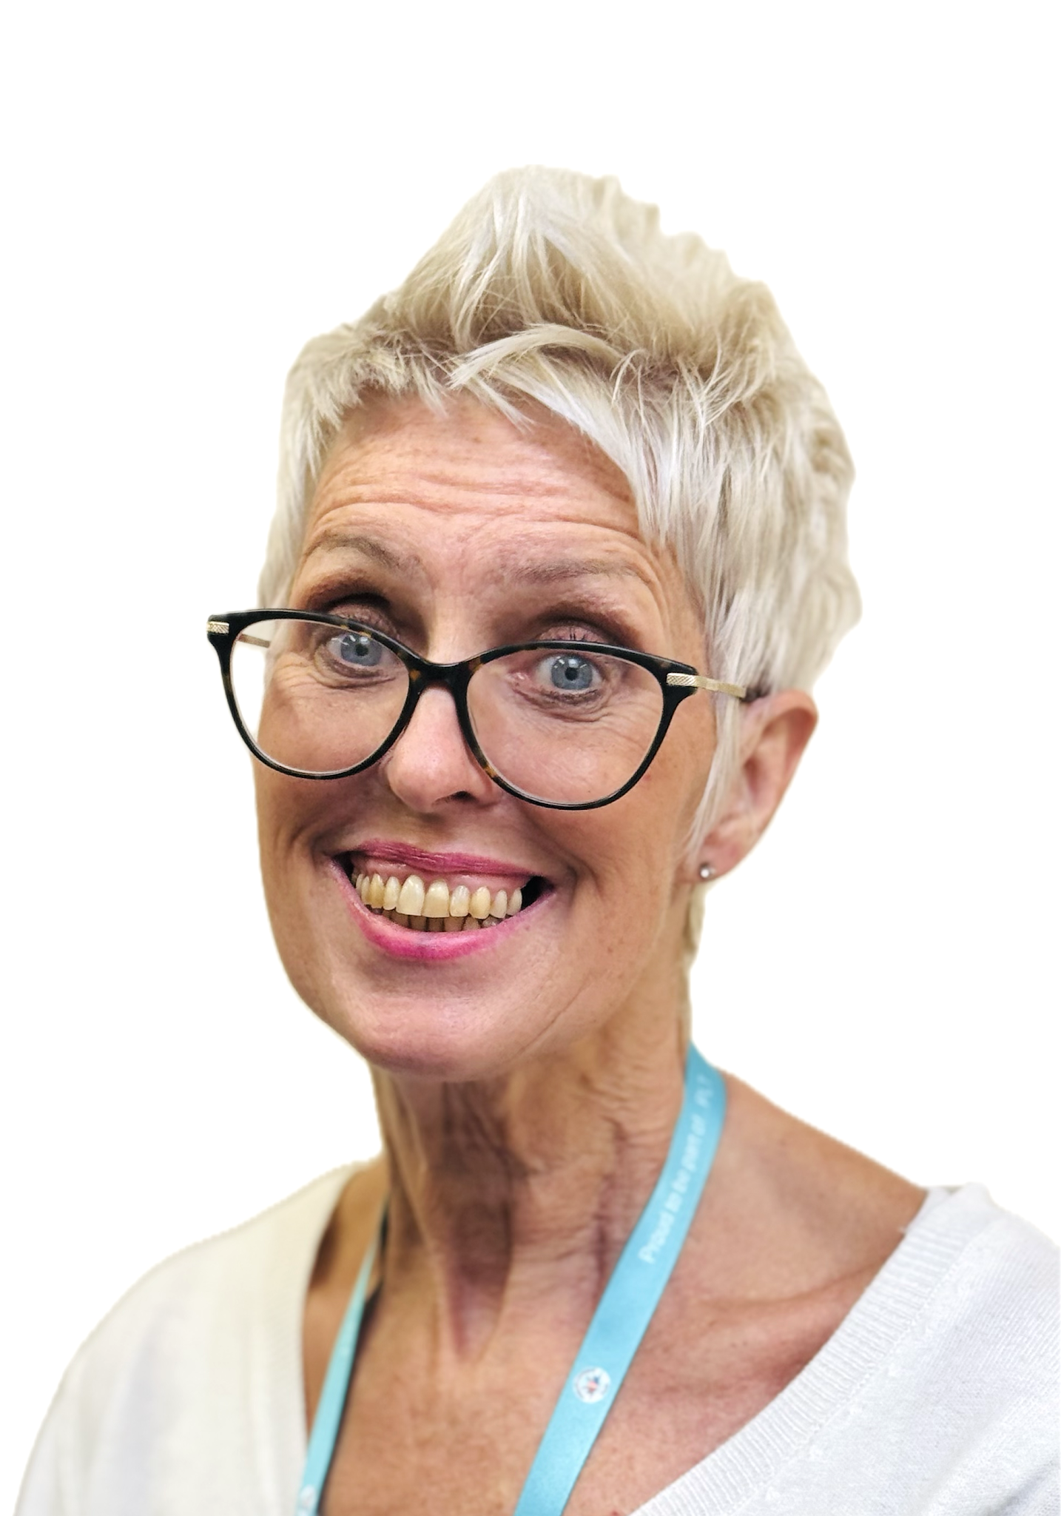
I will have some new teaching assistants.
These are my Year 2 teaching assistants:
Mrs Picknell, Mrs Hughes & Mrs Sargent
Year 2 Teaching Assistants

Slide 7
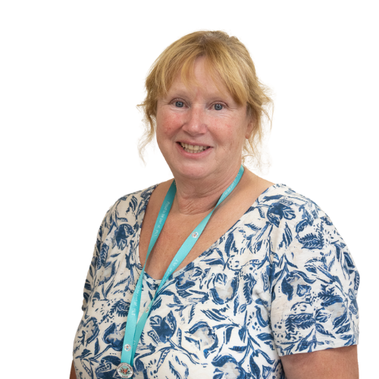
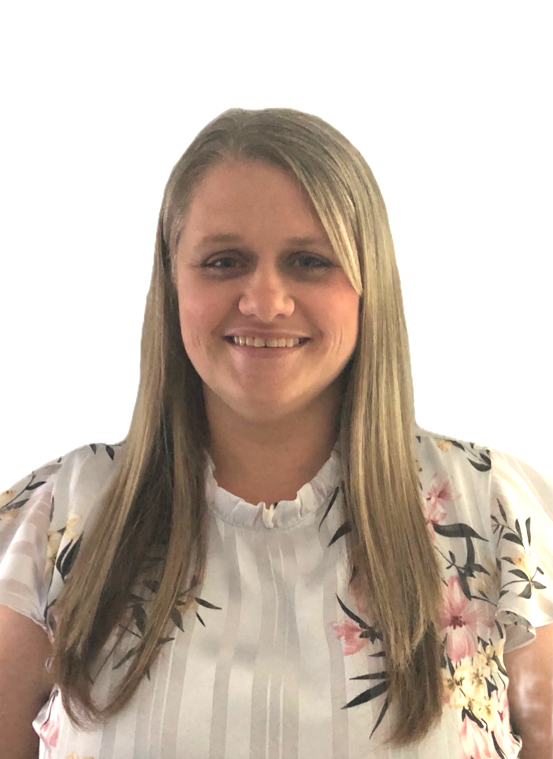
Other staff members that will teach me in the week are
Mrs Pheasant and Mrs Willis on Thursday afternoons.
Mrs Pheasant & Mrs Willis
Year 2 PPA Cover Teachers

Slide 8
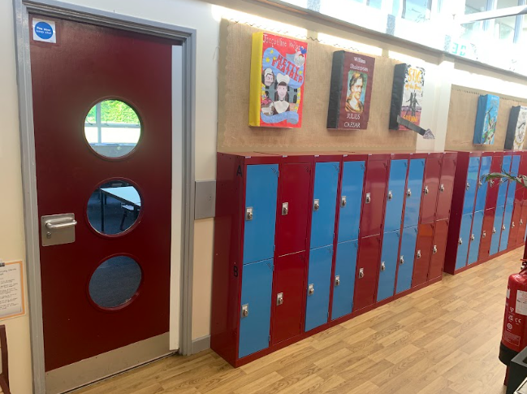
I will have a new locker.
This is where my locker will be:

Slide 9
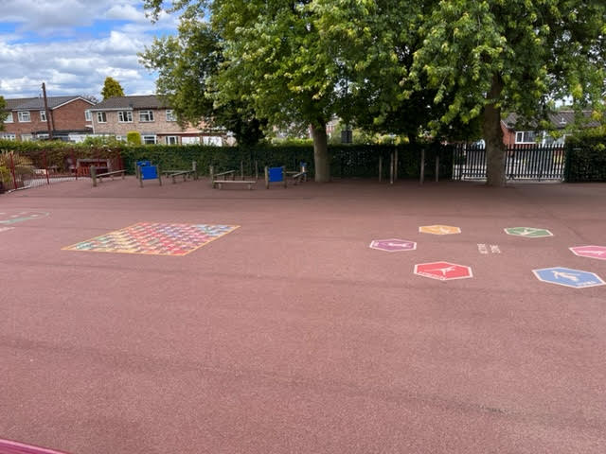
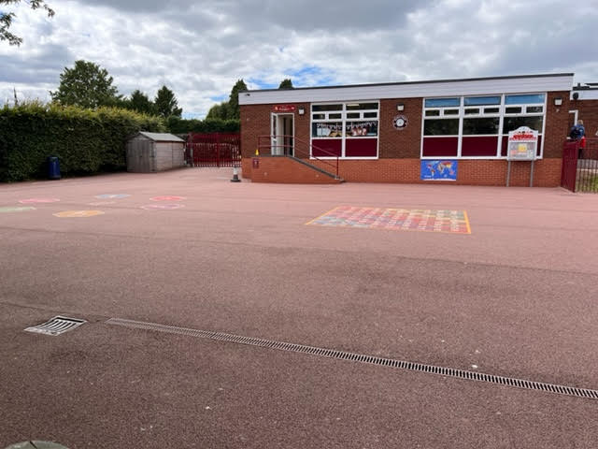
My playtime is: 10:30am-10:45am.
My lunchtime is: 11:45am-12:30pm.
I will have playtimes and lunchtimes on the KS1 playground:

Slide 10
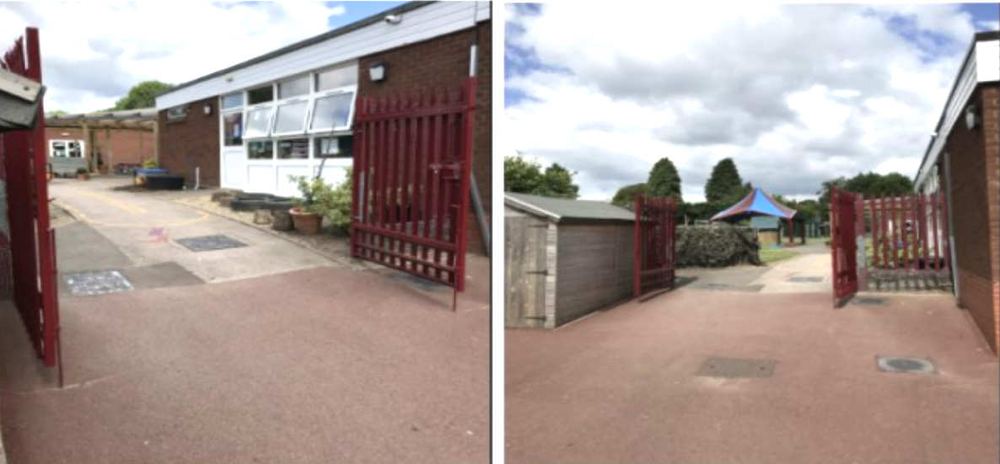
I will leave school at the end of the day through this exit/gate.
I finish school at 3:30pm.

Slide 11


I will have lots of fun and learn new things in 2K!

