Slide 1

My New Class
2026-2027

Slide 2
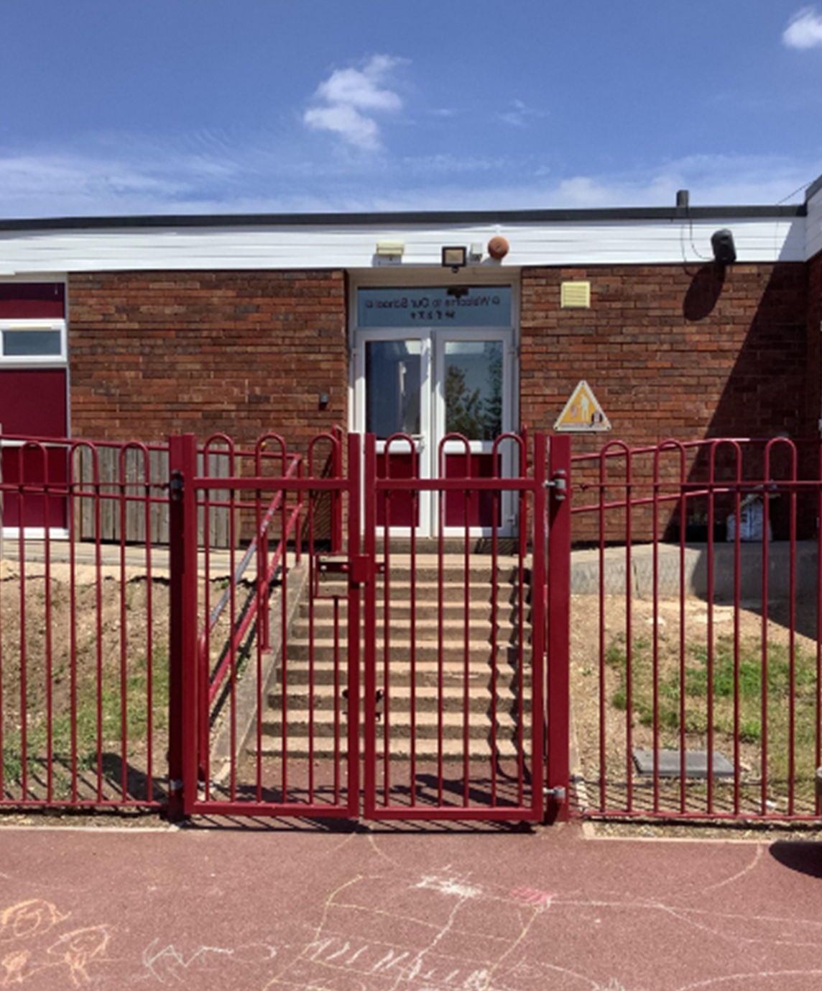
After the summer, I will enter the school through the playground.

Slide 3
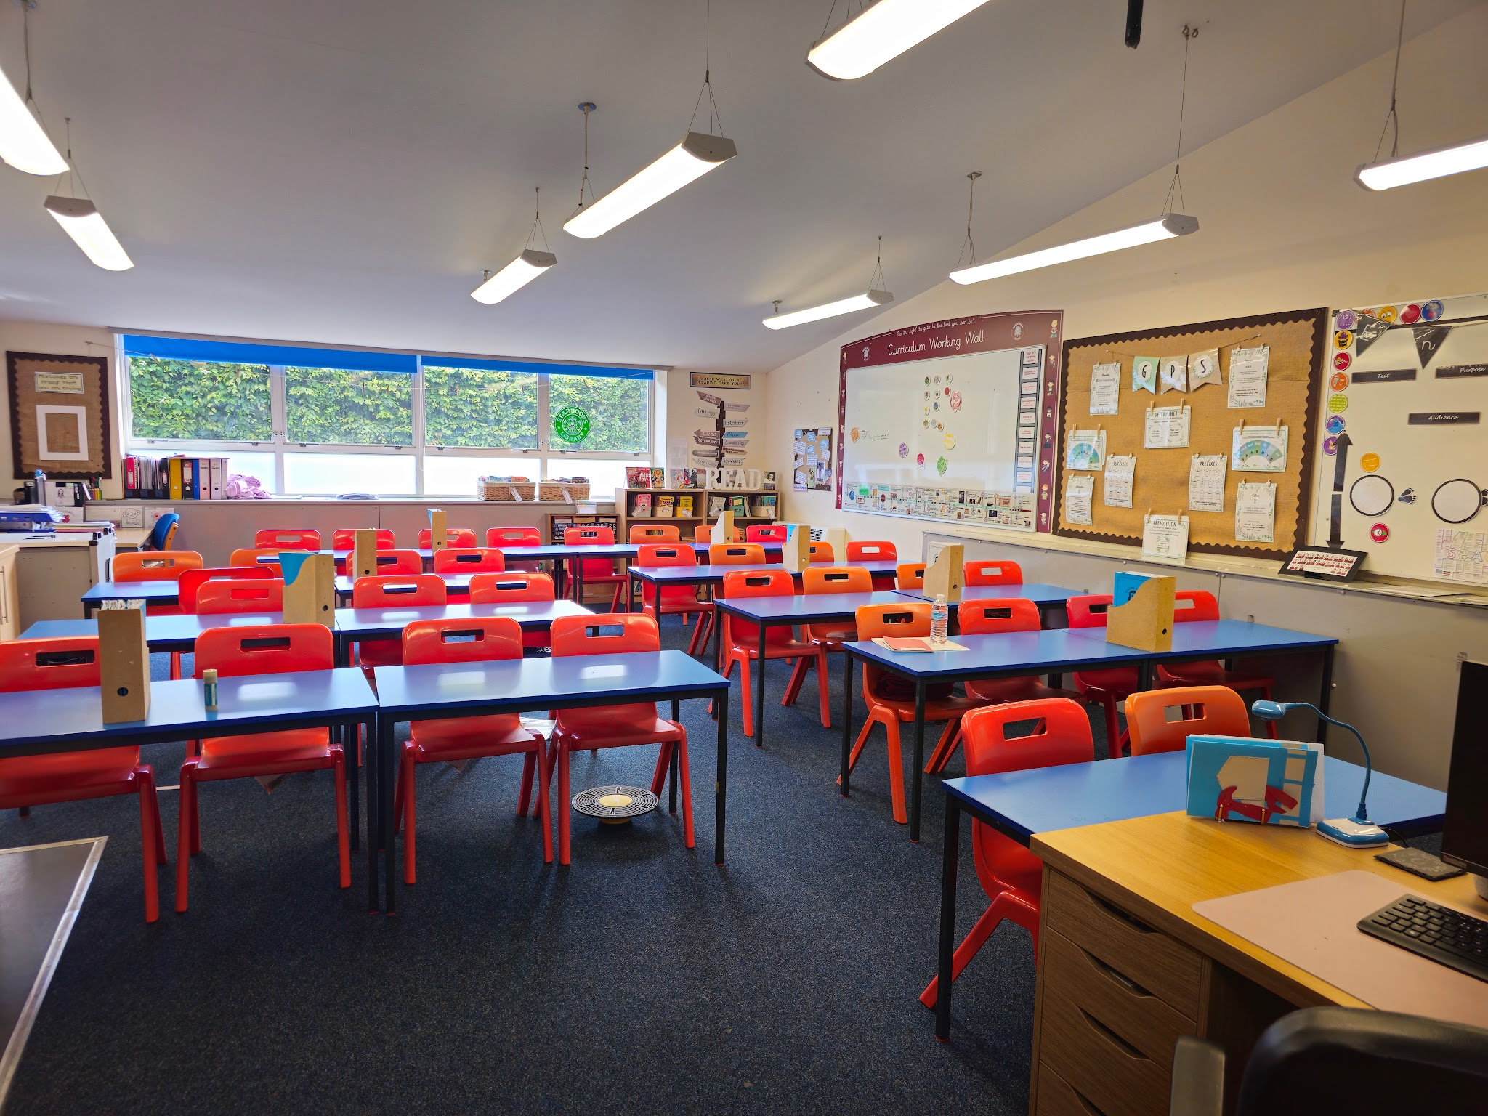
After the summer holidays, I will be in a new classroom.
This will be my new classroom, 6S.

Slide 4
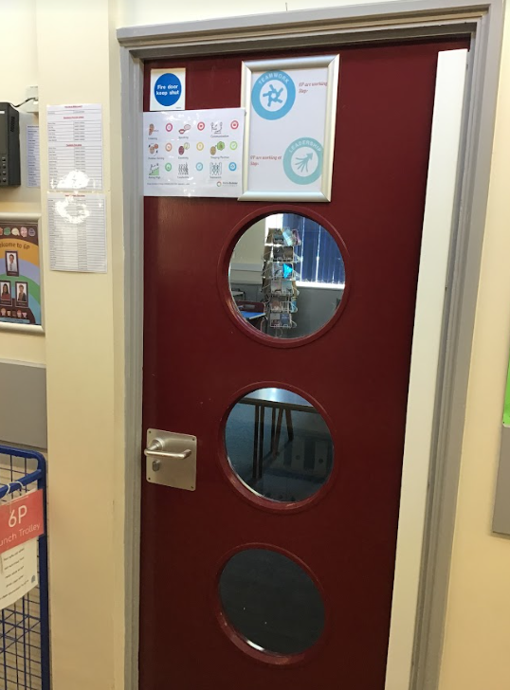
This will be my new classroom door:

Slide 5
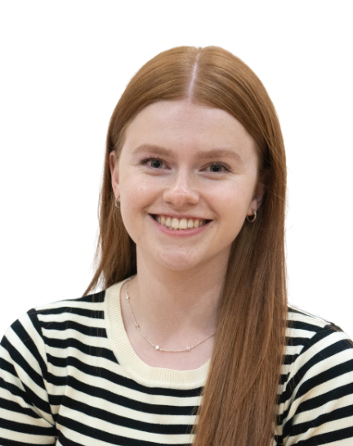
This is my new teacher, Miss Smith.
My new class is called 6S.
Miss Smith

Slide 6
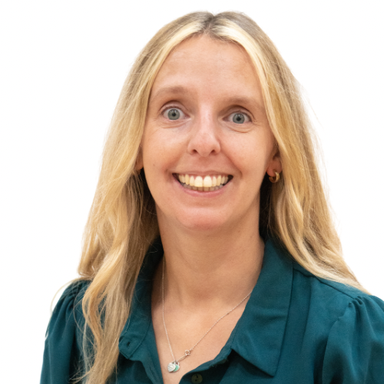
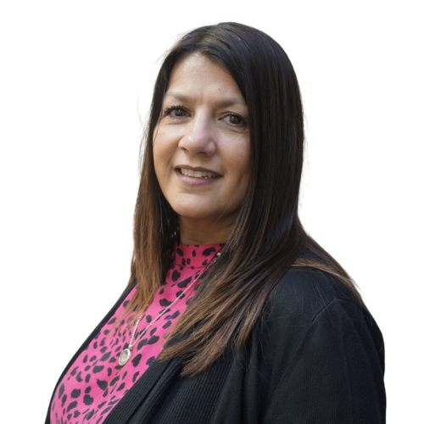
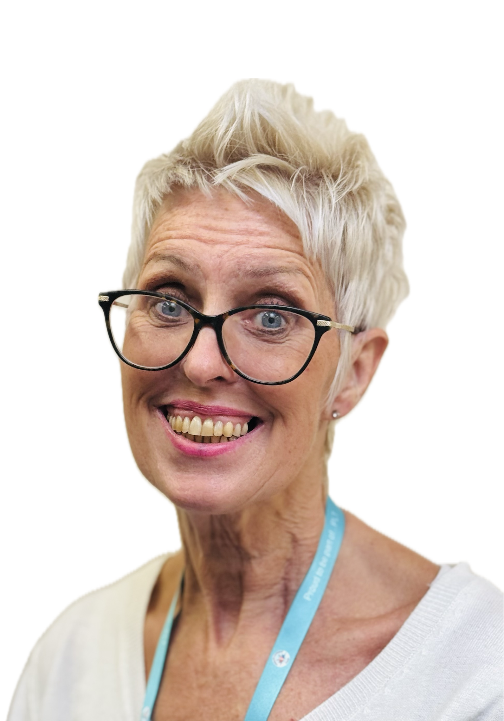
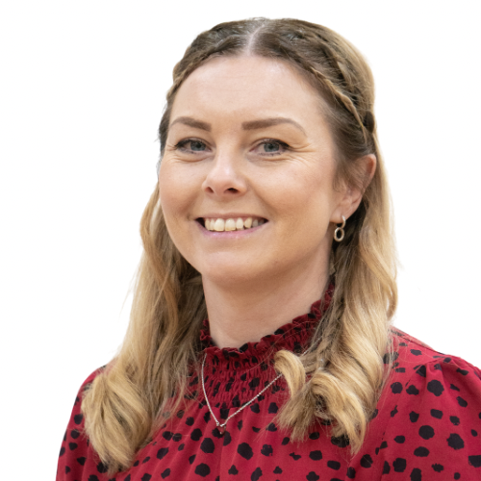
I will have new teaching assistants
Here are my Year 6 teaching assistants:
Mrs Nightingale
Mrs O’Connor
Mrs Sargent
Mrs Clarke

Slide 7
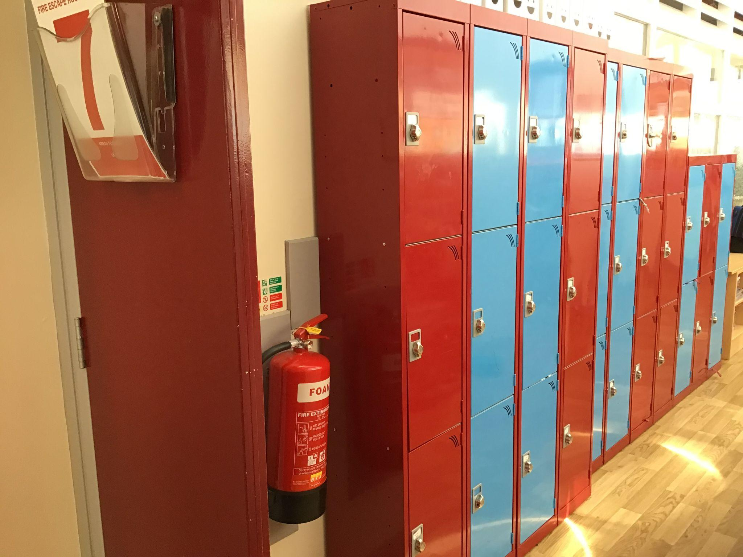
I will have a new locker.
This is where my locker will be:

Slide 8
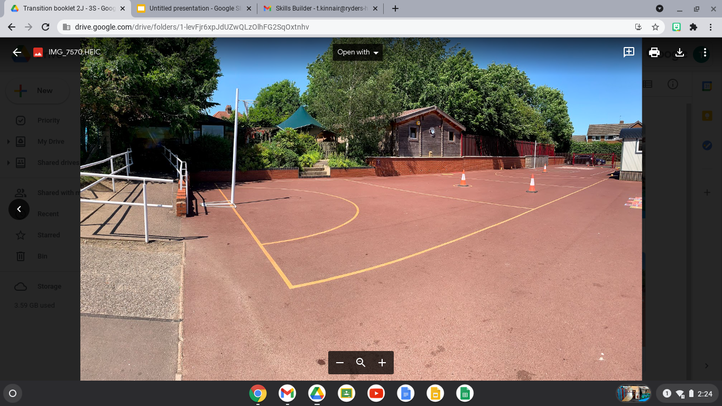
My playtime is at - 10:45am
My lunchtime is at - 12:00pm
I will have playtimes and lunchtimes in the KS2 playground:

Slide 9
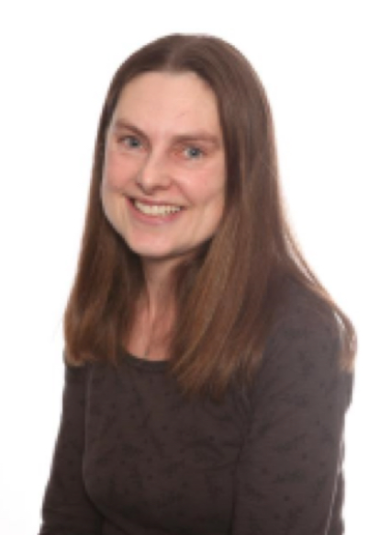
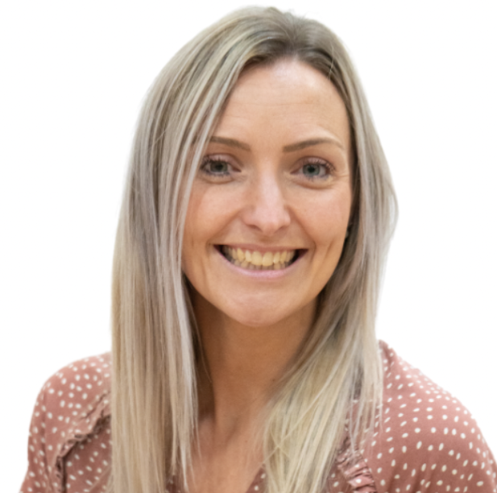
Other staff that will teach me through the week on Thursday’s are;
Spanish Mrs Hemms
Senora Holmes

Slide 10
I will leave school at the end of the day through this exit/gate:
I finish school at - 3:30pm

Slide 11


I will have lots of fun and learn new things in 6S!

