Slide 1





Year 6
Induction Evening
Notes:
Welcome,
We will be sharing a lot of information ahead on next year.

Slide 2
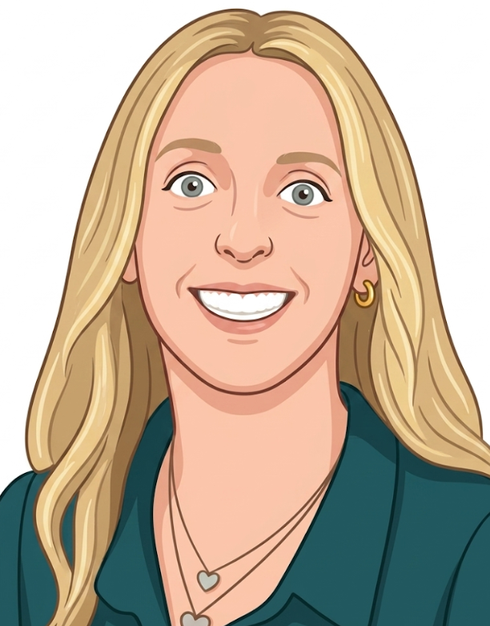
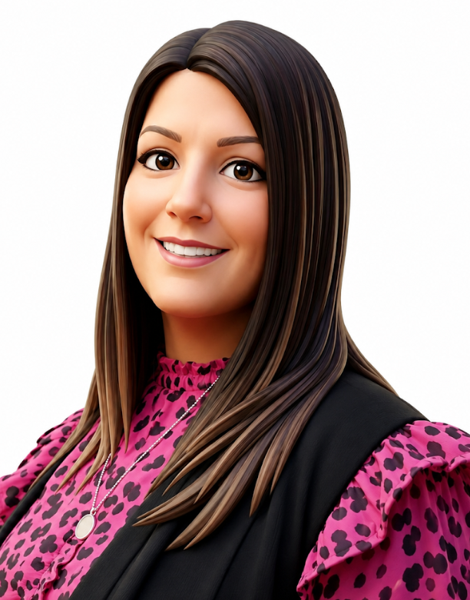
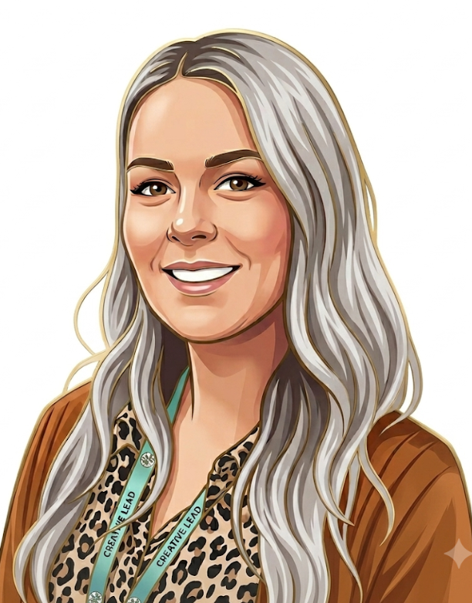
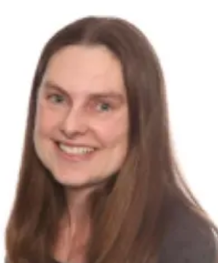
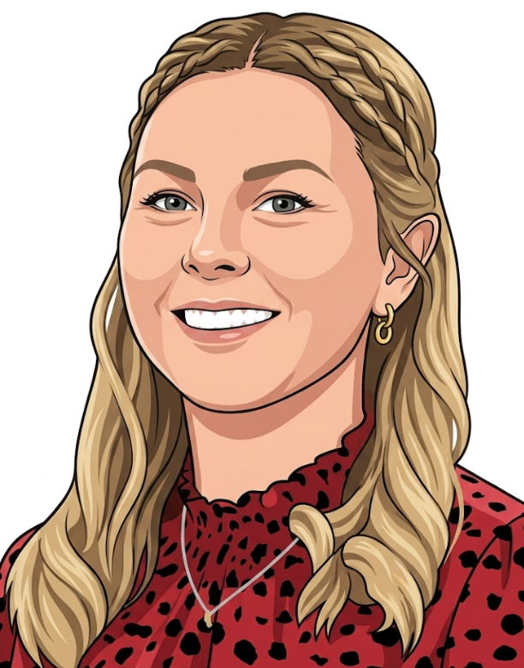
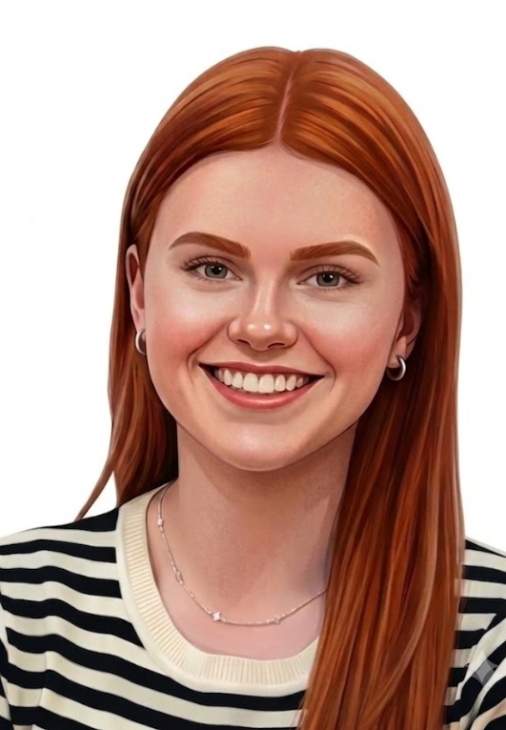
Meet the Year 6 Team
6S
6W
Miss Smith
Mrs O’Connor
Miss Hems
Mrs Nightingale
Miss White
Mrs Clarke

Slide 3

Learning at Ryders Hayes
Learning begins with the first steps onto the playground in a morning and is a seamless, stimulating, deep and challenging experience for everyone, driven through continuous provision; thirst for knowledge, and children’s curiosity throughout the day, continuing long after.

Slide 4
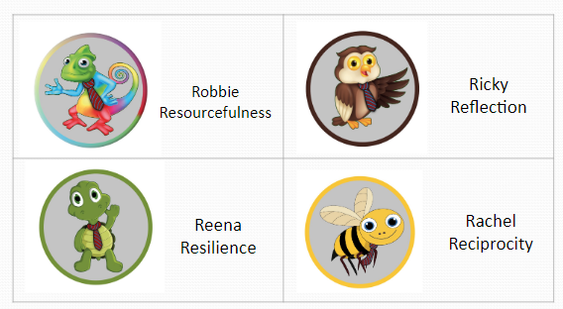
Learning Characters
A Good Learner at Ryders Hayes will be able to use:
Characteristics of learning:
Reciprocity: Listening; empathy; collaboration; inter/intra-dependence; thinking and communicating; imitation | Resilience: Perseverance; taking risks; managing distractions; finding humour; responding with wonderment and awe; absorption; noticing
Resourcefulness: Creating; imagining; innovating; making links; reasoning; questioning; applying past; capitalising; knowledge; gather data through all senses | Reflectiveness: Planning; meta-learning; distilling; revising; thinking about thinking; applying past knowledge to new situations; striving for accuracy – check, measure and exactness

Slide 5
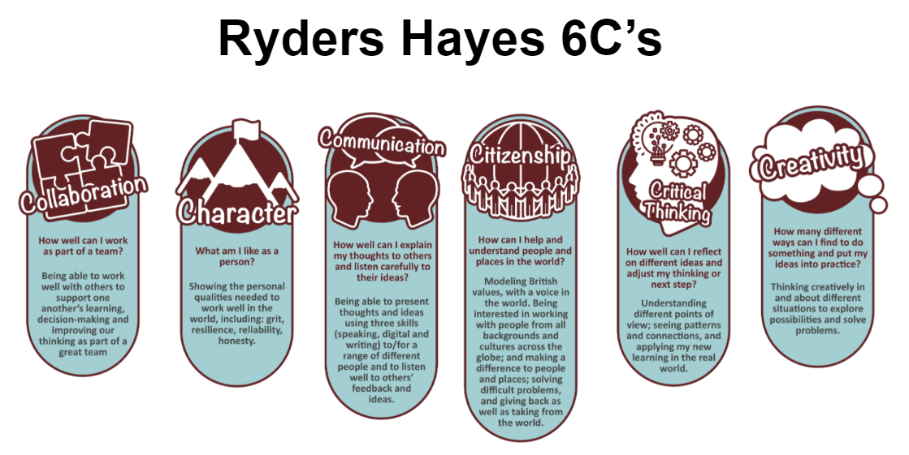
Notes:
Vision: To nurture and facilitate the growth of our pupils and their learning; equipping them with the skills and attributes to embrace the challenges of a rapidly changing world. To enjoy success for today and be prepared for tomorrow, by instilling the values of:
Character: qualities of the individual essential for being personally effective in a complex world including: grit, tenacity, perseverance, resilience, independence, reliability and honesty.
Citizenship: upholding British Values, thinking like global citizens, considering global issues based on deep understanding of diverse values with genuine interest in engaging with others to solve complex problems that impact human and environmental sustainability
Collaboration: the capacity to work interdependently and synergistically in teams with strong interpersonal and team-related skills including effective management of team dynamics, making substantive decisions together, and learning from and contributing to the learning of others.
Communication: entailing mastery of three fluencies: digital, writing and speaking tailored for a range of audiences, through early, high-quality back and forth interaction.
Creativity: having an ‘entrepreneurial eye’ for economic and social opportunities, asking the right questions to generate novel ideas and explore possibilities, demonstrating leadership to pursue those ideas into practice.
Critical Thinking: critically evaluating information and arguments, reflecting upon them, seeing patterns and connections, constructing meaningful knowledge and applying it in the real world.

Slide 6
The School Day
Main Gate Opens 8:30am
Internal Doors Open 8:45am (all classes)
Registration 8:55am
End of Day Nursery 3:45pm
Reception 3:20pm
Y1 - Y6 3:30pm
Clubs
Breakfast Club 7:30am - 8:45am
After School Club 3:30pm - 5:45pm
All clubs booked via Arbor
Notes:
Pencil cases and stationary - you don’t need anything! We will be asking pupils to not bring them in. School will provide everything.
Please use personal stationery at home.

Slide 7
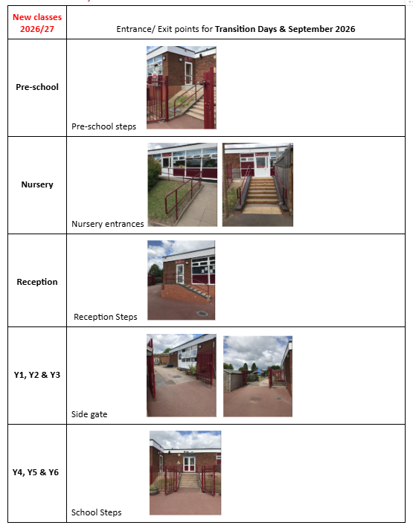
Entrance & Exit

Slide 8
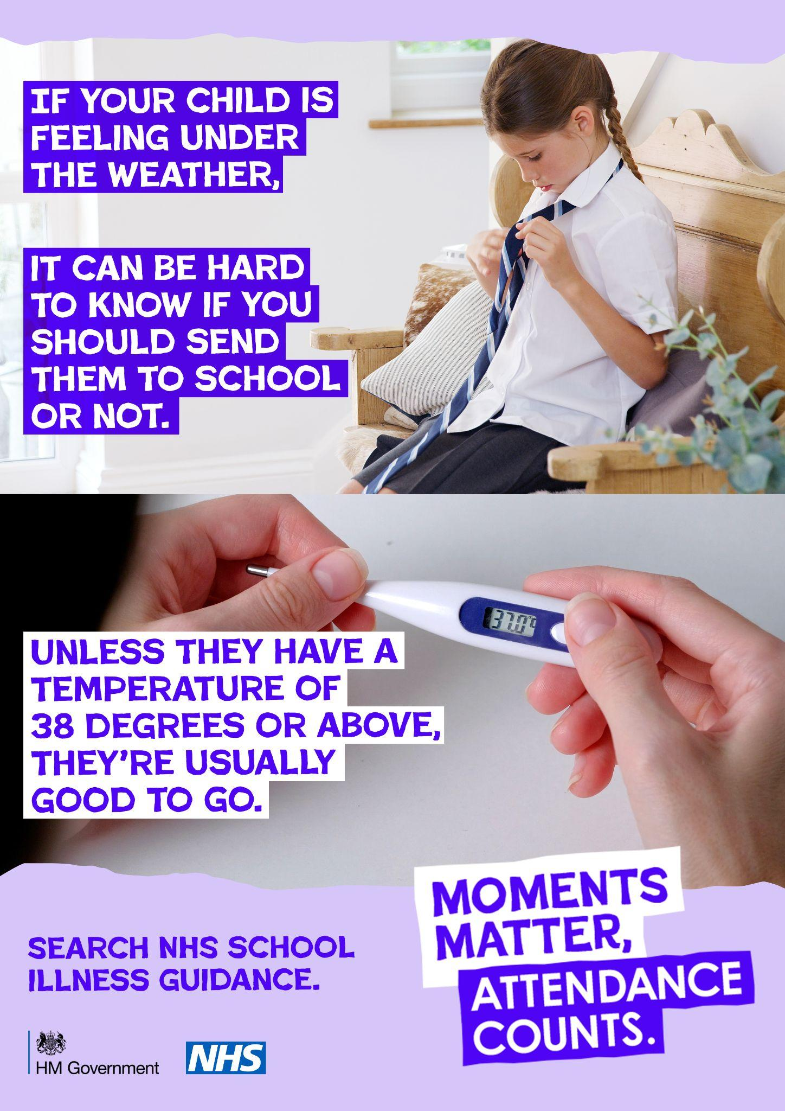

Attendance
VIP Education
Our Attendance Consultant will be working very closely with the School and our families, where there is a concern with attendance and offer support.
As you will be aware the school are working very hard to improve both attendance and punctuality and VIP’s role will be to meet with parents and discuss any concerns regarding attendance levels or lateness.
VIP will carry out home visits on behalf of the school to discuss reasons for absence and offer support to assist with any issues that may be preventing your child from attending on a regular basis or on time.
The government this year launched a national campaign in relation to attendance ‘moments matter, attendance counts’ Schools are required to the Department For Education guidance.
In 2024 guidance there is a change including higher penalty notices, changes to legal and prosecution for attendance.
Notes:
We want all children to be in school day possible. We understand that children may have a cough or cold, but we are able to administer medicinel in school and will certainly keep a close eye on them and contact families accordingly.
Attendance matters - Pupils who did not achieve the expected standard in reading, writing and maths in 2019 had an overall absence rate of 4.7% over the key stage,

Slide 9
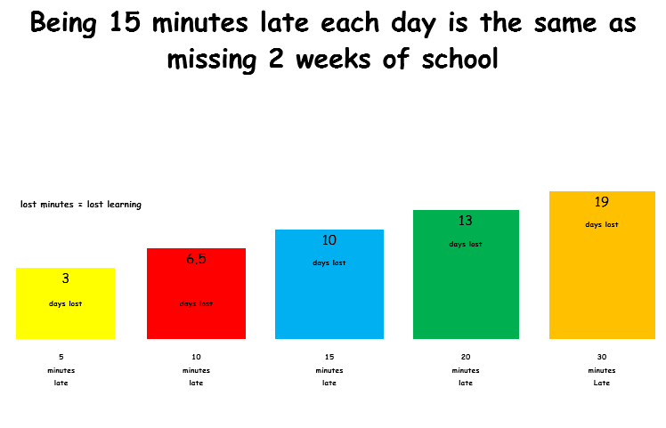
Punctuality
Arriving on time sets your child up for the rest of the day.
Arriving late interrupts not only your child’s learning but those around them.
Children arriving late after the bell (0855) but before 0915 will have a ‘L’ Late code applied to their registration document.
Children after 09:15 without a valid reason will have a code ‘U’ applied which counts as an unauthorised absence even though they are in school so will affect their overall attendance figure over the year.
Parents must accompany their child to the office to sign in their child if late using the signing in machine in reception.
Leave of Absence
A leave of absence form must be completed at least two weeks prior to any leave taking place and can be obtained online or at the office.
As a school we do not authorise any leave of absence and all leave will be coded as ‘G’ which means leave taken but not authorised by the school.
The local authority look at leave of absence along with VIP Education our attendance consultants and can issue penalty notices which can be £80 per child, per adult.
We encourage all leave to be taken during holiday periods where possible as this does affect your child’s learning
Notes:
Did you know being 15 days late each day is the same as missing 2 weeks of school!
Being punctual is a skill for life and preparing our children for the world of work.

Slide 10
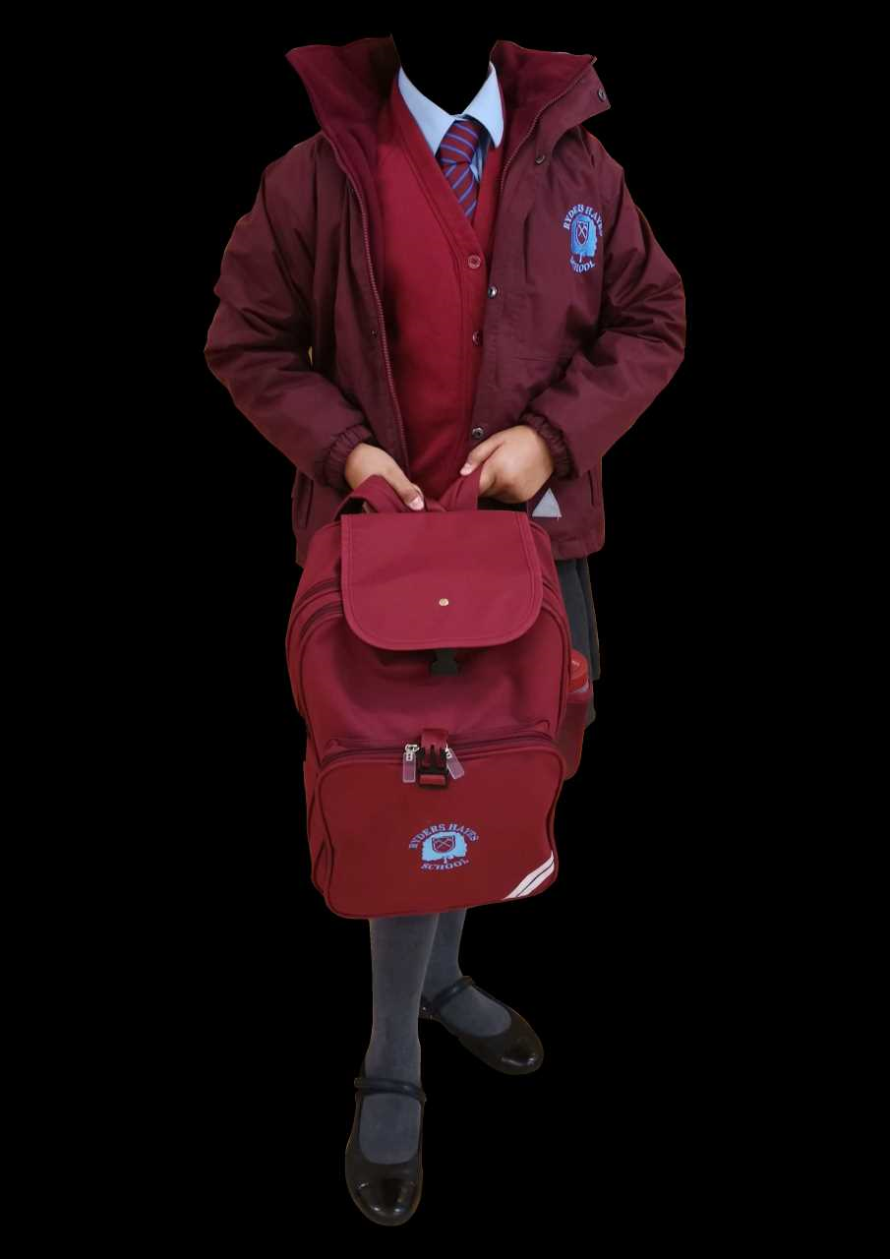
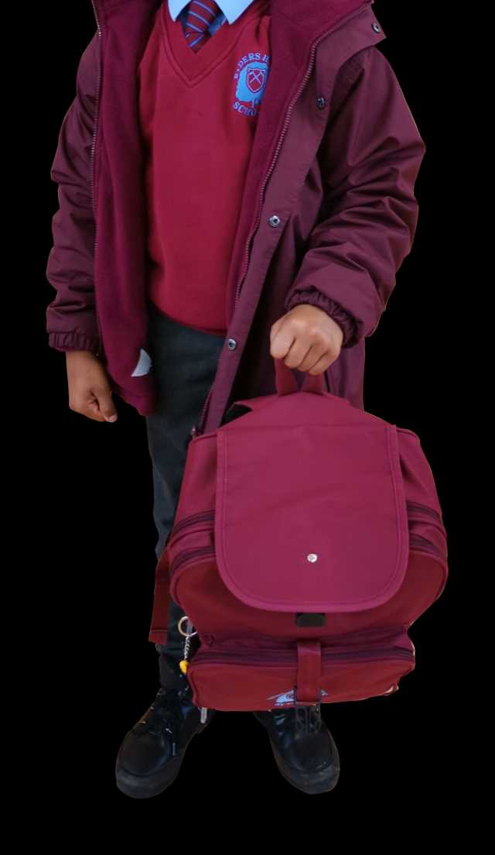
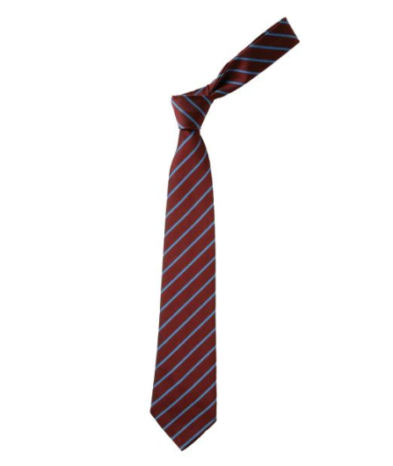
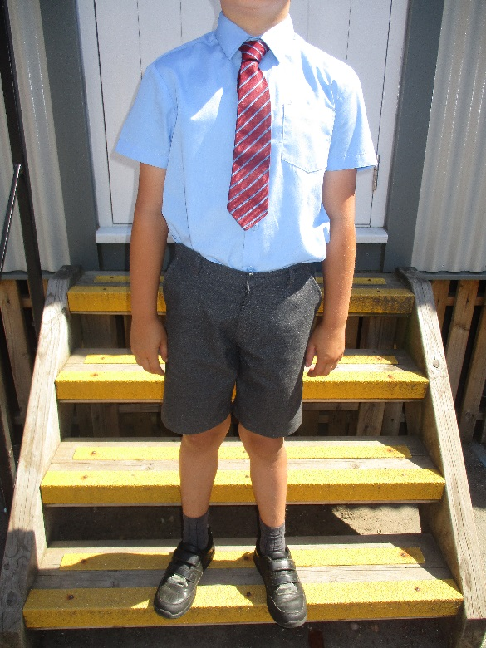
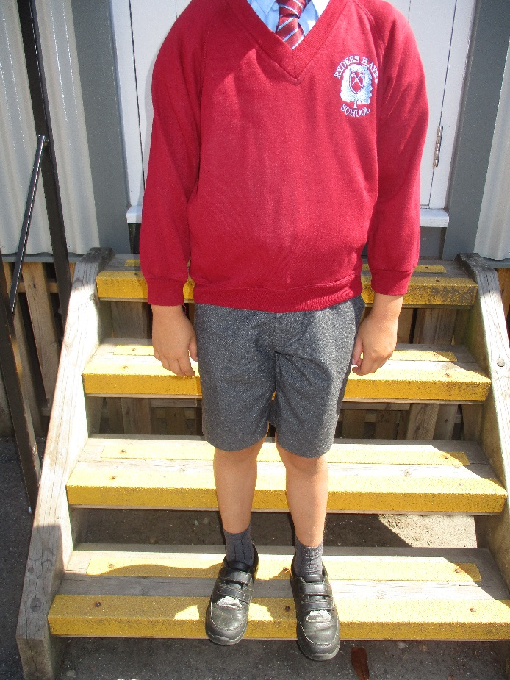
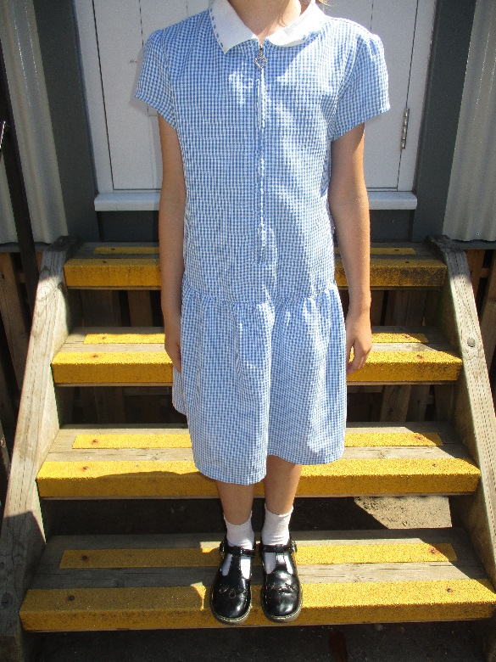
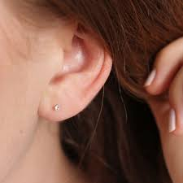
School Uniform
Uniform Policy .docx (ryders-hayes.co.uk)
Inline with Uniform Policy - children need:
-Expectation all children to have a Burgundy coat/school, school bag, tie, jumper/cardigan as appropriate.
-Winter uniform - grey trousers/skirt, grey tights/socks, black shoes no boots.
-Cornflower blue shirt Y1-Y6, (cotton polo shirt only in Nursery and Reception)
-School coloured tie Y1-Y6
-Children will come in their PE kit on PE days through the academic year.
-Hair longer than shoulder length - must be tied up in school colour functional accessories only
-Jewellery - Plain stud earrings and wrist watch only (No Smart or camera watches).
Children to take earrings out on PE days. If children have earrings in they will not be able to participate.
Optional Summer Uniform
Notes:
Inline with Uniform policy - children need ;
Expectation all children to have a Burgundy coat/school, school bag, tie, jumper/cardigan as appropriate.
Winter uniform - grey trousers/skirt, grey tights/socks, black shoes no boots.
Cornflower blue shirt Y1-Y6, (cotton polo shirt only in Nursery and Reception)
School coloured tie Y1-Y6
Hair longer than shoulder length - must be tied up in school colour functional accessories only
Jewelry - Plain stud earrings and wrist watch only - No camera watches. Children to take earrings out on PE days. If children have earnings in they will ntobe able to participate. Not other pieces of jewelry - bracelets, necklaces etc.
Children will come in their PE kit during the Autumn and Spring months - in the summer term children will bring their PE kit to school to change.
Water bottles - no hydroflasks/stanley cups (metal water bottles), plastic water bottles with sports cap. School sell plain school water bottles online
All items to be clearly named - children have the same items and we know these are high cost. Please ensure that everything your child brings into school is named.

Slide 11
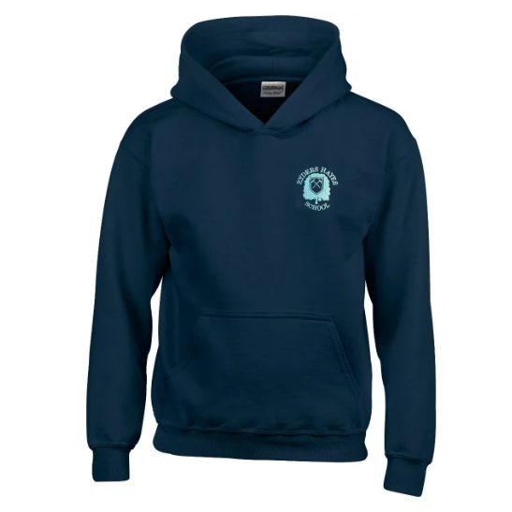

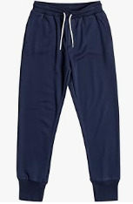
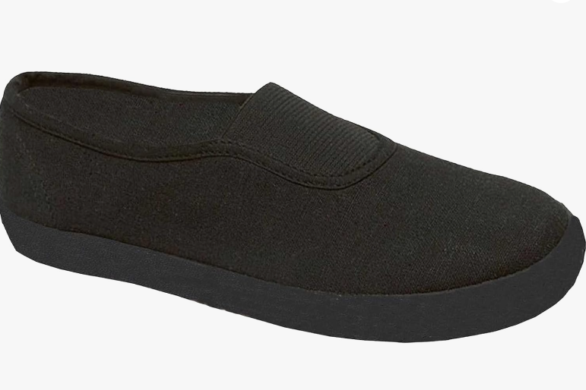
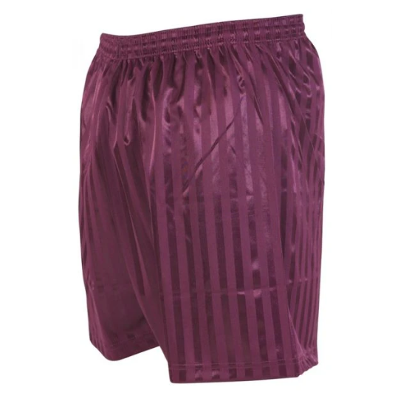
PE Uniform
Plain white t shirt, navy joggers or navy leggings- no logos
Set of pumps for wearing inside in the school hall.
Pumps to remain in school in lockers please through the year.
Black trainers for outside
Burgundy short only please - no hot pants or short cycling shorts
No earrings - must be taken out. Tape/plaster not allowed.
PE DAYS 2026/27:
Monday - Year 2
Tuesday - Year 5
Wednesday Year 6
Thursday - Year 1
Friday Year 4 and Year 3
Children to come dressed in their PE kits on their PE day through the year - Autumn, Spring and Summer term.
Notes:
Plain white t shirt - no logos
Set of pumps for wearing inside in the school hall.
Pumps to remain in school in lockers please through the year.

Slide 12
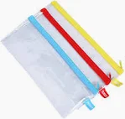




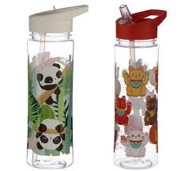
What to bring into school?
School equipment:
Pencil cases and stationery - you do not need anything!
We will be asking pupils to not bring them in. School will provide everything.
Please use keep personal stationery at home.
Squishes and fidgets:
A small number of children through school may use some small fidgets or aids to support their learning in class. These will be agreed in liaison with Mrs.Willis as Inclusion Leader. General squishies; Dumplings, Butter bars and Needoh’s should not be brought into school.
Water bottles :
Please ensure any water bottles in school are plastic and named. Bottles should have a secure cap to prevent leaking if knocked over. No hydroflasks or Stanley style cups in school please.
Notes:
Pencil cases and stationary - you don’t need anything! We will be asking pupils to not bring them in. School will provide everything.
Please use personal stationery at home.

Slide 13
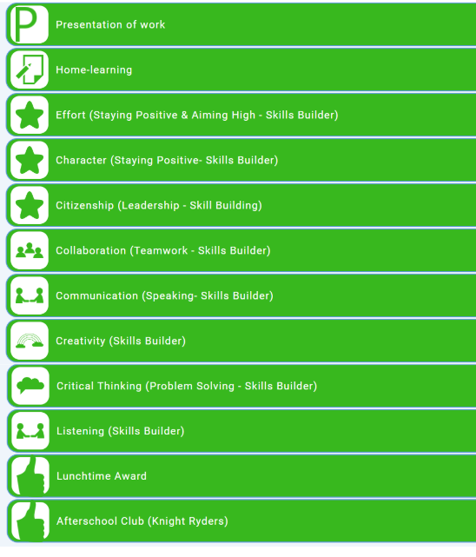

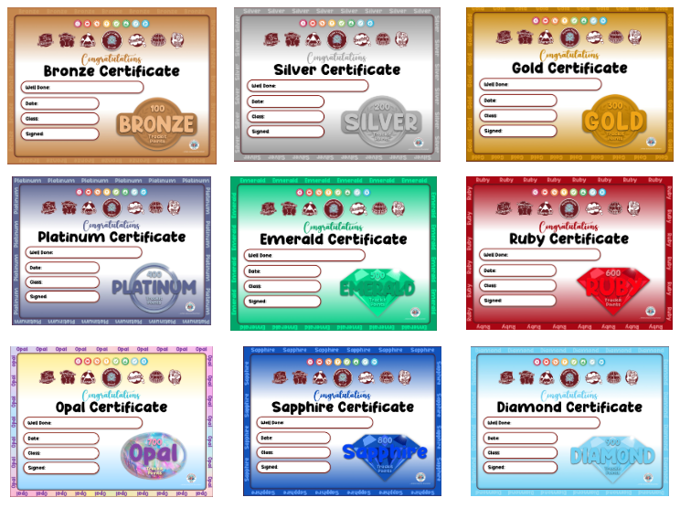
Rewards
We use lots of positive rewards through school. Children can be awarded ‘House Points/Trackits’ for demonstrating positive behaviors such as those listed in green below. These build up to certificates over the school year.
Trackit light certificates overview
100 Bronze
200 Silver
300 Gold
400 Platinum
500 Emerald
600 Ruby
700 Opal
800 Sapphire
900 Diamond

Slide 14
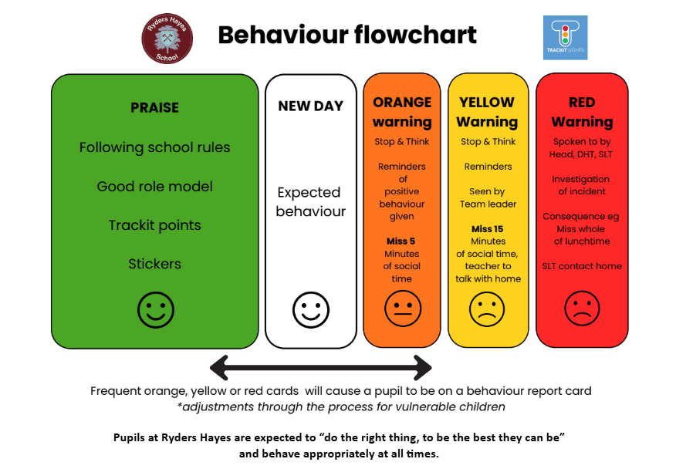
Here is our Behaviour flow chart for supporting positive behaviour in school. Children start each day on white as a new day.
If there are circumstances where behaviour needs to be address we will work through this process.
Notes:
Key Features:
Positive Reinforcement: Our system focuses on promoting positive behaviour by acknowledging and rewarding your child's achievements. Through a colour-coded system, children earn "light points" for demonstrating good behaviour, fostering a sense of accomplishment and motivation.
Encouraging Accountability: By instilling a sense of accountability in your child, Trackit Lights empowers them to take ownership of their behaviour. The system helps children understand the consequences of their actions, promoting self-awareness and personal responsibility.
Holistic Development: Beyond academics, Trackit Lights recognizes and encourages various aspects of your child's development, including social skills, collaboration, and positive attitude, fostering a well-rounded educational experience.
We believe that by incorporating Trackit Lights into our primary school environment creates a more collaborative, positive, and nurturing space for your child to thrive academically and personally. If your child receives a certain amount of Trackit points, they will receive a certificate based on that amount of points, this will be given to them in their year group internal assembly as a reward.
THE CLASS TEACHER

Slide 15
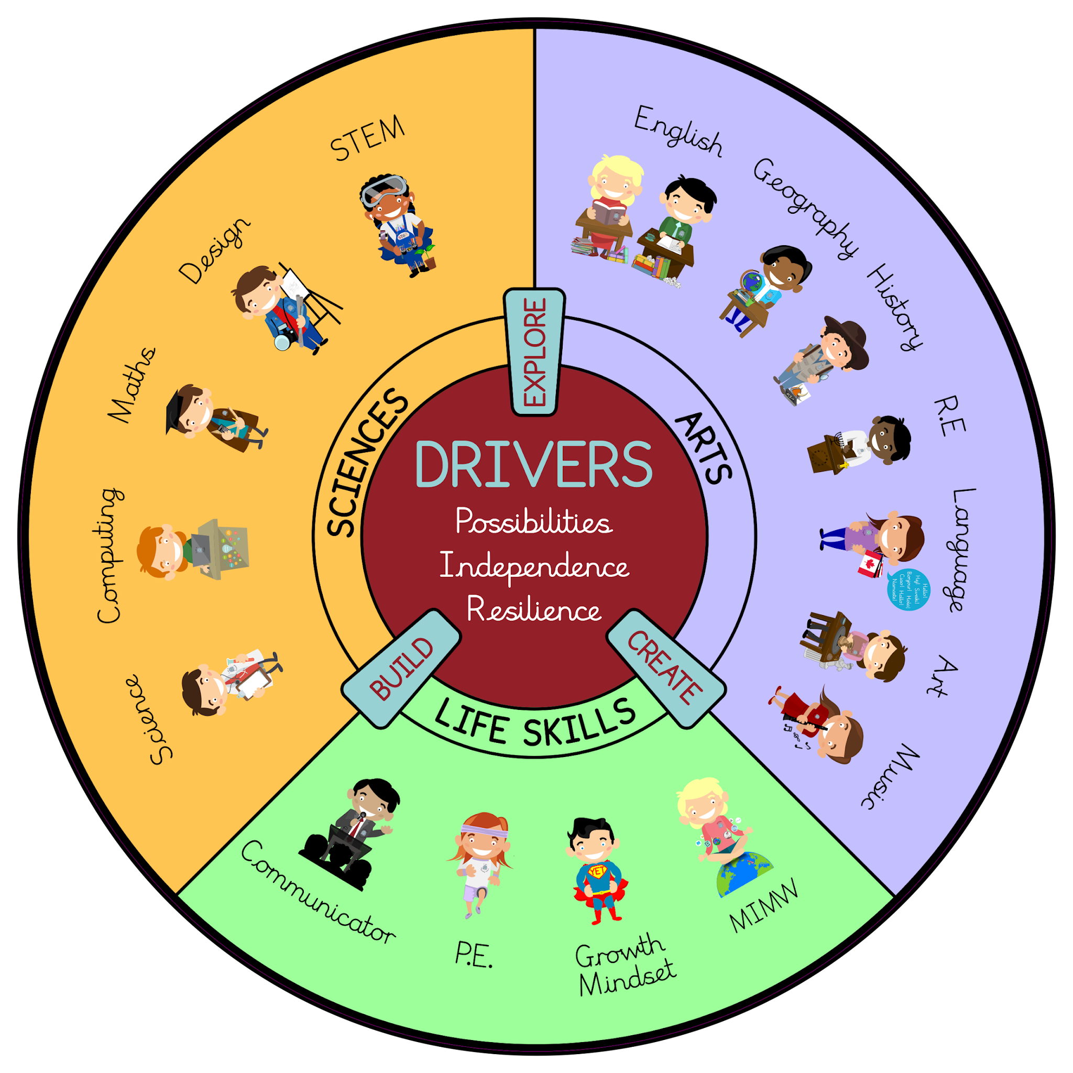
Our Curriculum
We have designed a bespoke curriculum specifically for our children.
In order to store information in long term memory children need to revisit the same key skills, concepts and vocabulary through a range of key experiences.
We have grouped our subjects into three categories - Sciences, Arts and Life skills.
Our curriculum drivers are
explore/build /create possibilities, resilience and independence

Slide 16
Termly overview
Autumn: Evolution, Circulatory System, Football, Gymnastics, Crime and Punishment, The Amazon Basin, Illusions, Soup Making
Spring: Electricity, Light, Dance, Hockey, Music from Around the World, RE - Temptation
Summer: Shadows, Living Things, Rounders, Athletics, Medical Breakthroughs, SAM Labs, Performing

Slide 17
Home School Promise
The Family promises to:
Ensure children come to school ready to learn; providing uniform, PE KIT.
Ensure children attend regularly and on time and inform school of absence on the first day.
Fully support the School’s Policies, and any sanctions required as part of the Behaviour Policy.
Read the Safeguarding Policy on the school website.
Support the child with readings, spellings and tables, as well as ensuring that set home-learning is completed and returned on time.
Read and respond to school communications, and attend meetings to discuss pupil progress.
Support their child’s learning and progress through attendance at every Parents’ Evening and specific year group workshops.
Treat staff with respect and refrain from any abusive, threatening or violent behaviour.
Refrain from making any reference to school or school staff on social media sites.
Signed ………………………………………………………………… (Parent/Carer)
Notes:
Signed by parents during 1st week back in Sept (in planners)

Slide 18
Acceptable User Policy (AUP)
I agree that I will:
Always keep my password a secret.
Respect the school network security.
Make sure all messages I send are respectful.
Show a responsible adult if I receive an unpleasant email or find Internet content nasty or uncomfortable.
Not bring my mobile phone to school unless I am in Year 5 or Year 6 and walk home. If I do bring a mobile phone, it has to be taken to the office, switched off and collected at the end of the day. My Parent/Guardian will have to give written permission for me to bring my phone into school.
Always keep my personal details private (my name, school name and address, home address any contact numbers, family information etc).
Only use an email account that is provided by the school.
Not upload pictures or digital images of myself or others without my teacher’s permission
Only create and share content that is legal.
Never meet an online friend without taking a responsible adult that I know with me.
I will only access my own work
My use of ICT (Internet, computer files) can be checked and that my parent/ carer contacted if a member of school staff is concerned about my E-Safety.
Only use ICT in school for school purposes.
I know:
Where to find and how to use the CEOP report abuse button.
That anything I share online may be monitored.
I know that once I share anything online it is out of my control and can be used or changed by others.
Pupils understand these rules are there to help keep me safe, and my friends and family safe. I agree to the above rules.
Parents/Carers: accept that ultimately the school cannot be held responsible for the nature and content of materials accessed through the Internet and other mobile technologies, but the school will take every reasonable precaution to keep pupils safe and prevent pupils from accessing inappropriate materials.
Notes:
Signed by parents and children during 1st week back (in planners)

Slide 19

E-Safety
The children will all be taught about E-Safety throughout the year. This is part of our computing curriculum as well as Me in My World studies.
At school we always take part in Safer Internet Day, held during February each year.
Parental Concerns:
If you have any concerns about E-Safety and your child, particularly cyberbullying or accessing content they shouldn’t; then please contact school and we can help you.

Slide 20


Home Learning
Google Classroom: weekly home learning set and class announcements.
Reading: daily reading and recording in pupil planner.
Maths: practise on TTRS every week.
Spellings: practise and weekly test.
Pupil planner in school everyday. Use for communication or email.
*The login and passwords for these are located inside your child’s Pupil Planner.

Slide 21
Summer Project
Hello Year 6!
Put on your ruffs and step back into the 1500s, because for your next home learning challenge, we are traveling to the treacherous world of Tudor England.
Imagine a time of absolute monarchs like Henry VIII and Elizabeth I. In Tudor times, there was no modern police force. Instead, keeping order relied on fear, public humiliation, and some seriously harsh justice. If you picked a flower from the King’s garden, swore in public, or didn't go to church on a Sunday, you were in big trouble!
Your mission is to become a Tudor investigator and explore how the Tudors dealt with lawbreakers.
You could look at:
The Pillory and the Stocks: Used to publicly humiliate local troublemakers, bakers who cheated their customers, or gossips. (And yes, the townspeople would throw rotten food at you!)
The Brank (The Scold’s Bridle): A heavy iron mask used on people accused of gossiping or arguing.
Treason and the Tower of London: The ultimate crime against the King or Queen, which carried the most famous—and gruesome—punishments of all.

Slide 22
Summer Project
We want to turn our classroom walls into a Tudor museum! We need you to create an incredible, eye-catching piece of work that can be displayed for everyone to see.
You can let your creativity run wild. Here are some ideas:
A 3D Model: Build a mini set of Tudor wooden stocks out of cardboard, or craft a model of the executioner's block.
A Tudor 'Wanted' Poster: Design an authentic-looking poster for a notorious Tudor criminal—like Guy Fawkes or a famous highwayman—detailing their crime and the gruesome punishment they face. (Tip: Use a wet tea bag to make your paper look like old Tudor parchment!)
A 'Horrible Histories' Style Comic Strip: Illustrate the journey of a Tudor thief caught stealing a loaf of bread, from the crime to the court, to the public punishment.
An Informational Artifact: Write a newspaper report from the year 1536, or create an illustrated 'Tudor Survival Guide' booklet.
🏆 The Golden Rules
Be Historically Accurate: Make sure your facts, names, and punishments belong strictly to the Tudor era. Be Bold: Use bright colors, clear writing, and strong drawings so your work stands out on our display board. Be Safe: If you're building models, make sure an adult helps you with any cutting or gluing!

Slide 23




English
There are the English texts your child will be focusing on across the year.
The Half term overview will share which ones will be covered each half term. If children have copies of these at home, or on loan from the library we welcome then to bring these into school to read along in class to support their learning and continue to develop a love of reading.

Slide 24
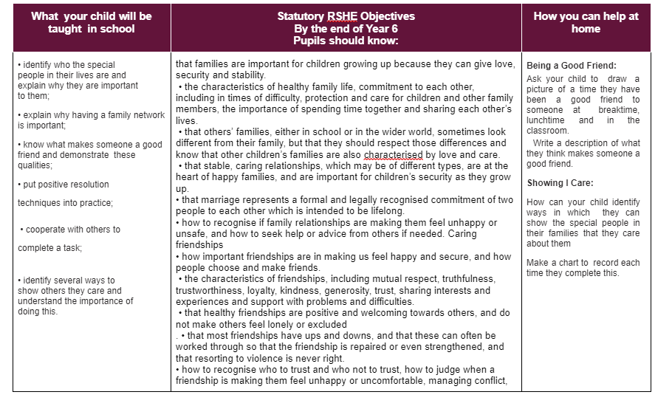
MIMW - Me In My World
Notes:
This is the autumn 1 example. Just to say that they will be sent the half-terms that compulsory RSE units are being taught x, Add an example from your year group

Slide 25
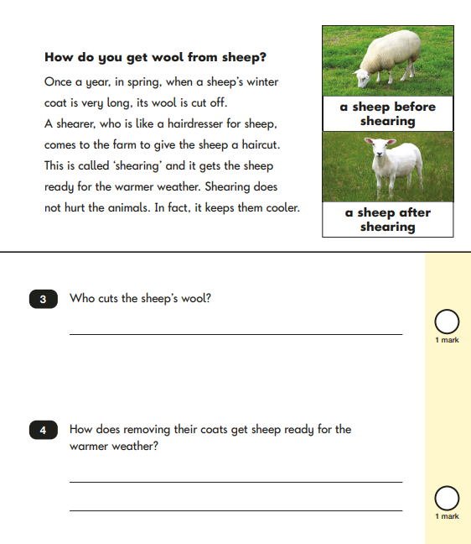
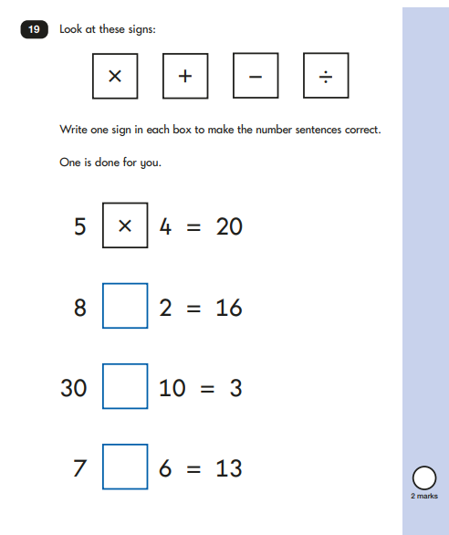
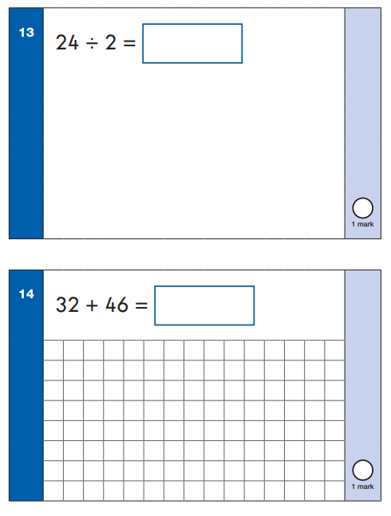
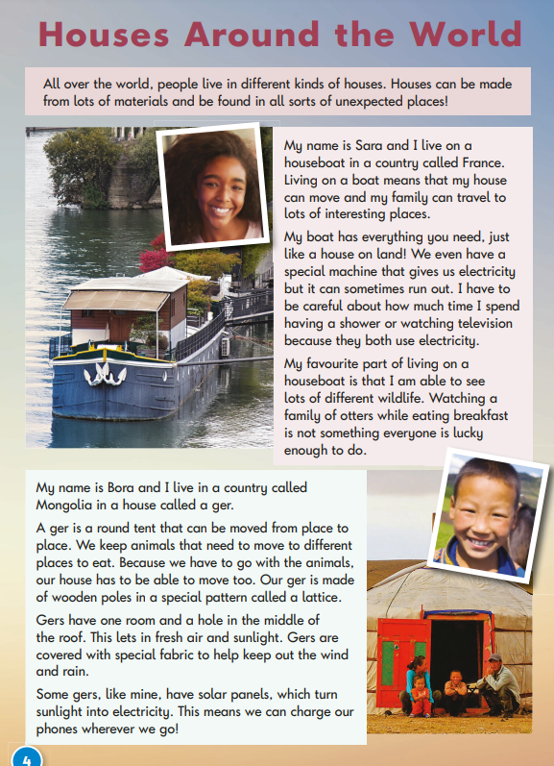
Assessments
We use Teacher Assessments to track how children are learning and developing their understanding in class. Alongside Teacher Assessments, we will assess children termly through the academic year. These assessments are age appropriate and help school identify where additional support and consolation is required. Your child’s class Teacher will talk about these assessments at parents evenings with you and help you understand how you can support your child at home.
Notes:
Assessment will be ongoing through the year
There will be formal assessments three times per year - these are completed in a supportive manner with adjustments and adaptations as appropriate to track children's development in subjects.
This will be shared with you termly through termly learning passports
These support us to identify gaps and support needed

Slide 26
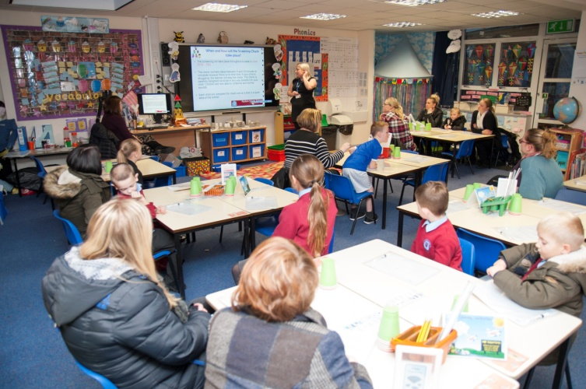
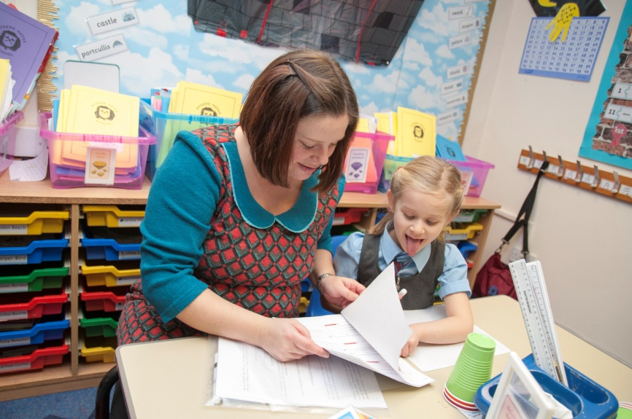
Family Learning
As part of Family Learning at Ryders Hayes during the next school year you will be invited in to work alongside your child in the classroom.
We look forward to this partnership with parents.

Slide 27
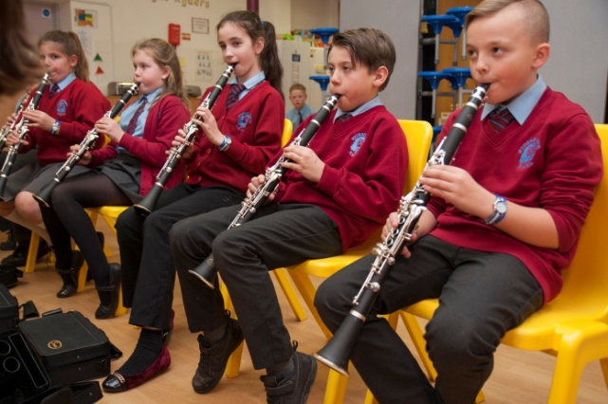
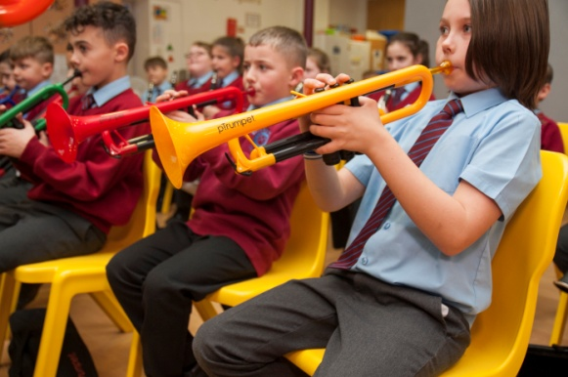
Music
All children from Reception to Year 6 have a weekly lesson where they learn about music through listening, composing and performing whilst developing skills in singing and playing instruments.
There is a whole school Singing Assembly each week and school choir that is open to KS2.
Peri group lessons available at an additional charge - children can be signed up to these in the hall from Y3 upwards.

Slide 28


Señora Holmes
Year 6
“This year, your child will bring together all of their Spanish learning to create stories, describe themsleves and where they live and plan and run their own Spanish day!”

Slide 29
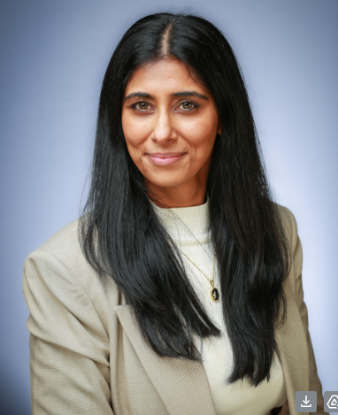
Trips
Laches Wood Residential - 16th-18th June 2027
London - Parliament - 2nd December 2026
Contact - finance@ryders-hayes.co.uk - Mrs Khan (Director of Finance and Operations)

Slide 30

Pupil Premium
A child is entitled to this if they are eligible to free school dinners, children of a parent in the forces and ‘children who are looked after’ (CLA).
If you think you may be entitled to this, please ask the office for advice on applying.
Your child will get
One free trip a year (or contribution to a residential)
One after school club or musical tuition free
Other extra support according to their needs within school

Slide 31
SATs
When : Monday 10th May - Thursday 13th May 2027
What : Reading test , Maths Arithmetic test, 2 Reasoning Maths papers and a Spelling, Punctuation and Grammar paper
How : However best meets the children’s needs – small groups if necessary

Slide 32
Parent Meetings
Parents’ Evenings will be face to face with some online appointments available this coming year.
October 2026, February 2027 dates and summer transition meetings.
We will be inviting parents in to school to work with children during a learning showcase afternoon.

Slide 33
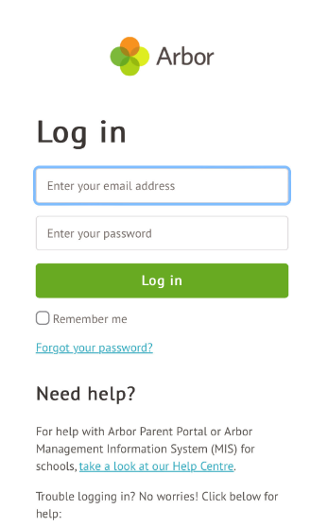

Arbor Parent App
We are paperless at Ryders Hayes School. All of our communication from school is through the online Arbor App and email. Please ensure you have an account set up for Arbor to access:
Information and contact details for your child
Breakfast club and AfterSchool Club bookings (Early and Knight Ryders)
Manage Trip permissions and payments
View pupil reports
Book parents evenings meetings
Notes:
From September this will replace ParentMail. Details will be sent out of how to register and use this APP.
This will be the new app and system for communication, completing forms, payment for trips, booking breakfast/after school club.
With payment for breakfast/after school club being through Arbor all sessions will need to be pre booked with payment made.

Slide 34

Lunchtime
Our school Hall and Art Centre convert into Ryders Diner at Lunchtime.
Year group eat in the hall in varying sitting to enjoy their lunch either brought from home or purchased from school. Children have time to eat their lunch and then also time to play and socialise at lunchtime.
Lunches from home :
For lunchtime some families and children may choose to bring food from home at enjoy a lunchtime. We encourage a varied and balanced diet for your children and ask for any items sent into school to not contain nuts. Inline in this due to possible allergens we do not permit any chocolate spread in school and items containing food items hazelnut spread.
We ask children not to share their food and bring their rubbish and uneaten food home so you can see what has been eaten through the day.
Notes:
Sample menu
We would like to encourage children to take advantage of the funded meal in Reception, Y1 and Y2.
We recognise that children have preferences and like certain meals - please take time to look at the menu and take samples today in the hall. We know that children can be more adventurous sampling meals and foods sometimes alongside their friends, even if children have a cooked meal booked and bring a lunch box as well.
It is nice for children to uptake this offer of a hot meal and use this funding.
We have worked hard over the past year to launch our ‘Ryders Diner’ and children to have the restaurant experience of being seated with their peers and the skills of using their cutlery.

Slide 35

Innovate Catering part of Impact Food Group (IFG) are delighted to be able to provide the meal service to Ryders Hayes Primary School. We have a fresh, personalised and personable approach with delicious and nutritious meals in schools. The food children eat at school plays an important role in their wellbeing, and eating a well-balanced diet will not only maintain and improve their health, but will also set them on the right track for later life. We understand this and that’s why we are passionate about serving fresh, high quality and locally sourced food.
Special Diets and Food Allergens
Please do not think that your child cannot enjoy our great food if they require a special diet. We can provide meal choices for those pupils who have an intolerance, allergy, or require an alternative choice due to religious beliefs.
​
Free School Meals
All children who are in Reception, Year 1 and Year 2 are entitled to receive FREE SCHOOL MEALS! This is a fantastic way to support families. Not only will you be saving money, but you will also be giving your child a nutritionally balanced meal to fuel their bodies for the rest of their learning day.
​
We are passionate about food and using fresh and sustainable ingredients. We create healthy, fantastic-tasting, homemade meals that children are keen to eat. The menus are selected to comply with the Government’s legislation for healthy eating and provide the right balance of nutrition to give children what they need. Every day we offer a fresh salad bar, a carbohydrate option and a choice of fresh seasonal vegetables to ensure children are getting the right balance of food.
We are passionate about food and using fresh and sustainable ingredients. We create healthy, fantastic-tasting, homemade meals that children are keen to eat. The menus are selected to comply with the Government’s legislation for healthy eating and provide the right balance of nutrition to give children what they need. Every day we offer a fresh salad bar, a carbohydrate option and a choice of fresh seasonal vegetables to ensure children are getting the right balance of food.
​
You will also find a host of information on our website – https://innovate2020.cashlessschool.co.uk/ with queries to primary@impactfood.co.uk
For any enquiries regarding school lunches, please contact the School Office.
Hot Lunches
Notes:
Sample menu
We would like to encourage children to take advantage of the funded meal in Reception, Y1 and Y2.
We recognise that children have preferences and like certain meals - please take time to look at the menu and take samples today in the hall. We know that children can be more adventurous sampling meals and foods sometimes alongside their friends, even if children have a cooked meal booked and bring a lunch box as well.
It is nice for children to uptake this offer of a hot meal and use this funding.
We have worked hard over the past year to launch our ‘Ryders Diner’ and children to have the restaurant experience of being seated with their peers and the skills of using their cutlery.

Slide 36

Friends of Ryders Hayes
We are currently a small group of parents who get together to raise funds and have fun activities for our all children at Ryders Hayes school. We would love for more parents/carers/grandparents/friends and family to get involved and help out.
What we do
We organise the Halloween disco, Christmas Market, Summer fayre and support the school in events such as parent evening, Christmas plays, end of year plays and more by supplying refreshments and a raffle . We hold meetings to discuss future plans and events.
Where do the funds go?
Money raised all goes towards children in school and all member of friends of Ryders Hayes are asked their views.
There is no need for commitment to all events or meetings.
If you can spare some time for even just an hour at one of the events, it is all greatly appreciated.
If you would like to know more about how you can help please get in touch via
Facebook @FriendsOfRydersHayes, email postbox@ryders-hayes.co.uk , passing your details to the office or let one of the members know you would like to be involved
Notes:
Friends of Ryders Hayes are always looking for new recruits, even if this to to support one event (set-up, at the event etc…). Should you be able to offer any time then please contact postbox@ryders-hayes.co.uk or Speak to Mr Rylance.

Slide 37
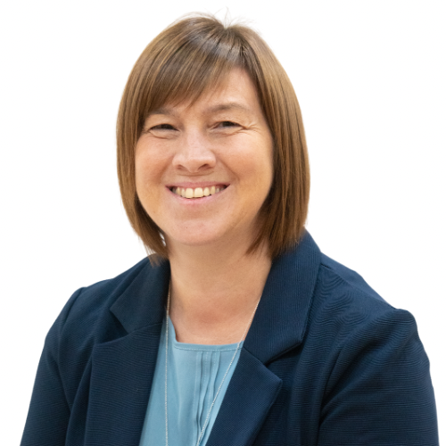
Who to See
b.white@ryders-hayes.co.uk
l.smith@ryders-hayes.co.uk
Year 6 team leader
g.middleton@ryders-hayes.co.uk

Slide 38
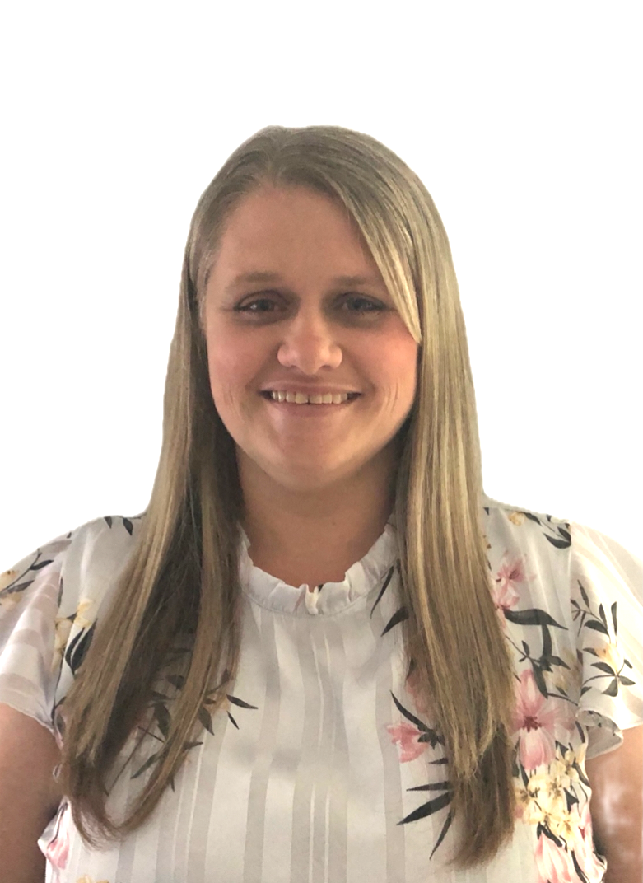
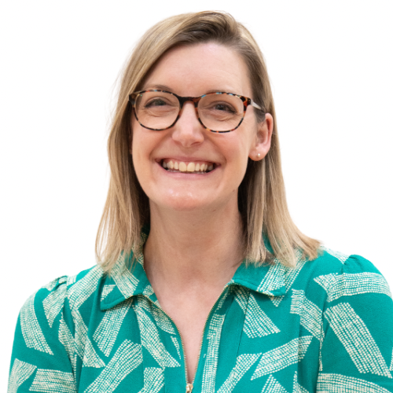
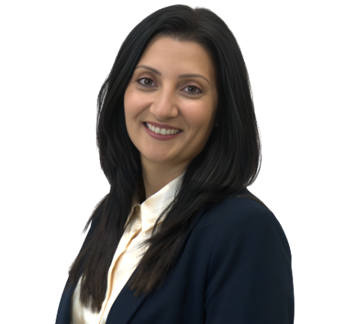
Who To See
Inclusion Lead & SENCO - Mrs Willis
Deputy Head of School - Mrs Middleton
Head of School - Mrs Deeley
Executive Headteacher - Mrs Paul

Slide 39
Thank you for attending-
There is lots more information on the school website-https://www.ryders-hayes.co.uk/school
Any questions?

