Slide 1

My New Class - 1J
2026 - 2027

Slide 2
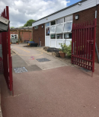
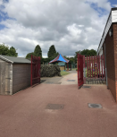
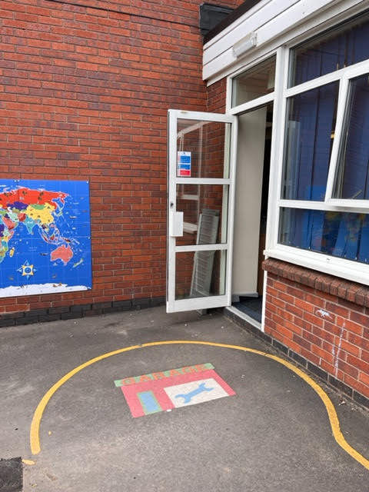
After the summer holidays I will enter school this way each morning:

Slide 3
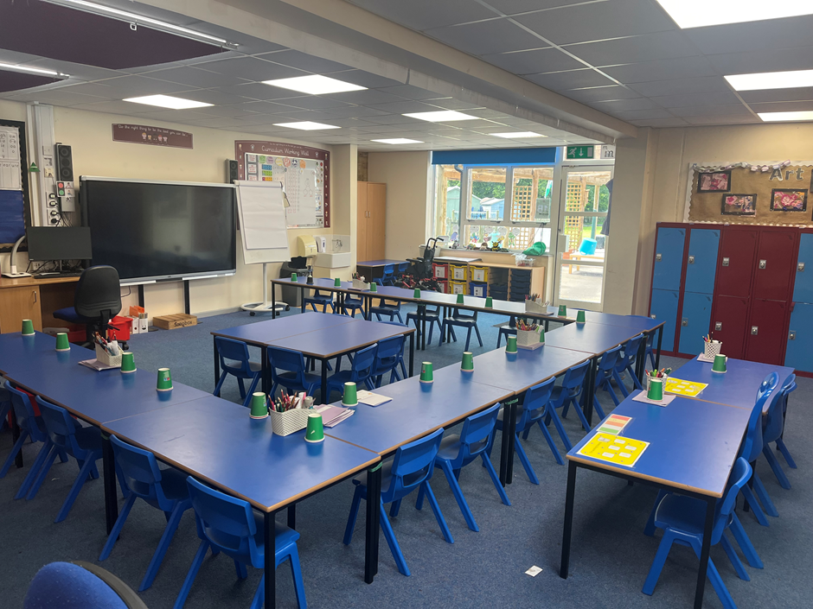
After the summer holidays, I will be in a new classroom.
This will be my new classroom; 1J:

Slide 4
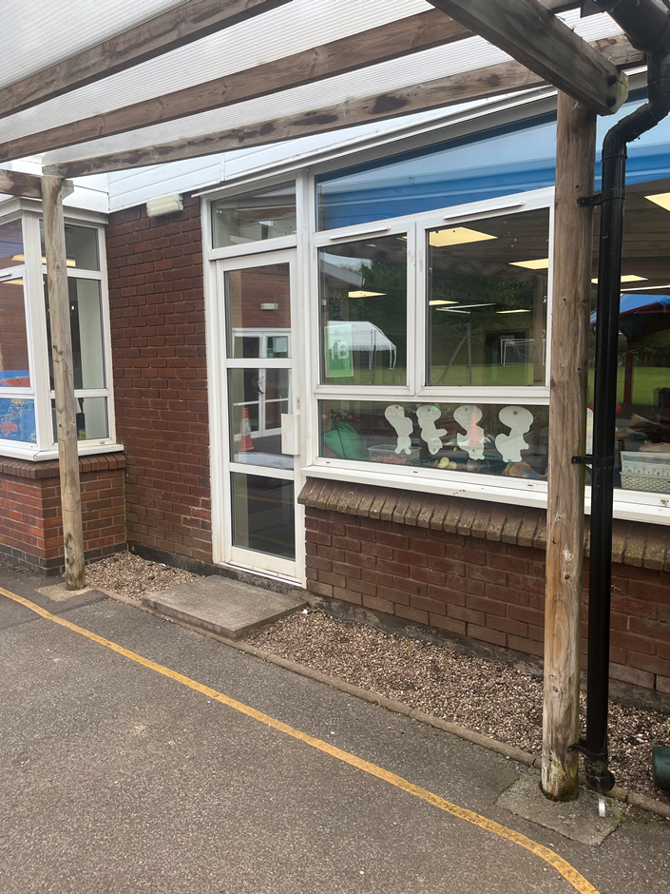
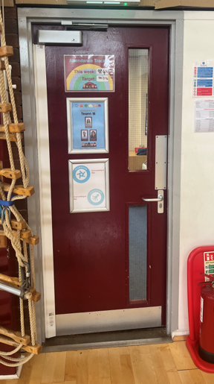
This will be my new classroom door:

Slide 5
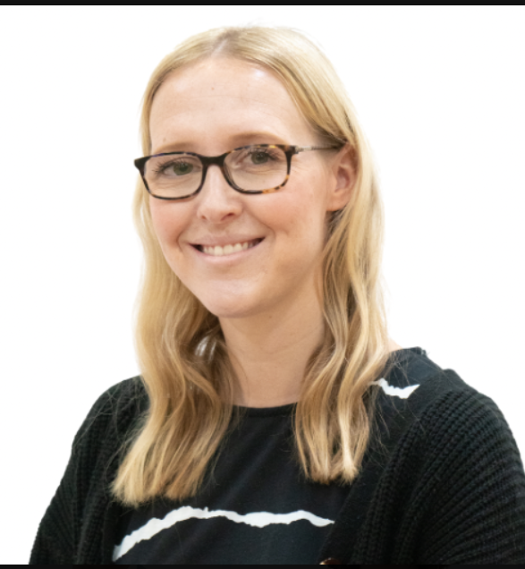
This is my new teacher Mrs Johns.
My new class is called 1J

Slide 6
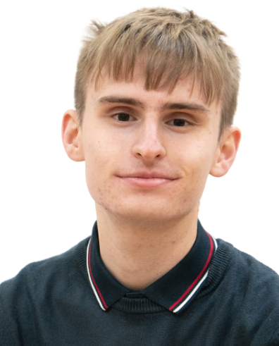
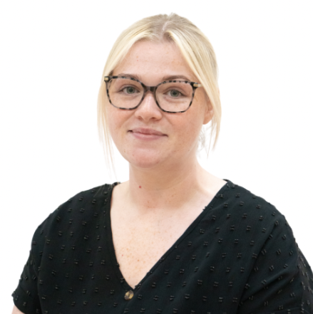
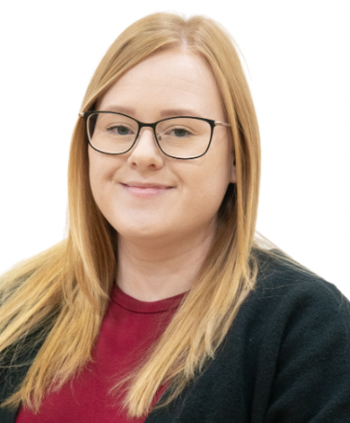
I will have some new teaching assistants.
These are my Year 1 teaching assistants:
Mr Collins
Miss Smith
Mrs Kinnair

Slide 7
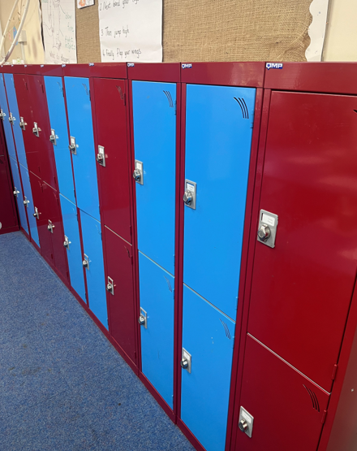
I will have a new locker.
This is where my locker will be:

Slide 8
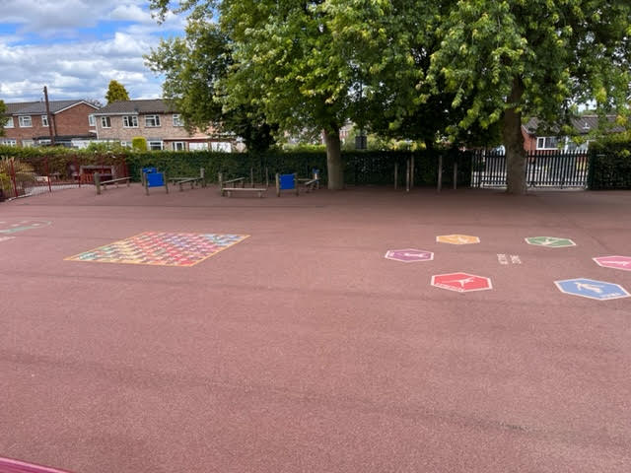
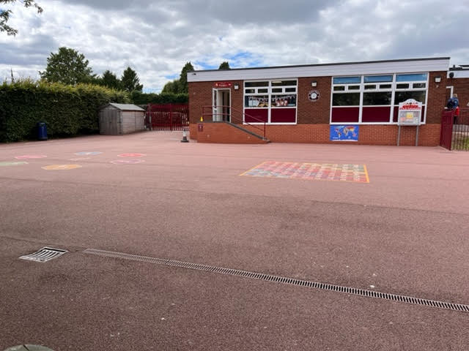
My playtime is at - 10:30
My lunchtime is at - 11:45
I will have playtimes and lunchtimes in the KS1 playground:

Slide 9
I will leave school at the end of the day through this exit/gate.
I finish school at - 3:30pm

Slide 10


I will have lots of fun and learn new things in 1J!

