Slide 1

My New Class
2026-2027

Slide 2
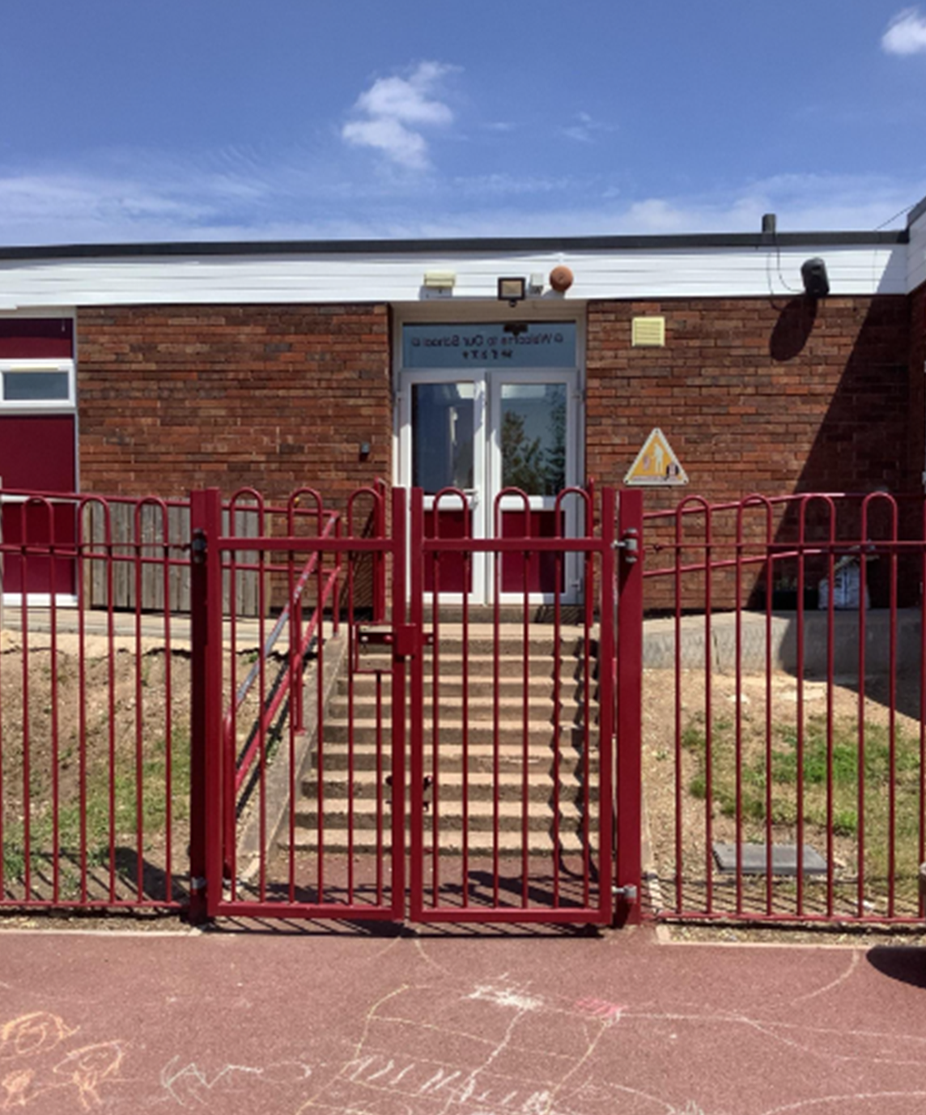
After the summer holidays I will enter school this way each morning:

Slide 3
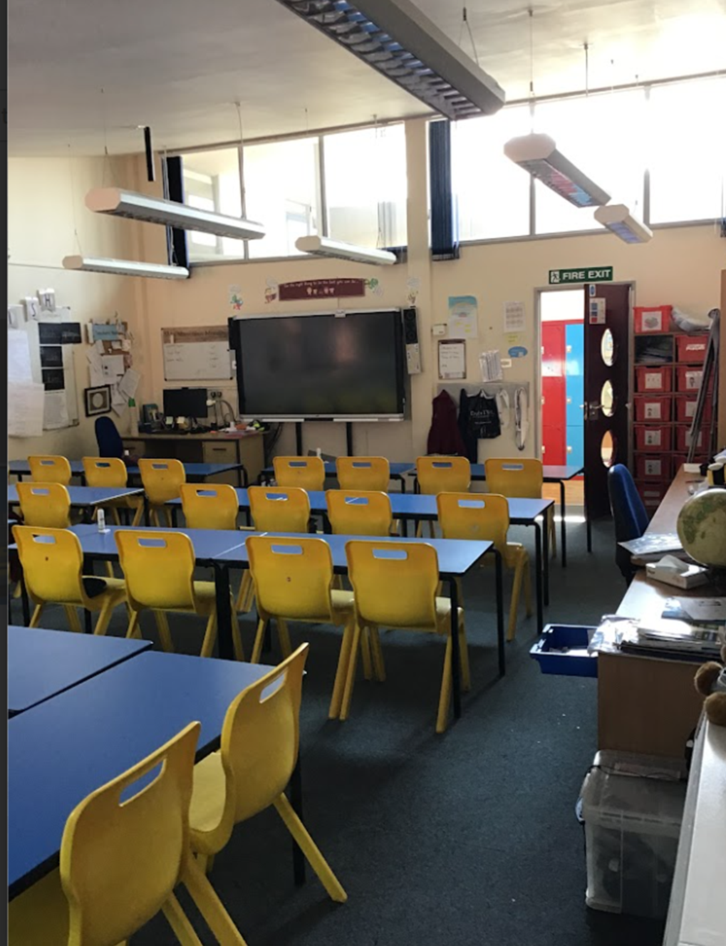
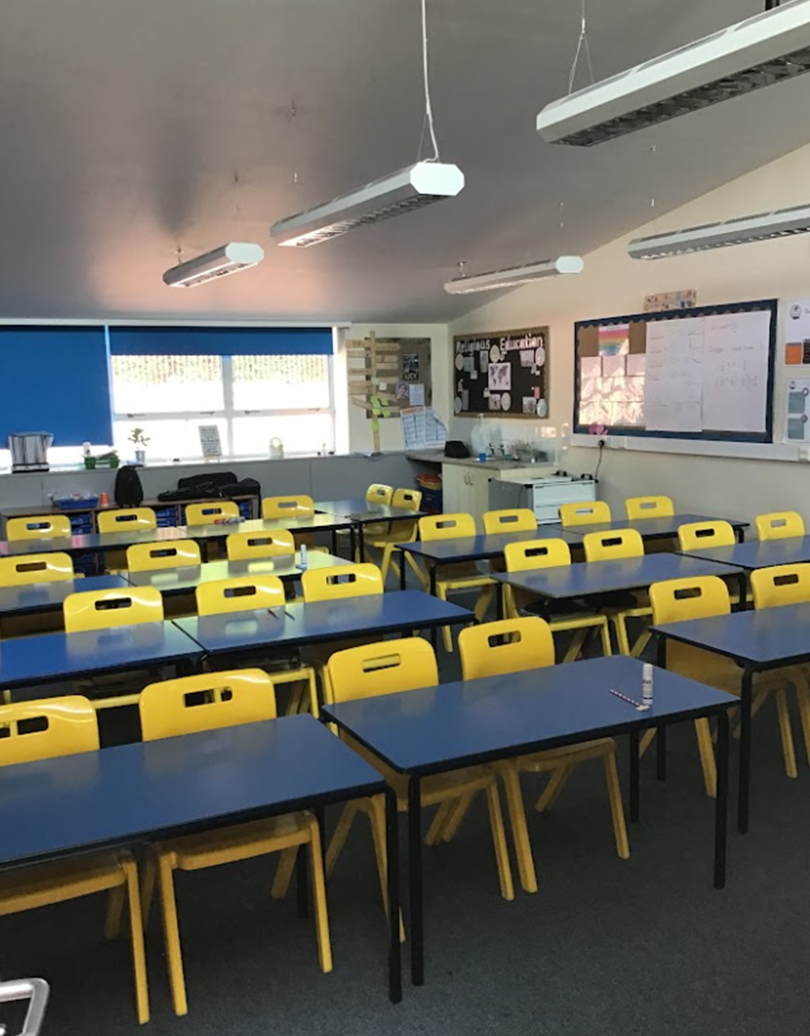
After the summer holidays, I will be in a new classroom.
This will be my new classroom

Slide 4
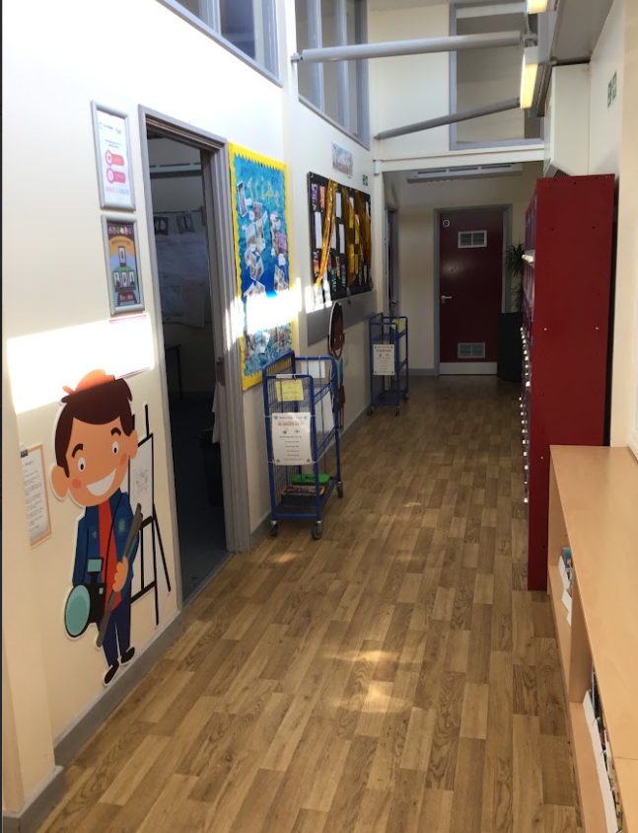
This will be my new classroom door:
New classroom door.
New lunchbox trolly.

Slide 5
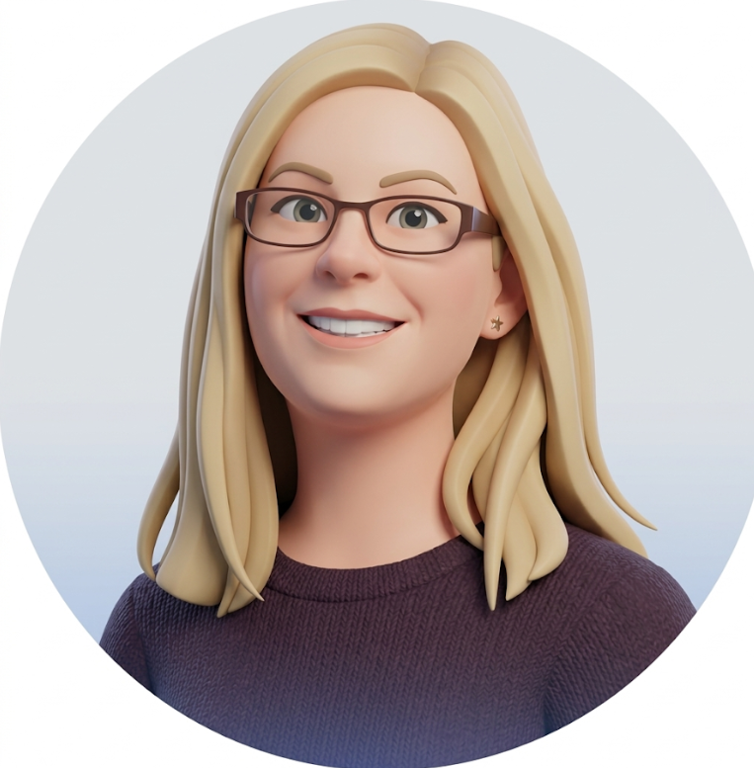
This is my new teacher, Mrs Lloyd (previously Miss Lemm)
My new class is called 5L.

Slide 6
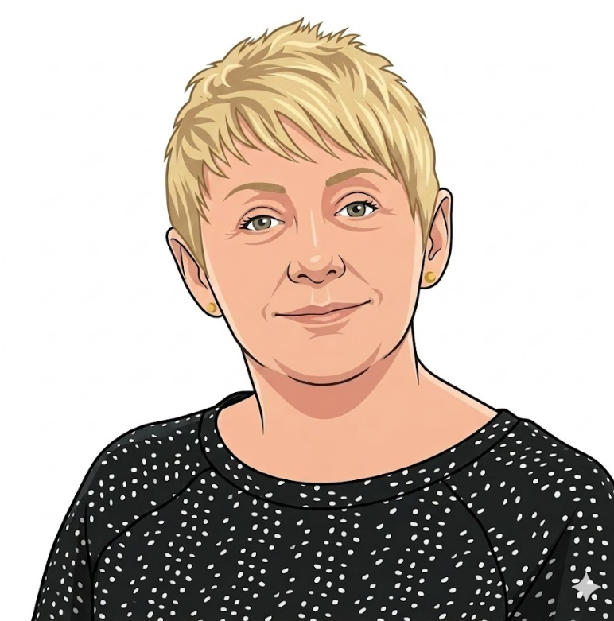
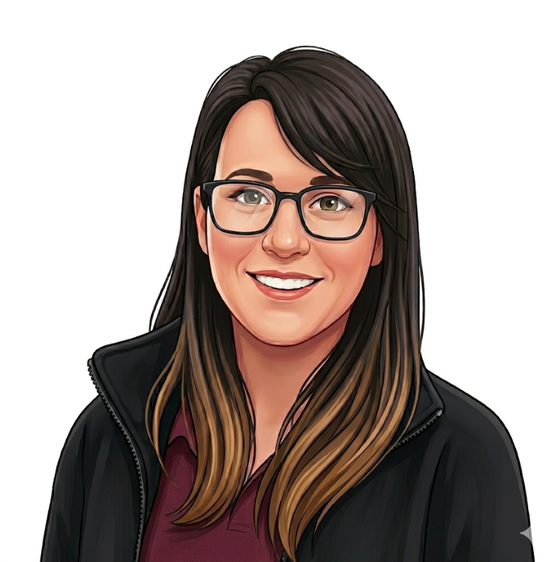
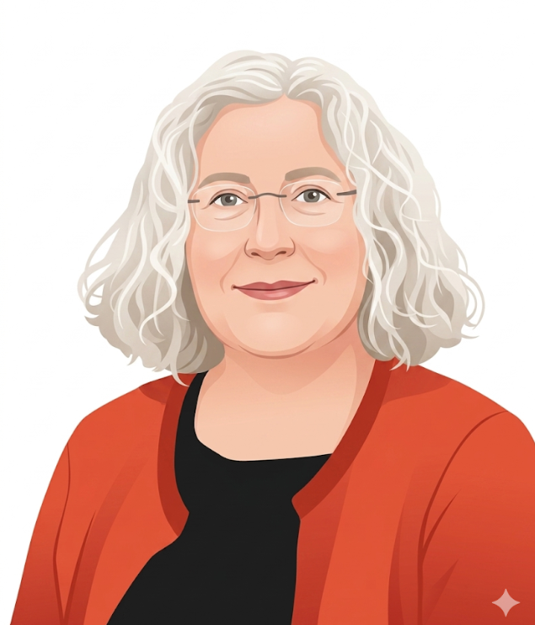
I will have some Teaching assistants I know well and a new teaching assistant.
These are my Year 5 teaching assistants:
Support staff
Miss Burdon
Miss Thorp
Ms Griffiths

Slide 7
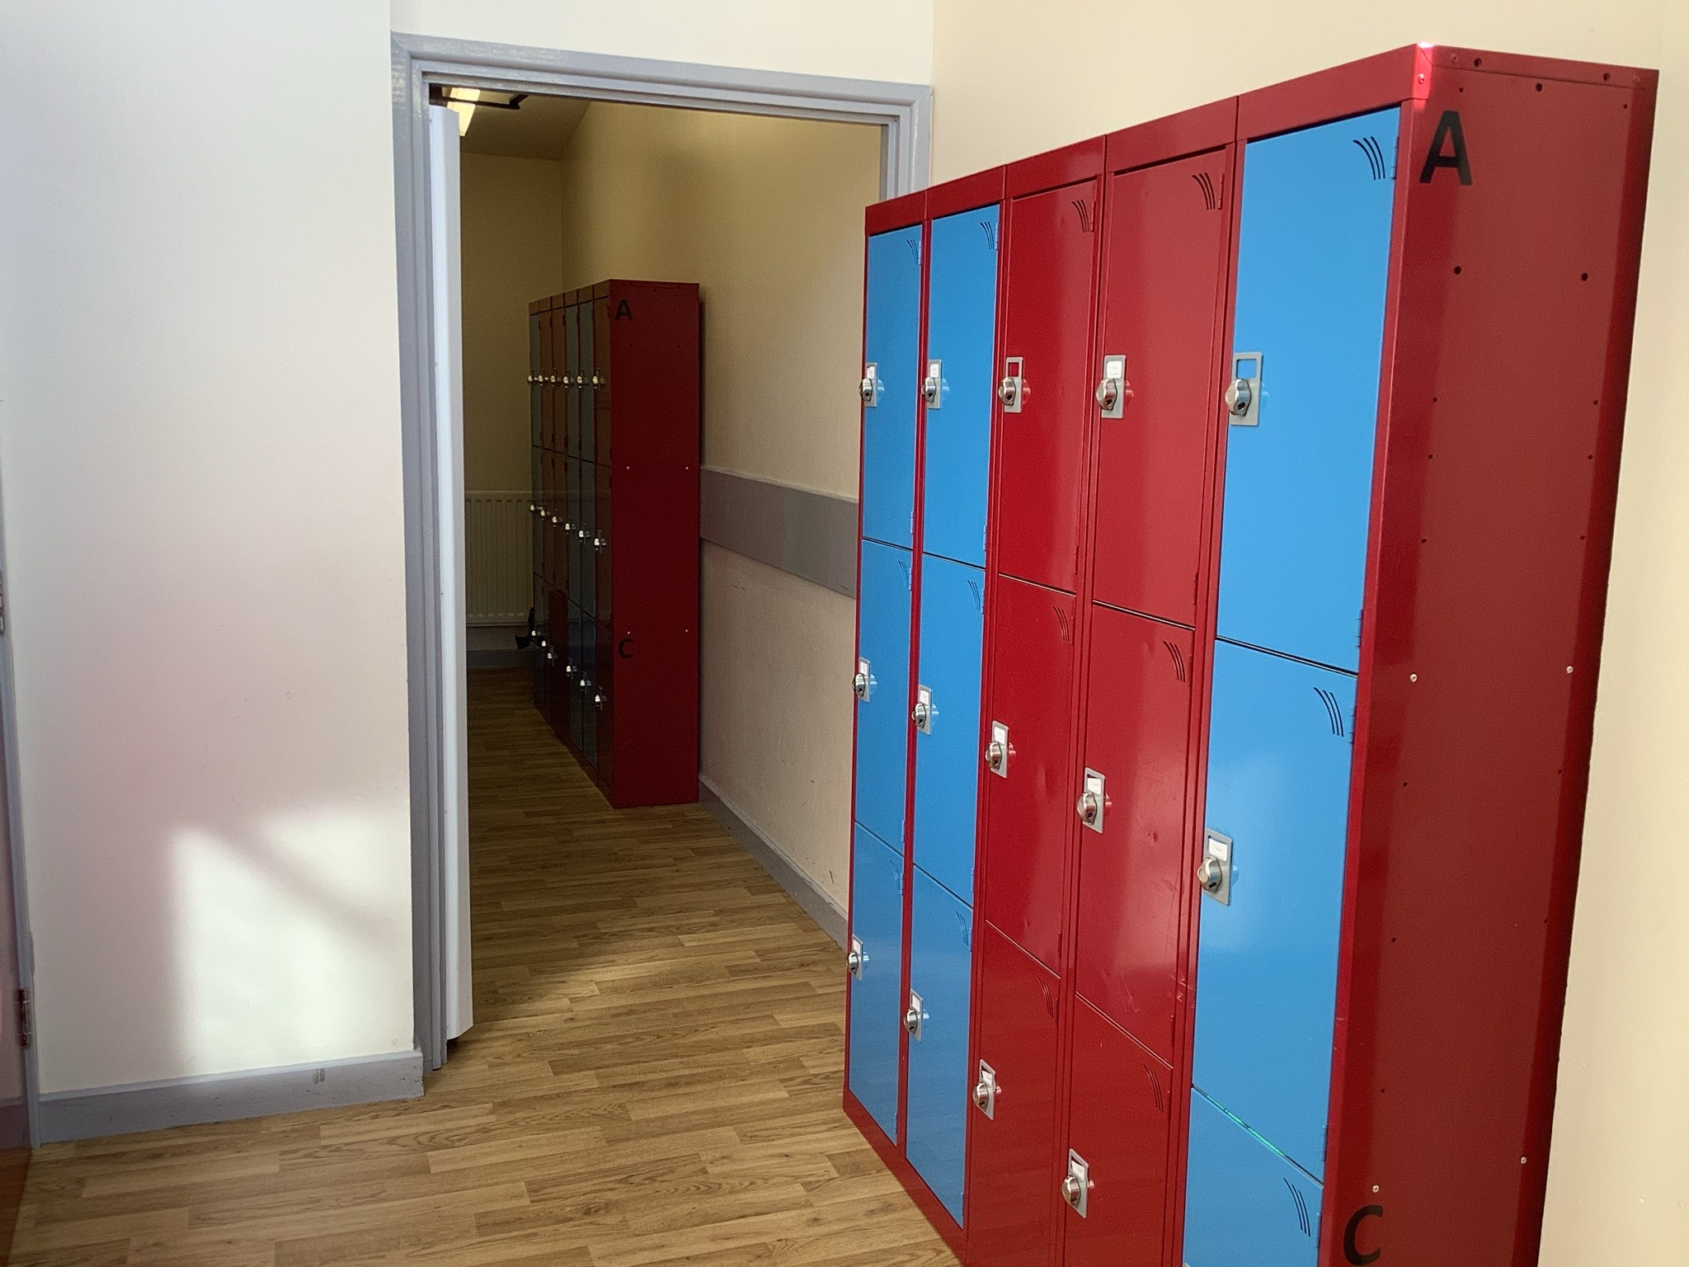
I will have a new locker.
This is where my locker will be:

Slide 8
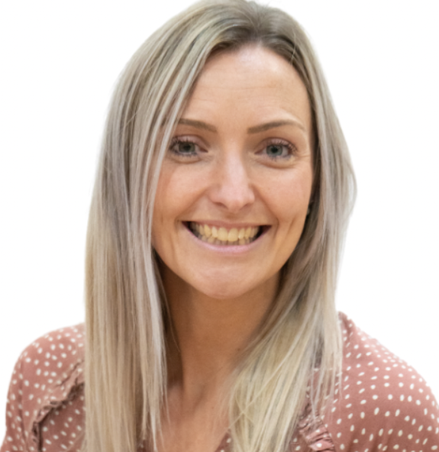
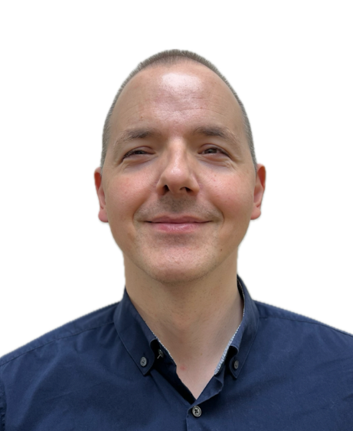
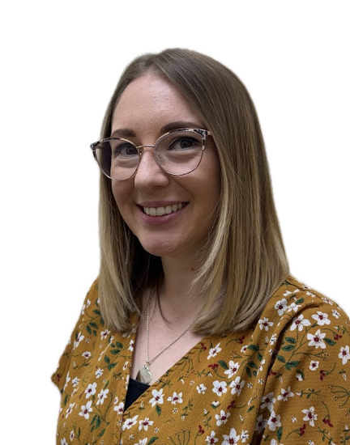
Other staff that will teach me through the week are -
Spanish
Senora Holmes
Music
Mr Horvath
(If I choose to play a Brass instrument)
Mrs Rossi
(If I choose to play a Woodwind instrument)

Slide 9
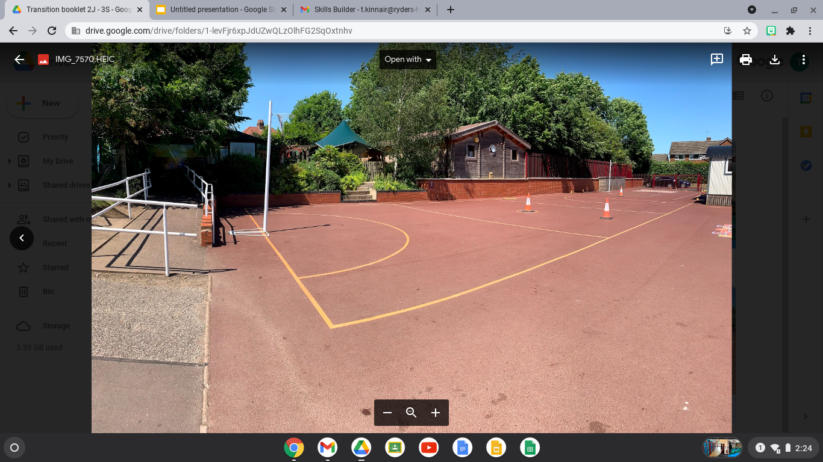
My Breaktime is at - 10:45am
My lunchtime is at - 12 noon
I will have playtimes and lunchtimes in the KS2 playground:

Slide 10
I will leave school at the end of the day through this exit/gate:
I finish school at - 3:30pm

Slide 11


I will have lots of fun and learn new things in 5S

