Slide 1



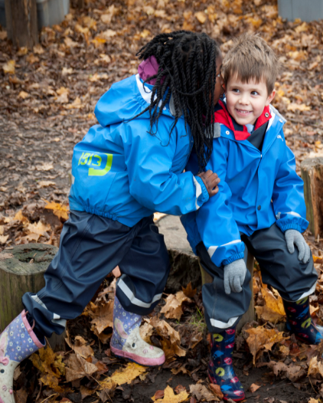


Welcome to the Reception Network
Strong Starts, Shared Success
Network 2: Wednesday 7th October 2026 4-5.30pm
Welcome: please add your name and the name of your school in the chat
Notes:
Jaz

Slide 2



Welcome and Introductions
Welcome and thank you for joining.
These virtual sessions are a regular space for colleagues across our region to come together, share practice, and strengthen reception provision.
These sessions are designed to support connection, provide clarity, and build shared foundations to improve outcomes for our youngest learners.
Housekeeping:
Please keep microphones muted unless speaking.
Turn cameras on where possible.
Use the chat to contribute throughout or raise your virtual hand.
If you were unable to attend our previous virtual network meetings, please contact us and we will be happy to share the slides. The sessions included useful information about why the network exists and what to expect.
There will be time for questions at the end.
Notes:
Jaz

Slide 3
Todays Agenda
Agenda Item | Time
Welcome and reminders | 4-4.05pm
DfE reception offer: refresher | 4.05-4.15pm
Settling in: reflections on your new cohort | 4.15-4.30pm
Understanding your cohort through transition, observation, assessments and other information sources | 4.30-4.50pm
Responding to cohort needs through interactions and environment | 4.50-5.10pm
Practice in Action | 5.10-5.25pm
Reflection, next steps and looking ahead as a network | 5.25-5.30pm
Notes:
Reflection, Next Steps and Looking Ahead as a Network

Slide 4
Todays Agenda
Agenda Item | Time
Welcome and reminders | 4-4.05pm
DfE reception offer: refresher | 4.05-4.15pm
Settling in: reflections on your new cohort | 4.15-4.30pm
Understanding your cohort through transition, observation, assessments and other information sources | 4.30-4.50pm
Responding to cohort needs through interactions and environment | 4.50-5.10pm
Practice in Action | 5.10-5.25pm
Reflection, next steps and looking ahead as a network | 5.25-5.30pm
Notes:
Reflection, Next Steps and Looking Ahead as a Network

Slide 5


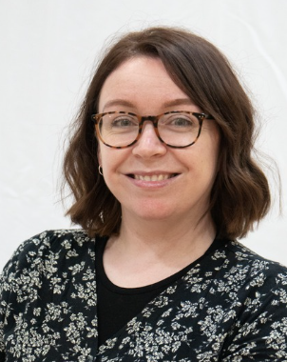
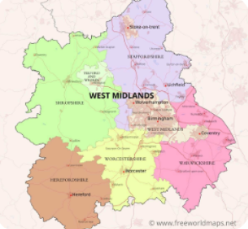
Welcome and Introductions
Thank you for making time to join today’s network meeting.
Meet the Reception Network Team.
Victoria Day Emily Page Sian Lavery
Assistant Head of School EYFS Team Leader Nursery Teacher
This is the second of many sessions designed to support reception practice across our region.
Notes:
Jaz

Slide 6

Support to strengthen reception practice
Today is about:
A secure and holistic understanding of each child’s development. Building knowledge of each child through everyday interactions, observations and learning.
Identify children’s strengths, interests, prior learning and emerging needs.: Teaching and provision reflect what children already know and can do.
Small changes can have a big impact… when they are well-sequenced, thoughtful and focused on what helps children feel secure, confident and ready to learn.
Notes:
Sian/Em

Slide 7

Support to strengthen reception practice
One thing to keep
One thing to adjust
One new thing to try
Notes:
Sian/EM

Slide 8
Todays Agenda
Agenda Item | Time
Welcome and reminders | 4-4.05pm
DfE reception offer: refresher | 4.05-4.15pm
Settling in: reflections on your new cohort | 4.15-4.30pm
Understanding your cohort through transition, observation, assessments and other information sources | 4.30-4.50pm
Responding to cohort needs through interactions and environment | 4.50-5.10pm
Practice in Action | 5.10-5.25pm
Reflection, next steps and looking ahead as a network | 5.25-5.30pm
Notes:
Reflection, Next Steps and Looking Ahead as a Network

Slide 9
A reminder: The DfE offer
Reception is a national priority within RISE, with free DfE support to help schools improve provision and contribute to the ambition for 75% of children to reach a Good Level of Development (GLD) by 2028. The full DfE reception offer can be found here: https://www.gov.uk/government/publications/reception-improvement-offer/reception-improvement-offer
What support is available from DfE?
Universal support- for all schools
Targeted and specialist support – where needed
Professional development for leaders and teachers
Supporting strong transitions
  Reception Networks: opportunities to connect with other local schools, share practice, and learn together, led by accredited Lead Schools.
  National webinars and training materials focused on reception priorities.
  ‘Compare your GLD data’ reports to help schools reflect on strengths and areas for development.
  RISE Reception Conferences in March 2026.
  Nuffield Early Language Intervention (NELI) – fully funded early language support for Reception children.
  English Hubs Reception offer:
    Reception‑focused audits of early language, reading and writing
    CPD and intensive specialist support for schools with greatest need.
  Maths Hubs Reception support:
    Mastering Number (Reception & KS1)
    Specialist Knowledge for Teaching Mathematics (SKTM)
    Intensive one‑to‑one support where required.
  Early Years National professional qualification (NPQ) courses – free professional development course for those wishing to progress to leadership in EY.
  Early Years leadership national professional qualification (NPQEL)- for current and aspiring EY leaders who want to develop their leadership expertise.
  Excellence in reception teaching course - national professional development (NPD) course for both new and experienced reception teachers. Including practical strategies to improve children’s outcomes
  National guidance, resources and examples to support transition into Reception
  Focuses on:
    Early and purposeful planning
    Strong partnerships with families and early years settings
    Inclusive, strengths‑based approaches for all children
  Early Education Partnerships: connect early year providers, schools and local services to improve transitions, school readiness and support for vulnerable children.

Slide 10
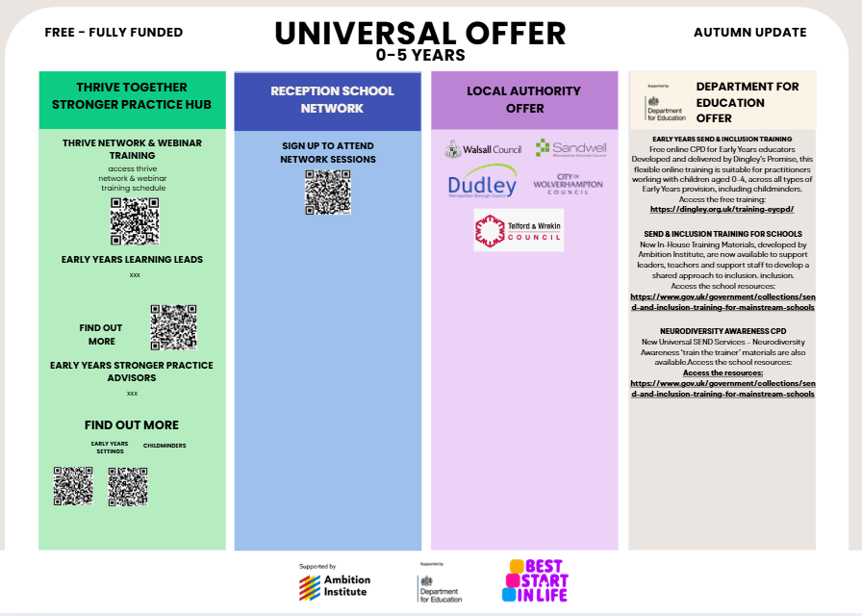
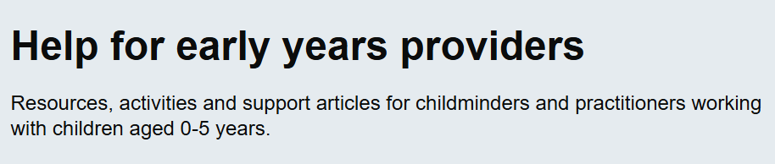

https://help-for-early-years-providers.education.gov.uk/

Slide 11
RISE Reception Quality Webinar Series- Autumn 2026 plans
Following success of our previous webinars, which attracted more than 10,500 live attendees, we have a new webinar offer for the autumn term based on attendee feedback:
Getting the reception environment right: preparing for a successful year
Wednesday 14 October 2026, 4-5:30pm
How reception learning environments can be designed to support children's engagement, learning and development from the start of the school year. ​
Using your GLD report to support reception improvement
Wednesday 4 November 2026, 4-5pm.
Introducing the new Good Level of Development (GLD) reports and explore how they can be used to support reception improvement.
​
What inclusive and adaptive practice means
Wednesday 2 December 2026, 4-5:30pm
What we mean by inclusive practice and how it is different from adaptive practice and how both can support all children, particularly for those with emerging or identified special educational needs and disabilities (SEND).
Find out more and register here: RISE Reception webinars Autumn 2026
Notes:
Following success of our previous webinars, which attracted more than 10,500 live attendees, the Department for Education has developed a new autumn programme informed by participant feedback. Attendees highlighted a strong appetite for practical support, particularly through case studies, SEND-focused content and examples of effective classroom practice.
In response, the autumn series will focus on three key areas of reception provision:
Wednesday 14 October 2026, 4-5pm. Getting the reception environment right: preparing for a successful year: How reception learning environments can be designed to support children's engagement, learning and development from the start of the school year.
Wednesday 4 November 2026, 4-5pm. Using your GLD report to support reception improvement: introducing the new Good Level of Development (GLD) reports and explore how they can be used to support reception improvement.
Wednesday 2 December 2026, 4-5pm. What inclusive and adaptive practice means: what we mean by inclusive practice and how it is different from adaptive practice and how both can support all children, particularly for those with emerging or identified special educational needs and disabilities (SEND).
Each session will combine expert perspectives with practical examples to support reflection, professional dialogue and continuous improvement in reception practice.

Slide 12
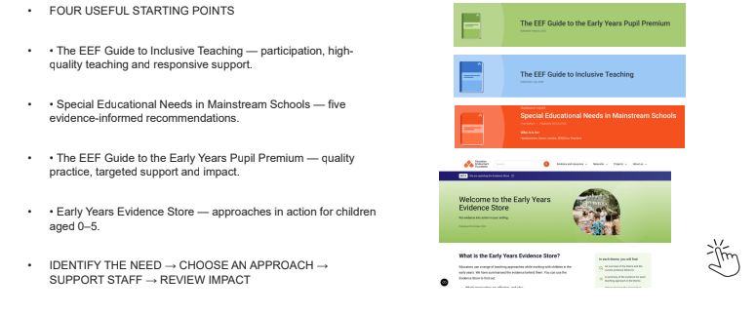
Using EEF Evidence… practices and approaches

Slide 13
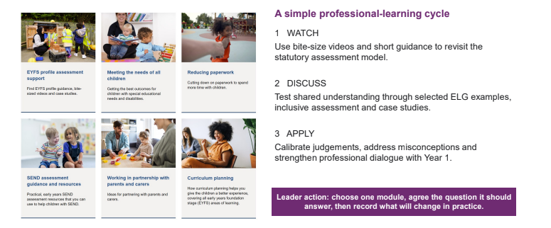
DfE Help for Early Years Providers:

Slide 14
-Chat Activity 1
To help us understand who is in the room and surface shared priorities, please introduce yourself in the chat or by raising your virtual hand to share:
School name
Your role
How has your school engaged with the DfE, EEF, Stronger Practice Hub EYFS/Reception year offer so far?
What has been most valuable, and what learning or experiences would you like to share with colleagues across the network?

Slide 15
Todays Agenda
Agenda Item | Time
Welcome and reminders | 4-4.05pm
DfE reception offer: refresher | 4.05-4.15pm
Settling in: reflections on your new cohort | 4.15-4.30pm
Understanding your cohort through transition, observation, assessments and other information sources | 4.30-4.50pm
Responding to cohort needs through interactions and environment | 4.50-5.10pm
Practice in Action | 5.10-5.25pm
Reflection, next steps and looking ahead as a network | 5.25-5.30pm
Notes:
Reflection, Next Steps and Looking Ahead as a Network

Slide 16


-Breakout room Activity 1
Settling in initial reflections: how are thing going so far?
Children have now had several weeks to settle into school routines.
This is often the point where first impressions begin to develop into a more secure understanding of the cohort.
Reflection and discussion:
Think about the children currently in your reception class.
What has gone particularly well?
What are you most pleased with so far?
What has surprised you?
What has been more challenging than expected?
What are you noticing about families and parental engagement?

Slide 17
Todays Agenda
Agenda Item | Time
Welcome and reminders | 4-4.05pm
DfE reception offer: refresher | 4.05-4.15pm
Settling in: reflections on your new cohort | 4.15-4.30pm
Understanding your cohort through transition, observation, assessments and other information sources | 4.30-4.50pm
Responding to cohort needs through interactions and environment | 4.50-5.10pm
Practice in Action | 5.10-5.25pm
Reflection, next steps and looking ahead as a network | 5.25-5.30pm
Notes:
Reflection, Next Steps and Looking Ahead as a Network

Slide 18
Understanding your new cohort
As children spend time in reception, we begin to build a more complete picture of who they are as learners. No single source of information tells us everything and we must use various sources to build a complete picture.
Understanding develops through:
Parent and carer conversations
Pre-reception setting information
Ongoing observations
Transition information
Professional judgement
SEND and multi-agency information
Learning journeys and examples of previous learning
Assessment information

Slide 19
Why this matters?
Children do not always demonstrate what they know and can do in the same way or in every environment. A child’s confidence, communication, engagement, and performance can be influenced by a range of factors, meaning a single observation or assessment may not provide a complete picture.
Children may demonstrate skills differently depending on:
Familiarity with adults
Language and communication
Confidence and emotional security
Individual interests and motivation
Previous educational and life experiences
The learning environment
  Children often show greater confidence and capability with people they know and trust.
  Children learning English as an additional language may understand far more than they are able to express in English.
  Some children need time to settle before they feel comfortable sharing their knowledge and abilities.
  Children are often more likely to demonstrate skills when activities connect to their interests and strengths.
  Opportunities and experiences prior to school can significantly influence how children engage with learning.
  Children may respond differently across settings, routines, and levels of structure.
Notes:
Disc

Slide 20
-Chat Activity 2: Discussion
How does your school bring together all available information to create a holistic understanding of children as they enter reception?
Consider:
What information do you currently gather before children start school?
What processes help you identify children’s strengths, interests, needs and any potential barriers to learning?
How do you use this information to inform provision, curriculum planning and early intervention?
Are they any children for whom it is more difficult to build a complete picture before entry?
This discussion is an opportunity to hear how colleagues approach this, share effective practice, and take away ideas that could be adapted and used within your own school.

Slide 21
How did transition help build an understanding of your cohort?
Before children arrive in September, schools invest significant time in transition arrangements.
This year’s transition approaches
What strategies were used across your setting?
Parent engagement activities
Home visits
Transition meetings
Stay and play sessions
SEND transition planning
Multi-agency collaboration

Slide 22
-Breakout room Activity 2
Reflecting on transition this year
Discussion:
Which parts of your transition process provided the most useful information?
Which strategies had the greatest impact on children and families?
What helped children settle successfully?
Were there any challenges or barriers?
What feedback did you receive from parents, nurseries or school staff?
How effective were your arrangements for children with SEND?
What do you wish you had known before September?
Looking ahead:
Now that this year’s transition has taken place, what is the key learning from your setting that will shape your transition offer for next year?
Use this discussion opportunity to reflect on transition outcomes, learn from colleagues’ experiences, and gather ideas to strengthen practice in your own setting.

Slide 23
Todays Agenda
Agenda Item | Time
Welcome and reminders | 4-4.05pm
DfE reception offer: refresher | 4.05-4.15pm
Settling in: reflections on your new cohort | 4.15-4.30pm
Understanding your cohort through transition, observation, assessments and other information sources | 4.30-4.50pm
Responding to cohort needs through interactions and environment | 4.50-5.10pm
Practice in Action | 5.10-5.25pm
Reflection, next steps and looking ahead as a network | 5.25-5.30pm
Notes:
Reflection, Next Steps and Looking Ahead as a Network

Slide 24
Identifying cohort trends
Schools can use their growing understanding of the cohort to identify common strengths, needs and priorities. Looking across the cohort helps practitioners move beyond individual children and consider how curriculum, provision and the environment can best support the group as a whole.
Cohort trends may emerge in areas such as:
Communication & language
Attention and listening
Independence and self-regulation
Early literacy experiences
Confidence and wellbeing
The aim is not to focus on scores or individual assessment outcomes, but to identify cohort-level patterns that can inform curriculum decisions, teaching approaches and provision.
The table below provides examples of how identified cohort trends might shape practice.
Cohort Pattern | Possible Response | Resource
Emerging communication skills | Increase language-rich interactions and opportunities for talk | DFE Help for EY Providers: CL Interactions. EEF ShREC, Evidence Store CL Teaching and modelling Vocabulary
Reduced independence | Explicitly teach routines and self-help skills | DfE Help for EY Providers PSED. EEF Evidence Store PSED/Self-regulation and Executive Function
Limited literacy experience | Prioritise stories, rhymes and reading | Literacy Hub, DfE Help for EY Providers and EEF Evidence Store Literacy and CL

Slide 25

What is your cohort telling you?
Discussion:
What strengths are emerging across your cohort?
e.g. communication, independence, physical confidence, creativity and problem-solving.
What priorities are emerging across your cohort?
e.g. vocabulary development, attention and listening, fine motor development or self-regulation.
If you had to describe your cohort in one sentence, what would that sentence be?
e.g. “A highly curious cohort who will benefit from support to develop independence”

Slide 26
How should your environment respond to what your cohort is telling you?
A high-quality reception environment is more than a physical space. It actively supports learning and development.
Children learn from:
Adults: what adults teach and model
Peers: interactions with other children
The environment: what the environment enables, encourages and communicates.
For this reason, the environment is often described as the third teacher. A strong environment supports:
Independence
Language development
Sustained play
Exploration
Problem solving
Relationships
Inclusion
Self- regulation

Slide 27
What makes a high-quality reception environment?
A high-quality reception environment is safe, supportive and enabling. Through predictable routines, purposeful spaces and thoughtful design, the environment supports children's learning, wellbeing, independence and development from the moment they walk through the door.
Strong safeguarding culture and practice
Predictable routines and consistency
Enabling, purposeful environments
Low-distraction learning spaces with minimised noise
Thoughtful environment designs including zoning, calm spaces, visual cues and space for outdoor learning
  Children feel safe, secure and valued.
  Safeguarding is embedded in daily practice.
Consistent routines, expectations and organisation help children know what to expect and support successful transitions throughout the day.
  Every area, resource and display has a clear purpose and supports learning, development and independence.
  The environment reduces unnecessary noise, visual clutter and competing stimuli, helping children focus and engage.
Spaces are deliberately designed to support different types of learning, including active, quiet and collaborative play.
Visual clues, defined areas and access to outdoor learning help children navigate and engage with the environment successfully.

Slide 28
Todays Agenda
Agenda Item | Time
Welcome and reminders | 4-4.05pm
DfE reception offer: refresher | 4.05-4.15pm
Settling in: reflections on your new cohort | 4.15-4.30pm
Understanding your cohort through transition, observation, assessments and other information sources | 4.30-4.50pm
Responding to cohort needs through interactions and environment | 4.50-5.10pm
Practice in Action | 5.10-5.25pm
Reflection, next steps and looking ahead as a network | 5.25-5.30pm
Notes:
Reflection, Next Steps and Looking Ahead as a Network

Slide 29
Practice in Action: School Spotlight
Lead school to use this slide to share their own example, covering:
What we noticed
Lead school to add own examples. E.g:
Communication and language emerged as a key area for development
Many children needed support to sustain conversations with peers
Independence skills were less secure than in previous cohorts
Fewer children demonstrated familiarity with stories and books on entry.
How we responded
Lead school to add examples of changes. This could cover:
Environment: what changed?
Provision: what changed?
Curriculum: what changed?
Family engagement: what changed?
Adult interactions: what changed?
Support and intervention: what changed?
Why we prioritised these changes?
Explicitly connect changes back to what the cohort was telling you.
Early impact
Lead school to add examples. Possible reflections:
Improved confidence in speaking
Increased engagement during story sessions
Greater independence in routines
More purposeful peer interactions

Slide 30
EYFS Formative Assessment: A Connected Process NOTICE- INTERPRET- RESPOND
Formative assessment in the Early Years is one continuous, connected process rather than isolated administrative tasks. By linking what we notice directly to how we understand and respond, adults can deliver meaningful, real-time support that moves learning forward.
Step 1: Notice-Build the Picture "What do we know about the child?"
Step 2: Interpret & Prioritise
"What does this tell us developmentally, and what do we do next?"
Step 3: Respond
"How will adults, routines, and the environment respond?"
Gathering meaningful information relies on viewing the child holistically during authentic, unprompted play and everyday routines.
Child-Initiated Observation: Noticing what children know, can do, and are interested in during self-chosen play.
Adult Interactions: Capturing key moments, conversations, and problem-solving attempts during guided activities.
Parent & Family Insights: Valuing information shared by parents about home life, interests, and milestones.
Key Person Knowledge: Using daily interactions to build a complete, nuanced view of the child's emotional and physical well-being.
Observations only become assessment when practitioners analyze what the information means for the child's growth.
Developmental Understanding: Identifying where the child is on their unique learning trajectory using professional judgment and EYFS guidance.
Identifying Strengths & Gaps: Recognizing securely embedded skills as well as areas where the child needs support or challenge.
Prioritising the Immediate Next Step: Selecting 1–2 high-impact, immediate learning goals that build naturally on current interests and capabilities.
Assessment comes alive through intentional action. The identified next steps directly shape three core levers of practice:
Adult Interactions: Modeling language, asking open-ended questions, offering timely scaffolding, or stepping back to allow independent problem-solving.
Routines & Transitions: Adapting daily schedules (e.g., small-group work, extended play blocks, tailored snack times) to support emerging skills.
Continuous Provision & Environment: Adding or adapting resources, enhancing interest areas, or setting up provocations that encourage the child to practice their next steps independently.

Slide 31

Identifying meaningful next steps
Building deep knowledge of all children through everyday interactions, observations, and evidence-informed practice

Slide 32

What do we mean by meaningful next steps?
A meaningful next step in the Early Years Foundation Stage (EYFS) is a practitioner’s immediate, planned response to an observed learning moment.
Rooted in guidance from the Department for Education (DfE) and the Education Endowment Foundation (EEF), it focuses on real-time interaction to extend, challenge, or embed learning—rather than recorded, paperwork-heavy targets.

Slide 33

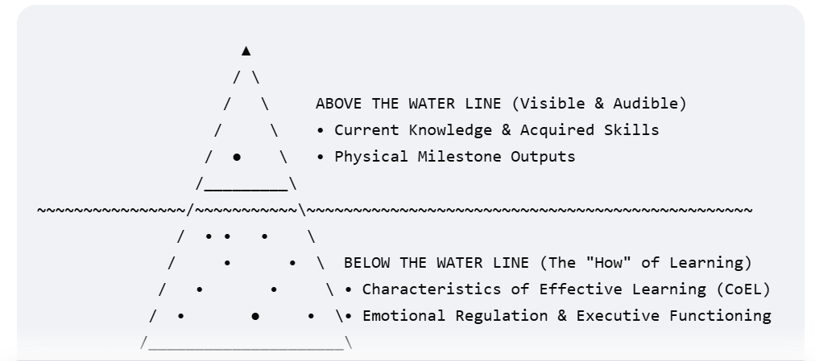
When observing in the moment … What do we see?

Slide 34
Above the Water Line (Visible Knowledge & Skills)
Speech & Language: Verbal sentence structures, vocabulary size, and conversational clarity.
Literacy & Numeracy: Letter and number recognition, phoneme blending, name writing, and rote counting.
Fact Recall: Topical knowledge like identifying colours, naming animals, or explaining plant growth.
Gross Motor: Whole-body movements including running, jumping, balancing, and climbing.
Fine Motor: Finger-hand coordination such as pencil grip, scissor control, and bead threading.
Below the Water Line (Less visible Learning Behaviours)
Engagement (CoEL): Curiosity to explore resources, open-ended play, and a willingness to try new things.
Motivation (CoEL): High levels of deep concentration, resilience through setbacks, and intrinsic drive.
Critical Thinking (CoEL): Connecting new ideas to past experiences, predicting outcomes, and changing strategies when stuck.
Self-Regulation: Impulse control, waiting for turns, managing strong emotions, and following simple directions.
Emotional Security: Internal sense of safety, strong attachments to staff, and the confidence to take risks.
Executive Functioning: Holding instructions in short-term memory, shifting attention, and planning task steps.

Slide 35
2. When observing our children in the moment …
How do we know what to look for ?
Knowing what to look for comes down to combining pedagogical knowledge with deep knowledge of the child:
Professional Knowledge of Child Development: Understanding typical developmental sequences (as outlined in Development Matters or Birth to 5 Matters). This helps you recognize when a child is at the edge of their current skill level (the "Zone of Proximal Development’)
Knowing the Unique Child: Understanding individual interests, home background, current fascinations, and personal social/emotional needs. This context helps you recognize why a child is choosing a specific activity.
Spotting "Teachable Moments": Looking for signs of authentic engagement and wellbeing: (Leuven Scales/ COEL Visible))
  Deep focus or absorption in a task. A moment of struggle or trial-and-error.
  A sudden spark of curiosity or hesitation. Social interactions or communication attempts.

Slide 36
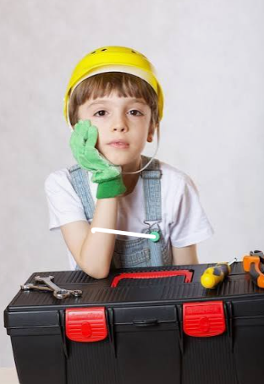
How do we know if the tools and documents we use actually help us identify children’s learning and decide immediate next steps- HOW to Respond —or if they're just adding to our workload?

Slide 37
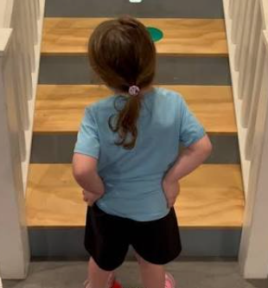
Core Characteristics of Meaningful Next Steps
In-the-Moment Action (Not always Written Targets): Aligned with the DfE’s guidance to eliminate unnecessary paperwork, next steps are immediate actions taken during play and learning —such as introducing a new material, modelling how to do something, asking an open-ended question, or modeling rich vocabulary.
High-Quality Interactions & Scaffolding ‘ next steps in the moment’
Enabling Environments in and outdoors
Parent Partnerships

Slide 38
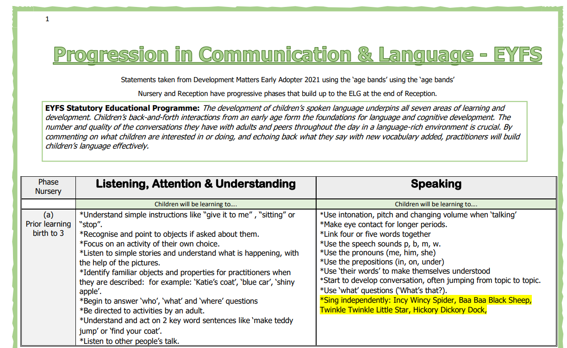
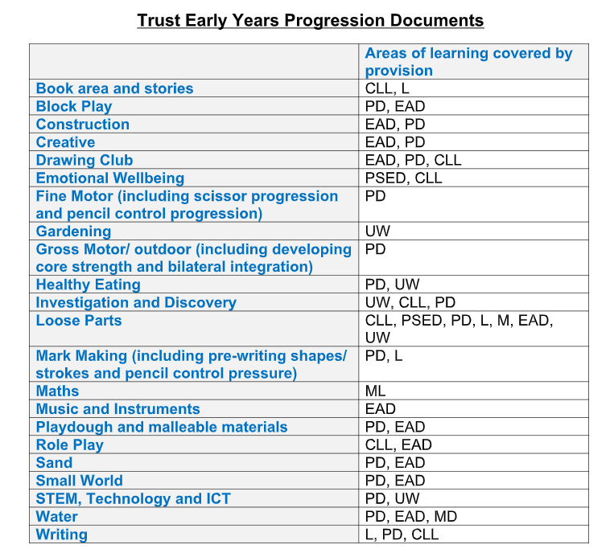
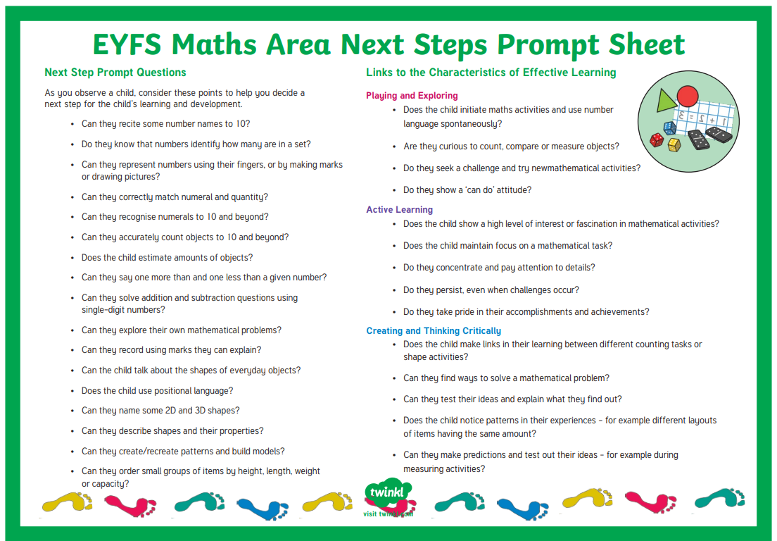
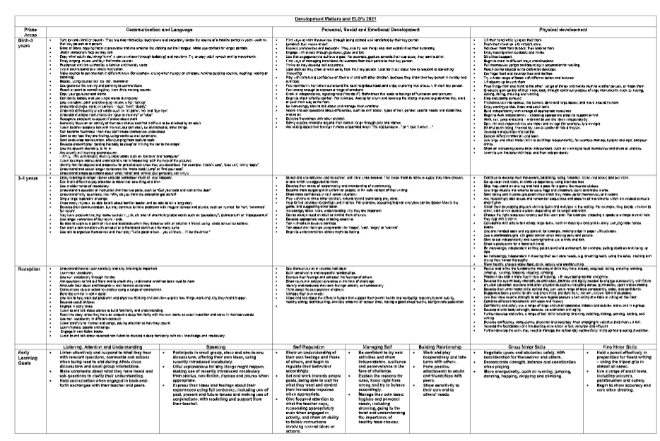
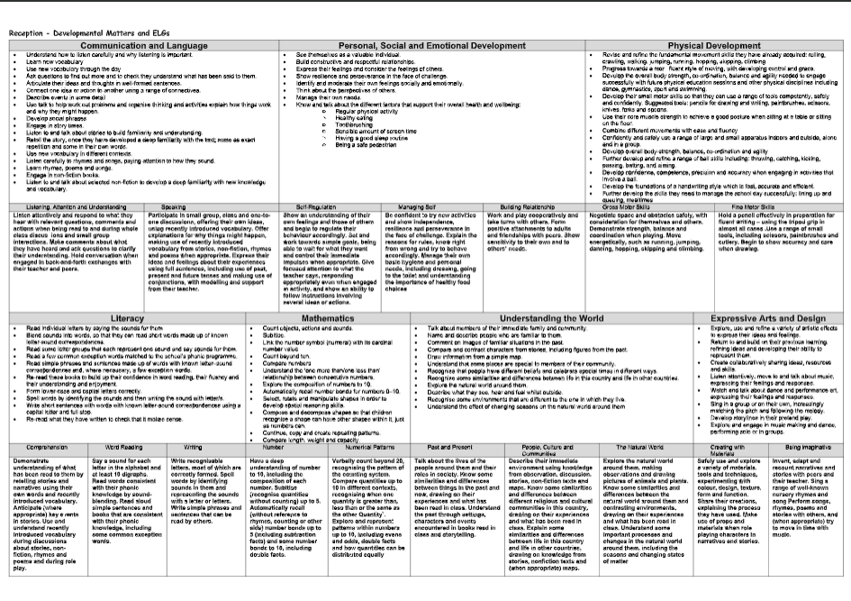
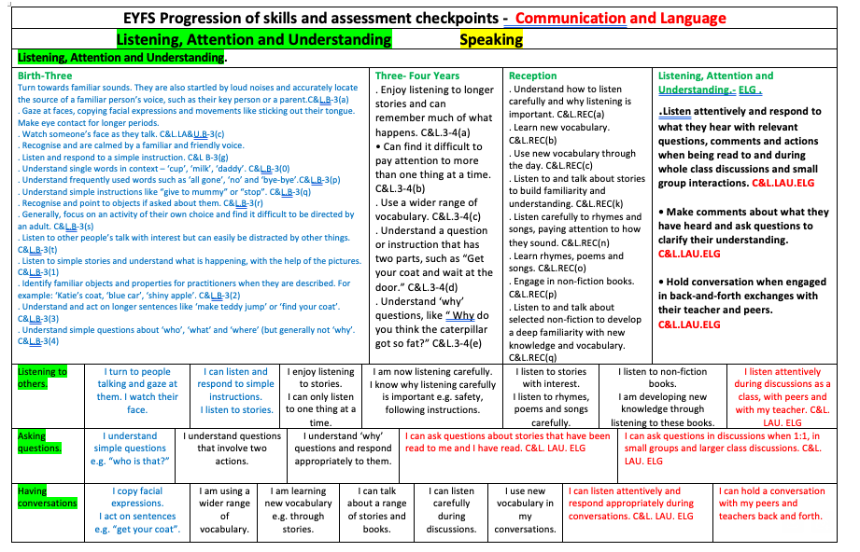
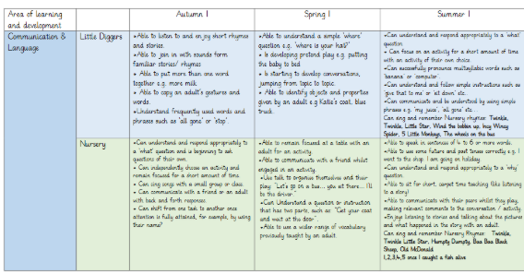

Slide 39
Useful Statutory/ Non Statutory / Evidence Informed we use:
Curriculum Frameworks (Development Matters / Birth to 5 Matters): Provide an internal developmental pathway to quickly recognize where a child is and what challenge they need next.
Speech & Language Screening Tools (WellComm / Speech and Language UK): Identify specific communication barriers, track vocabulary levels, and pin-point targeted language interventions.
Guidance & Progression Maps (Learning Trajectories): E.g Maths-. Map out early number sense and spatial reasoning steps to pinpoint precise mathematical gaps or extension points.
Your School AoL Progression Grids: These are your internal maps. They break down the broad steps in Development Matters or Birth to 5 Matters into tiny, sequential learning steps unique to your curriculum.
Interaction Tools: Use sentence stems, EEF ShREC /SST and open-ended prompts.
Environmental & Visual Aids: Use talking buddies, vocabulary prompt cards, and visual task boards to see if a child can work independently or needs scaffolding. (EEF STAIRS)
Continuous Provision Enhancements: Deliberately adding targeted materials and resources to areas inside and out, to observe whether children can apply newly learned skills in different contexts or to extend.

Slide 40


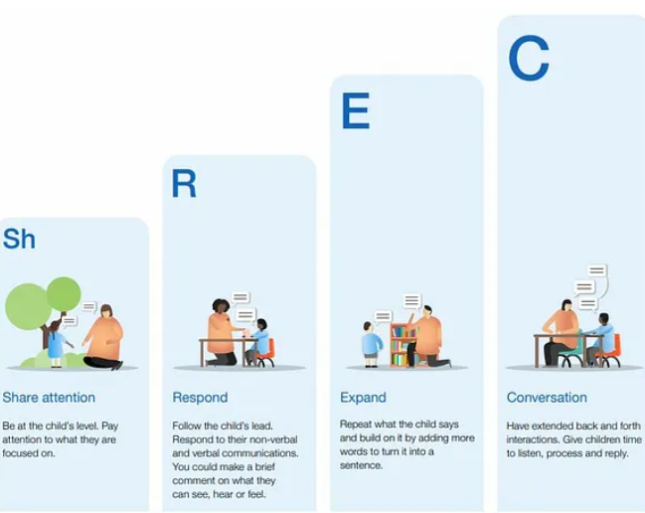


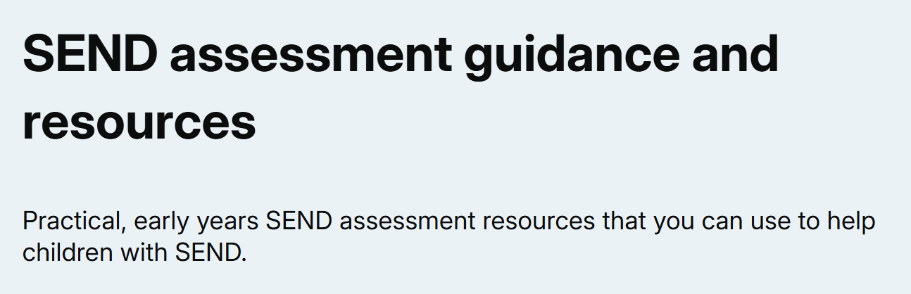

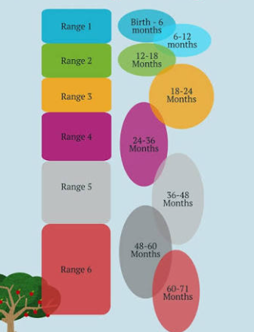


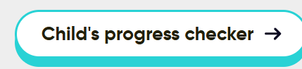
https://educationendowmentfoundation.org.uk/early-years/high-quality-interactions
https://educationendowmentfoundation.org.uk/early-years/evidence-store
https://educationendowmentfoundation.org.uk/early-years/the-shrec-approach
https://d2tic4wvo1iusb.cloudfront.net/production/content/the-STAIRS-model_v.1.0.0.pdf
https://help-for-early-years-providers.education.gov.uk/
https://assets.publishing.service.gov.uk/media/64e6002a20ae890014f26cbc/DfE_Development_Matters_Report_Sep2023.pdf
https://speechandlanguage.org.uk/help-for-families/ages-and-stages/
https://birthto5matters.org.uk/learning-development/ranges/

Slide 41


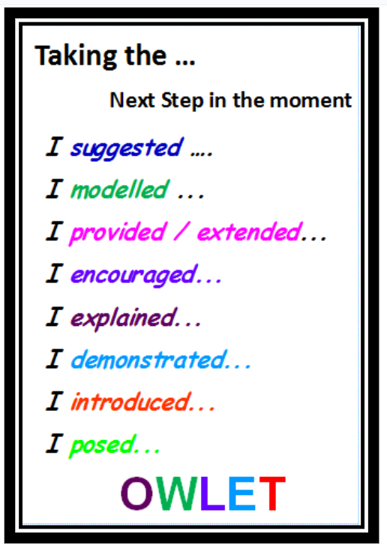
Identifying Meaningful Next Steps - reflections and takeaways
Building deep knowledge of the unique child through everyday interactions, observations, and evidence-informed practice
Build Knowledge, Skills and Learning Behaviours-, Through Everyday Interactions: Learn about each child dynamically through authentic play, conversations, and observations to develop a secure and holistic understanding of their development.
Notice with Curiosity ("Above and Below the Waterline"): Watch children during child-initiated play to identify visible capabilities as well as underlying schemas, self-regulation, and deeper conceptual understanding.
Identify Strengths, Interests, and Emerging Needs: Pinpoint what children already know, what fascinates them (note - children will develop lots of interests in a rich enabling environment£, and where they encounter a productive challenge to ensure teaching and provision directly reflect their starting points.
Teach in the Moment: Provide immediate feedback, model rich vocabulary, or scaffold learning right as play happens—focusing on real-time interactions over written paperwork targets. (OWLET)
Ground Decisions in Evidence-Informed Tools: Draw on key frameworks (such as DfE Development Matters, EEF Early Years and WellComm etc.) to accurately and efficiently assess progress and select targeted in the moment next steps
Partner with Parents: Value family insights as a critical piece of the puzzle, using two-way dialogue to understand a child's home interests, baseline abilities, and holistic needs.
Involve the Whole Team: Share observations daily across the EYFS team so every adult understands each child's current focus and how to extend their learning.
OWLET
Observe Wait Listen
Explore: Use open-ended questions and intentional interaction to probe and expand their thinking.
Teach: Deliberately introduce new skills or knowledge, add to the environment- to scaffold learning and address next steps in the moment.

Slide 42



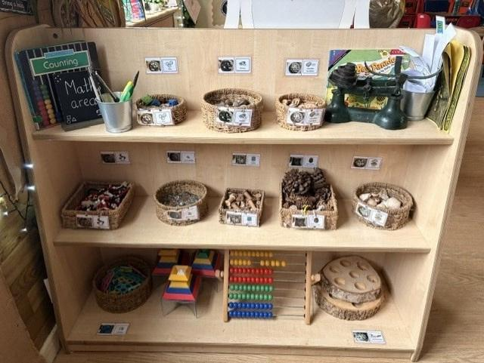







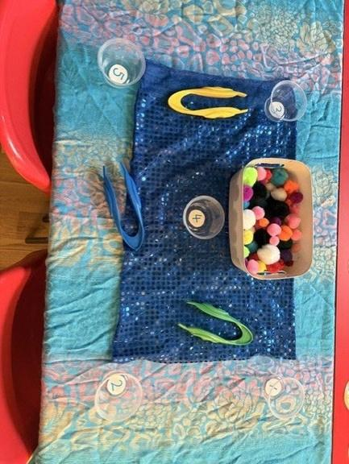

Using assessment to shape
interaction and environment.
Refinements Staffdiscussion regarding the maths area and
ShREC approach within it
what the practitioners have noticed.
Children have needed support to recognise numerals 1-5 and count out the amount accurately
Refinements
Staff used enhanced activities to support recognition of numbers 1-5 and counting out the correct amount.
what the practitiners have noticed
Children have been accessing fine motor activities, such as using tweezers.
What the practitioners have noticed.
Children have accessed the maths area but are not utilising the resources well.
Refinements
Tweezers were added to the maths areas to encourage children to access the provision.
What might be added to further support children's learning?

Slide 43
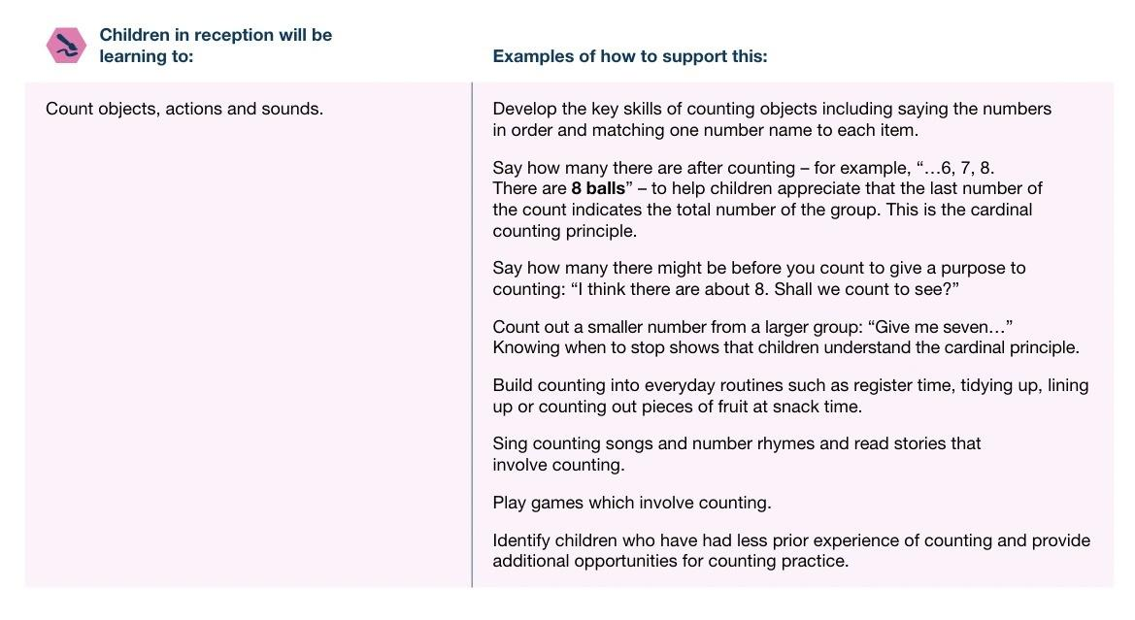
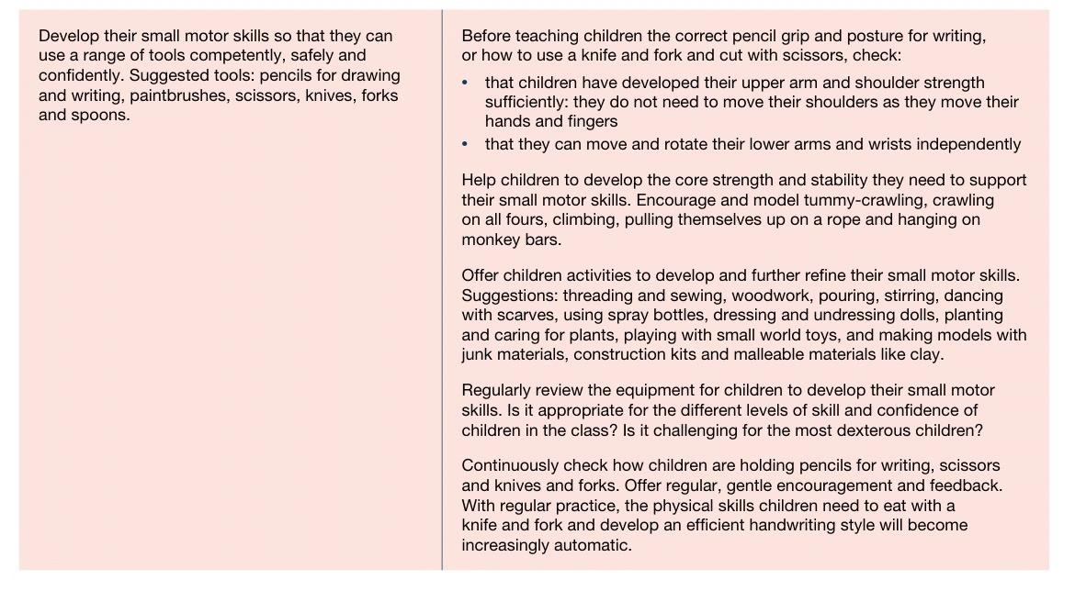
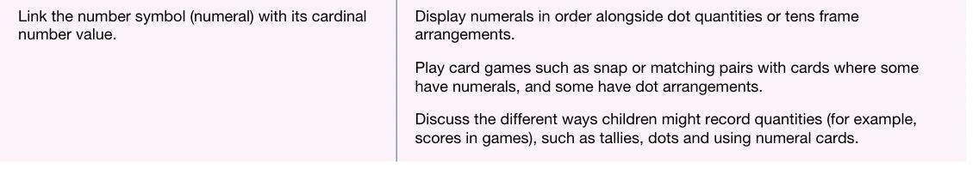
Using assessment to shape interaction and environment - links to Development matters.
What have we noticed now and where do we
want them to be?

Slide 44
Using assessment to shape the routines.
what the practitioners have noticed.
Refinements
Staff would ensure a visual timetable (widgets) is displayed forall children andreferred to throughout the day anda Now and Next board with matching images for the individual child / children. Ensure routines remain consistent. Encourage through high-quality interactions and follow previous advice from previous setting.
Children enter the classroomand
stand still waiting for an adult to intervene.
Staff understand this will impact the children’s GLD through their PSED ELGs
Refinements
Review PD planning and opportunities in the setting. Links to core strength. Playing turn taking games, attention games etc..Visual strategies, Identify key children with a ‘wobble cushion’ or alternative resources. Check their WELLCOMM score - is it a C&L issue? Use the EEF evidence store and look to the PD element for advice on how to transfer into the classroom practice.
what the practitiners have noticed Children have difficulty sitting on a chair.
Staff understand this will impact the children’s GLD through their PD gross motor ELG.
What might be added to further support children’s development?

Slide 45
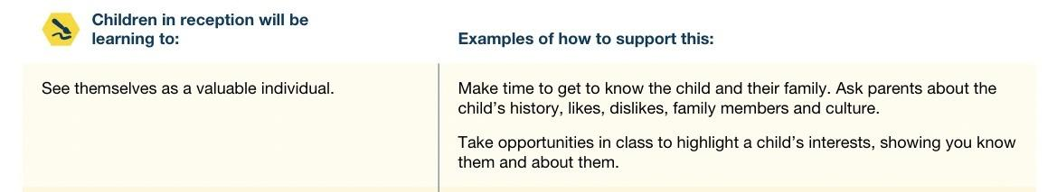
Using assessment to shape
the routines - link to development matters
What have we noticed now and where do we
want them to be?

Slide 46
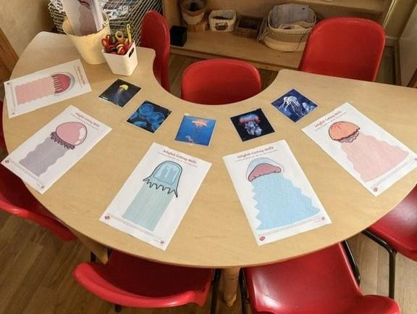
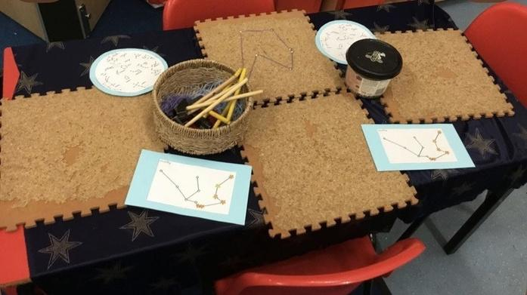

Using assessment to shape the environment.
Refinements
what the practitioners have noticed.
Children (especially the boys) had shown a real interest in space and the ocean through books in the reading area.
what the practitiners have noticed
Pencil grip and pressure is poor across the co-hort.
What the practitioners
have noticed.
Fine motor skills, especially cutting, has been identified as requiring further support.
Natasha Garrad
AHT Delves Infant and Nursery School
Early Years Learning Lead – PSED
EYFS Specialist Advisor-Thrive Together SPH
What might be added to further support
children's learning?

Slide 47
Todays Agenda
Agenda Item | Time
Welcome and reminders | 4-4.10pm
DfE reception offer: refresher | 4.10-4.20pm
Settling in: reflections on your new cohort | 4.20-4.40pm
Understanding your cohort through transition, observation, assessments and other information sources | 4.40-5.00pm
Responding to cohort needs through interactions and environment | 5.00-5.15pm
Practice in Action | 5.15-5.25pm
Reflection, next steps and looking ahead as a network | 5.25-5.30pm
Notes:
Reflection, Next Steps and Looking Ahead as a Network

Slide 48
Reflection and action planning
What are you going to change?
Today has focused on:
Understanding your cohort
Reflecting on provision
Reflecting on environment
Think about the following:
One thing I have learned about my cohort is…
One aspect of the cohort I would like to understand more deeply is…
One strength we should build upon is…
One aspect of my provision I may need to review is…
One aspect of the environment I may need to adapt is…
One action I will take before half term is…
One impact I hope to see is…
Use this opportunity to discuss your reflections with colleagues, challenge your thinking, and identify meaningful changes that will make the greatest difference for your cohort.

Slide 49
Support to strengthen reception practice
Today was about:
A secure and holistic understanding of each child’s development. Building knowledge of each child through everyday interactions, observations and learning.
Identify children’s strengths, interests, prior learning and emerging needs.: Teaching and provision reflect what children already know and can do.
Small changes can have a big impact… when they are well-sequenced, thoughtful and focused on what helps children feel secure, confident and ready to learn.
Notes:
Sian/Em

Slide 50
Support to strengthen reception practice
One thing to keep
An aspect of current practice that is working well and supports children and families effectively.
One thing to adjust
An element that may need refining, strengthening or approaching differently to better support children’s thriving forward in reception
One new thing to try
A realistic change or new approach that will lead to impact for your target Reception children e.g. in the routine, environment…
Notes:
Sian/EM

Slide 51

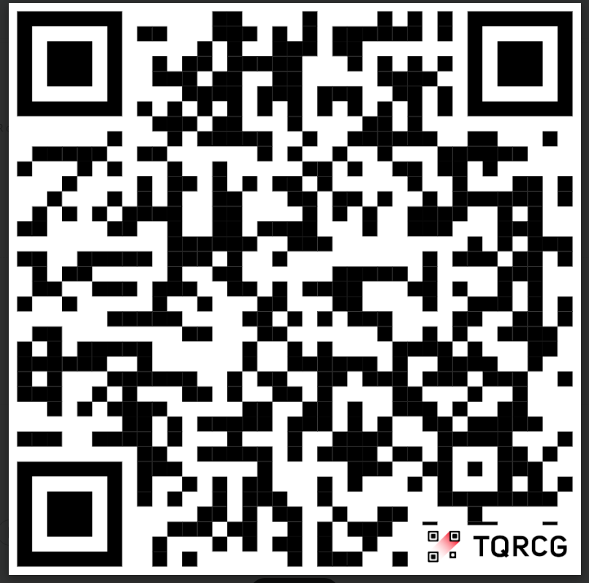
Looking ahead as a network: Google form
Thank you for your engagement and openness today.
We really appreciate the time, contributions and reflections you have all brought— this is what makes the network meaningful and helps it work well for everyone.
We hope you have found the session useful.
As we begin a new academic year, this is an opportunity to identify shared priorities, build on the expertise within the network, and shape future collaboration to meet the needs of reception children and families.
What should be our network priorities this year?
Think about:
Current reception challenges
Professional development needs
Areas of expertise within our schools
Opportunities for collaboration
Please scan the QR Code to complete this short feedback form: https://forms.gle/EadnVbuPA71CyTqh6
This network is shaped by its members. We want it to be a supportive, collaborative space that meets the needs of everyone involved. All ideas, experiences and perspectives are welcome, and your contributions will help shape the focus of our work together this year.
Notes:
Sian/Em
QR code to be added, before weds

Slide 52


Closing and next steps
Our next virtual meeting will take place on
9th December 4-5.30pm
Following today’s session, we will share the slides with you.
Thank you again, and we look forward to continuing the conversation at our next meeting.

Slide 53
Thank you

