Slide 1

My New Class 3S
2026 - 2027

Slide 2
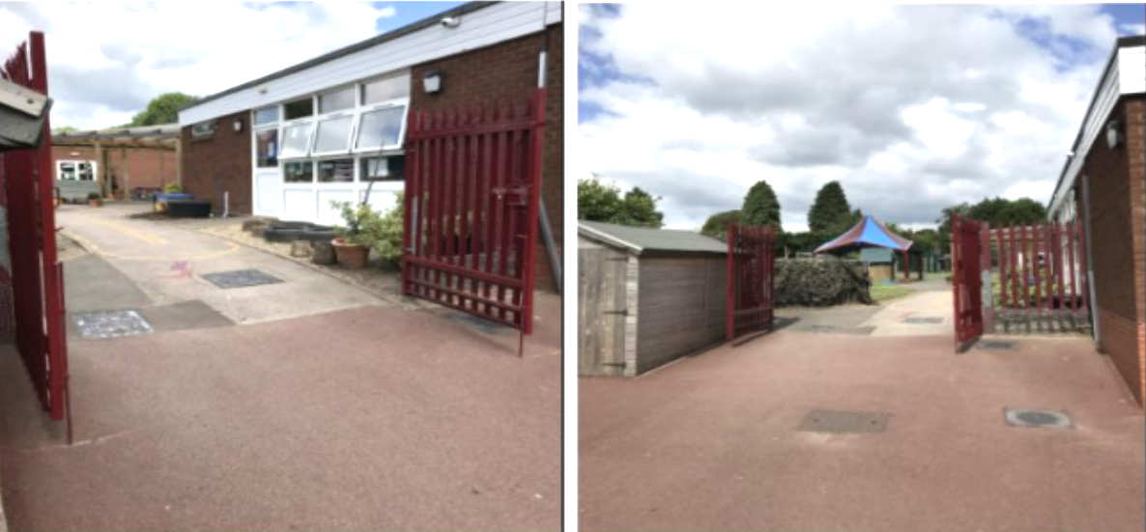
After the summer holidays I will enter school this way each morning: at 8:45am

Slide 3
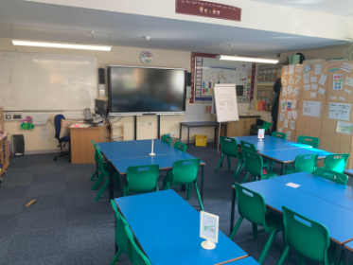
After the summer holidays, I will be in a new classroom.
This will be my new classroom: 3S

Slide 4
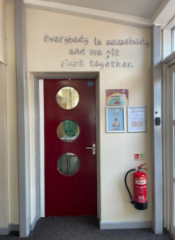
This will be my new classroom door:

Slide 5
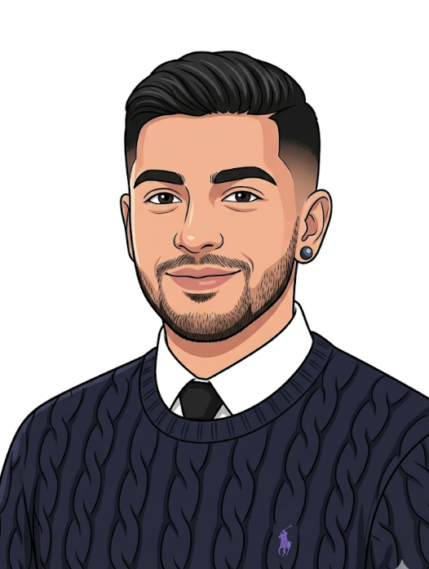
This is my new teacher, Mr Samra.

Slide 6
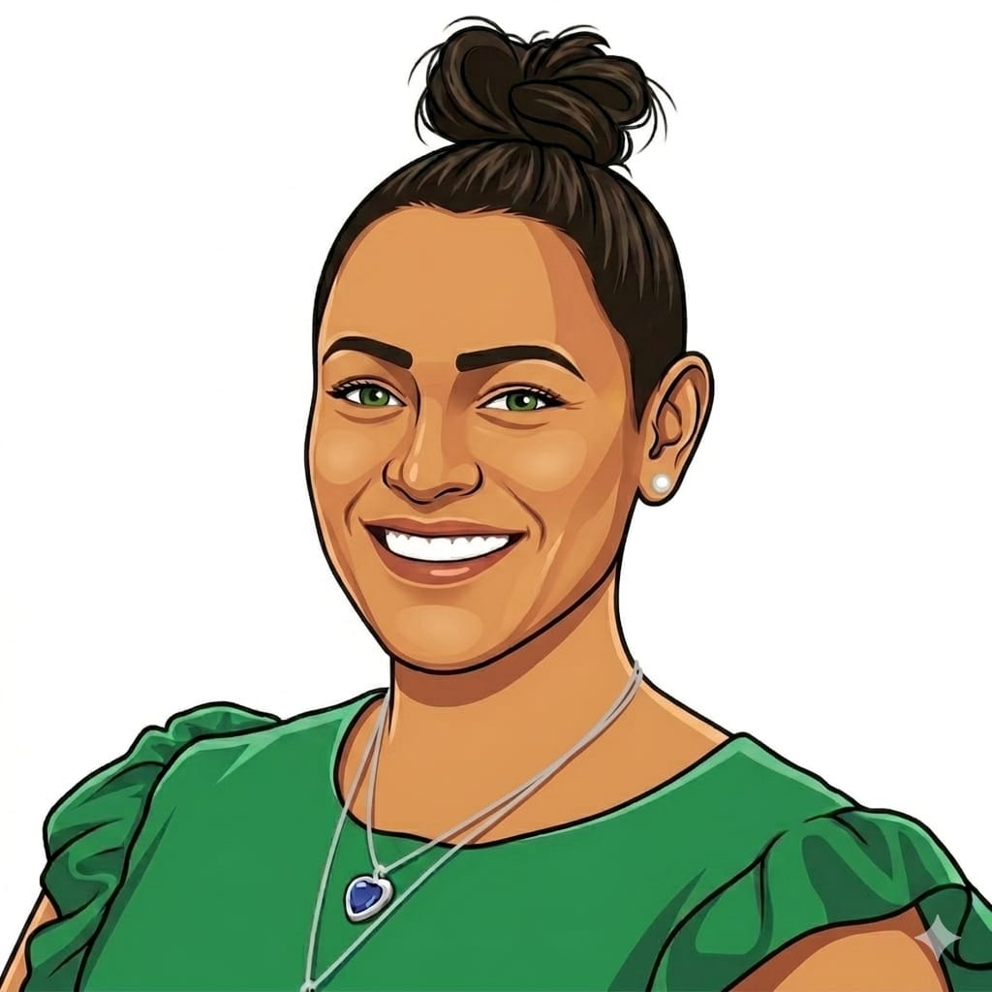
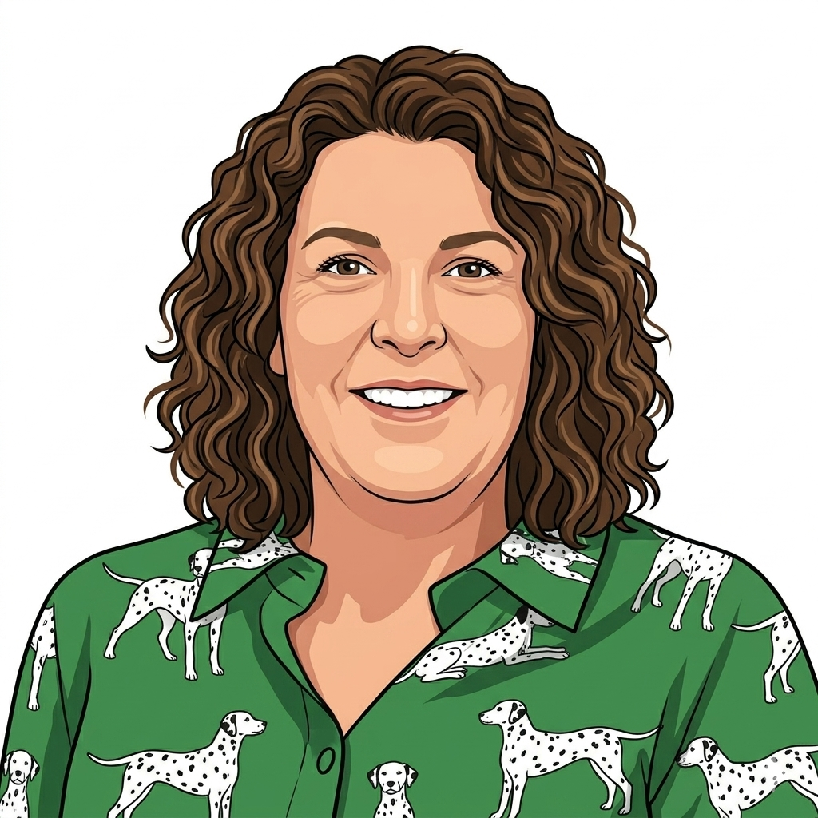
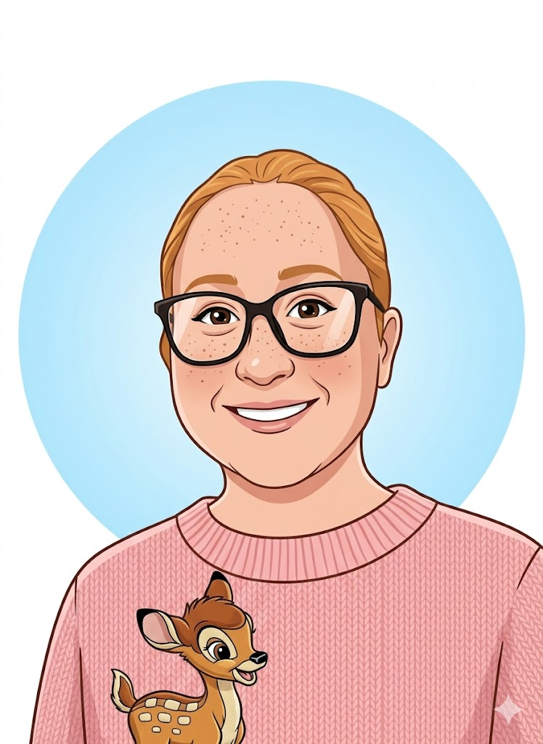
I will have new teaching assistants and a teaching assistant who I know.
These are my Year 3 teaching assistants:
Miss Jackson
Mrs Davies
Miss Lewis

Slide 7
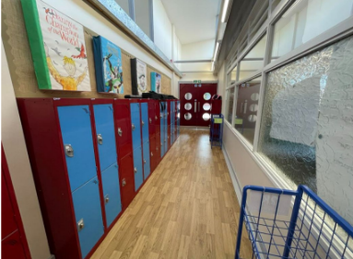
I will have a new locker.
This is where my locker will be:

Slide 8
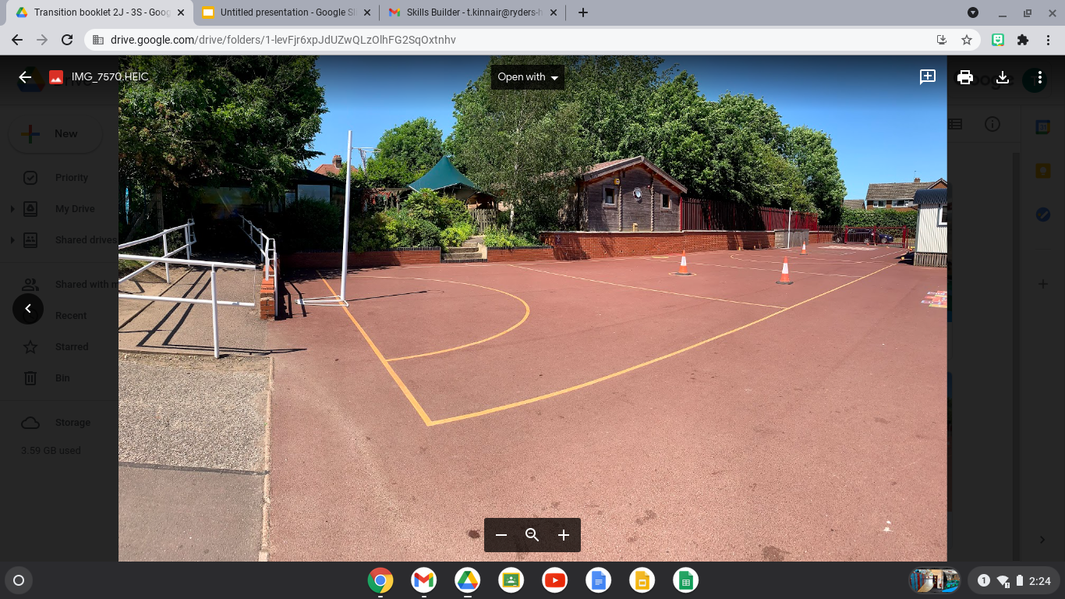
I will have playtimes and lunchtimes in the KS2 playground:

Slide 9
My playtime is: 10:30am-10:45am.
My lunchtime is: 12:00pm-12:45pm.
I will have playtimes and lunchtimes in the KS2 playground:

Slide 10

Other staff that will teach me through the week are -
Senora Holmes for Spanish on Fridays
Walsall Football Club for PE on Fridays

Slide 11
I will leave school at the end of the day through this exit/gate:
I finish school at - 3:30pm

Slide 12


I will have lots of fun and learn new things in 3S

