Slide 1

My New Class
2026-2027

Slide 2
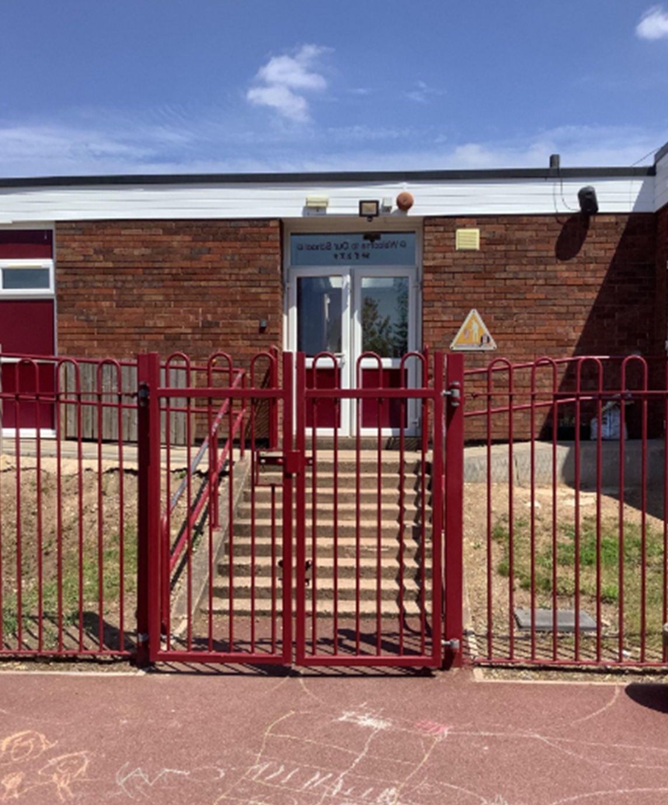
After the summer I will enter the school through the playground

Slide 3
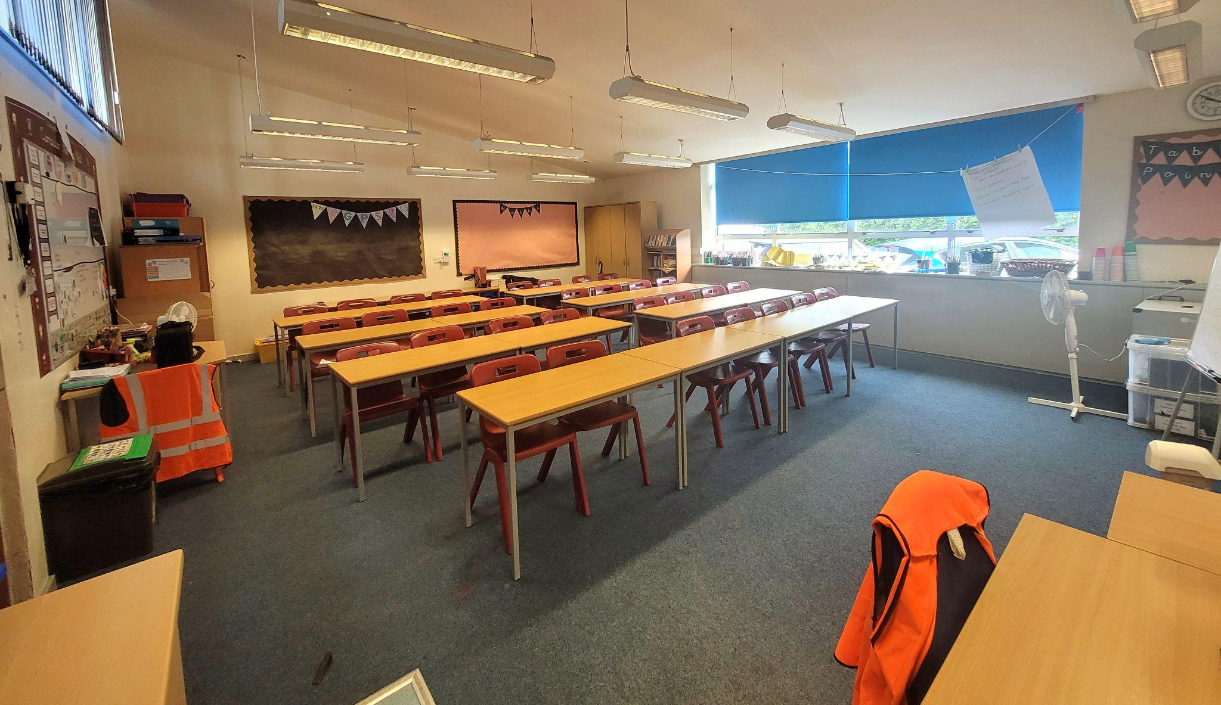
After the summer holidays, I will be in a new classroom.
This will be my new classroom, 6WH

Slide 4
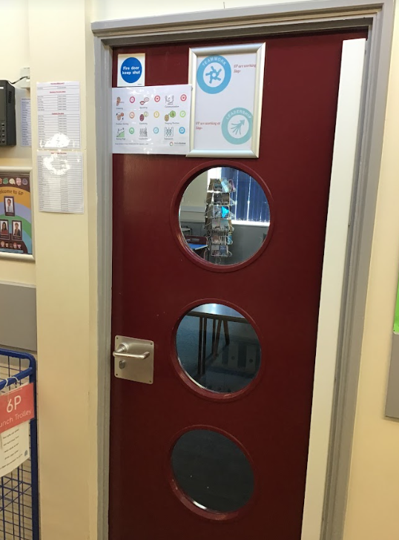
This will be my new classroom door:

Slide 5
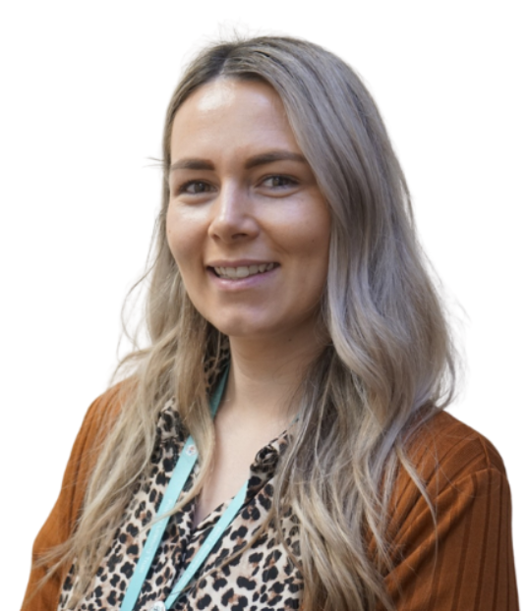
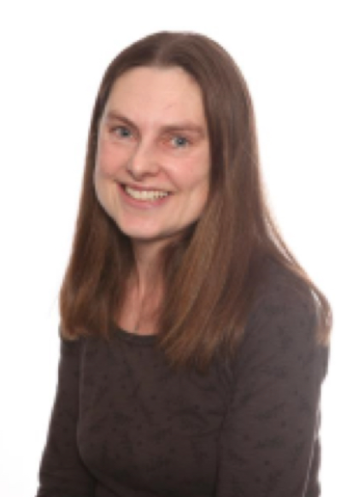
Here are my new teachers, Miss White and Miss Hems
My new class is called 6W.
Miss White
Miss Hems

Slide 6
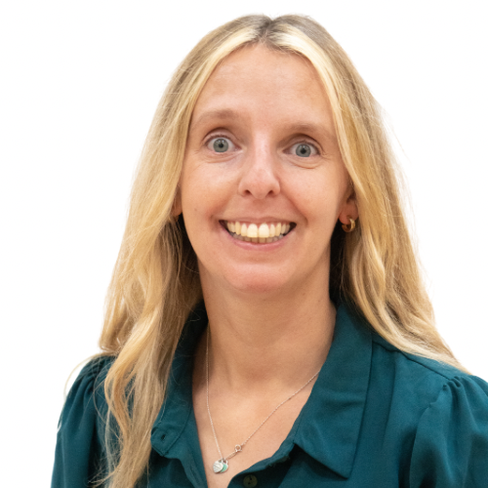
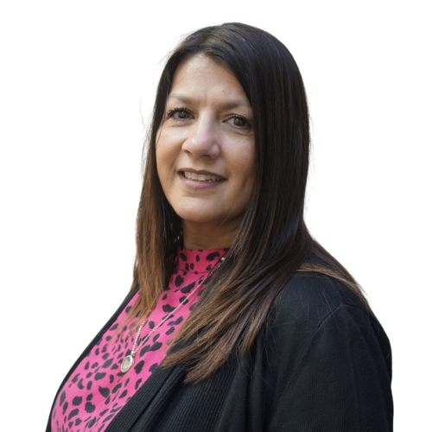
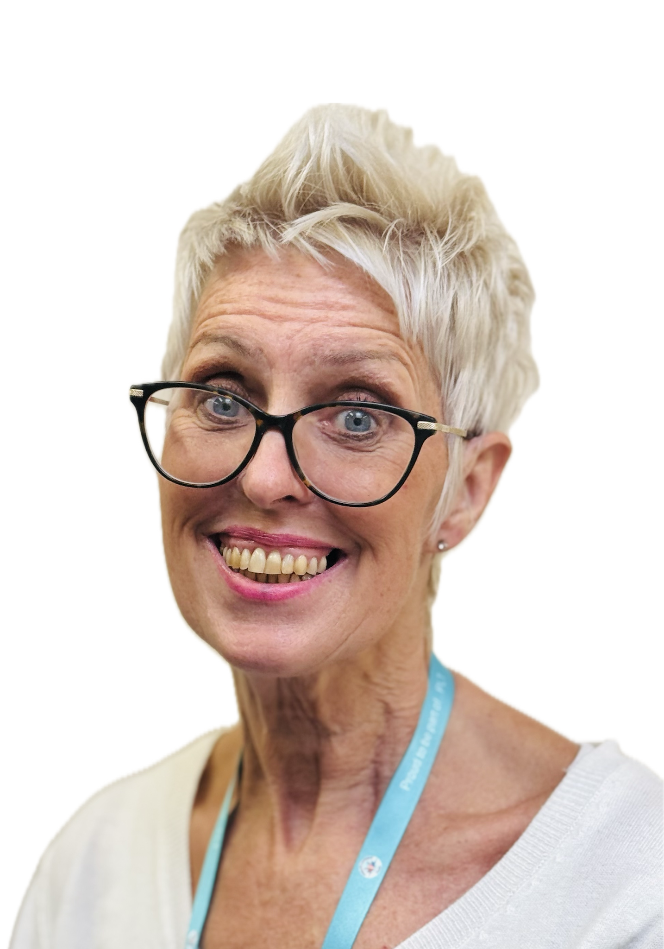
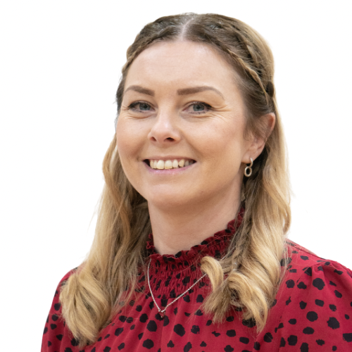
I will have new teaching assistants
Here are my Year 6 teaching assistants:
Mrs Nightingale
Mrs O’Connor
Mrs Sargent
Mrs Clarke

Slide 7
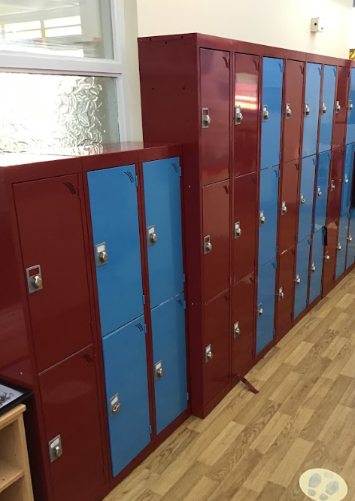
I will have a new locker.
This is where my locker will be:

Slide 8
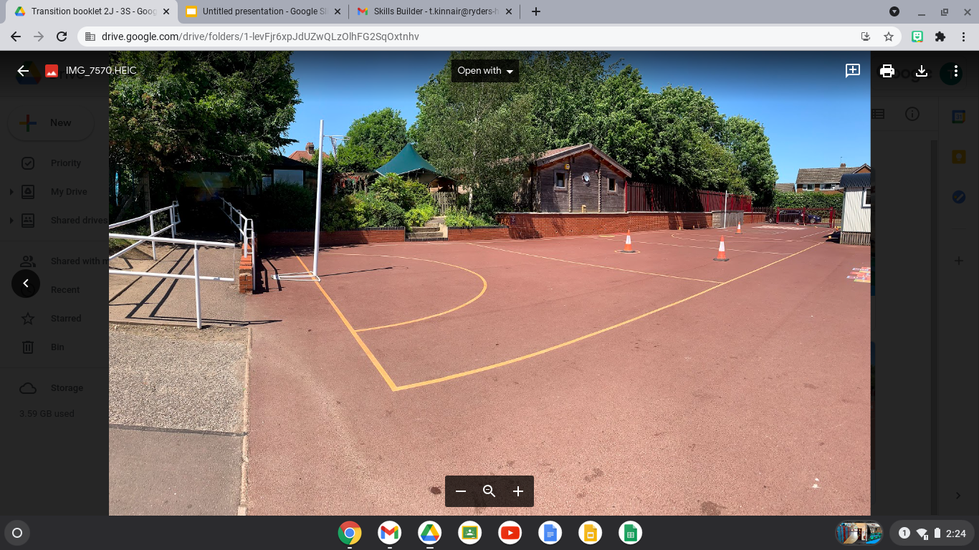
My playtime is at 10:45am
My lunchtime is at 12:00pm
I will have playtimes and lunchtimes in the KS2 playground:

Slide 9
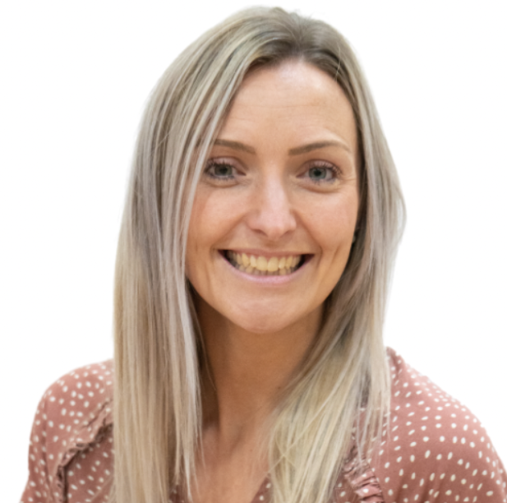
Other staff that will teach me through the week on Thursday’s are;
Spanish Mrs Hemms
Senora Holmes

Slide 10
I will leave school at the end of the day through this exit/gate:
I finish school at - 3:30pm

Slide 11


I will have lots of fun and learn new things in 6WH

