Slide 1

My New Class
2026 - 2027

Slide 2
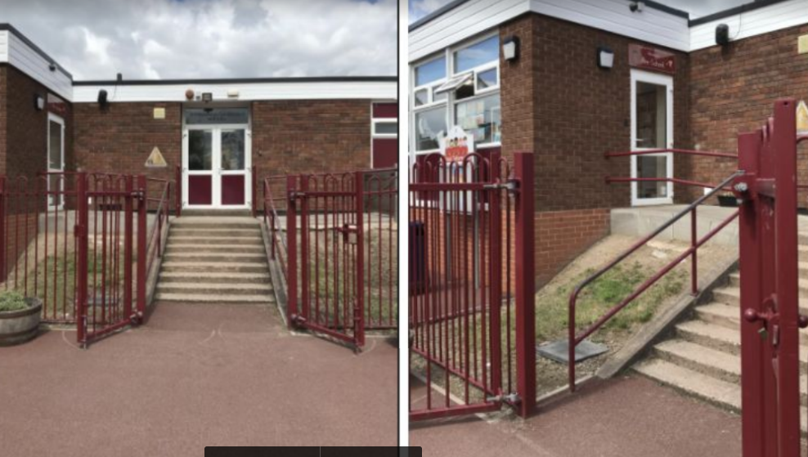
After the summer holidays I will enter school this way each morning:
Steps closest to Pre-school

Slide 3
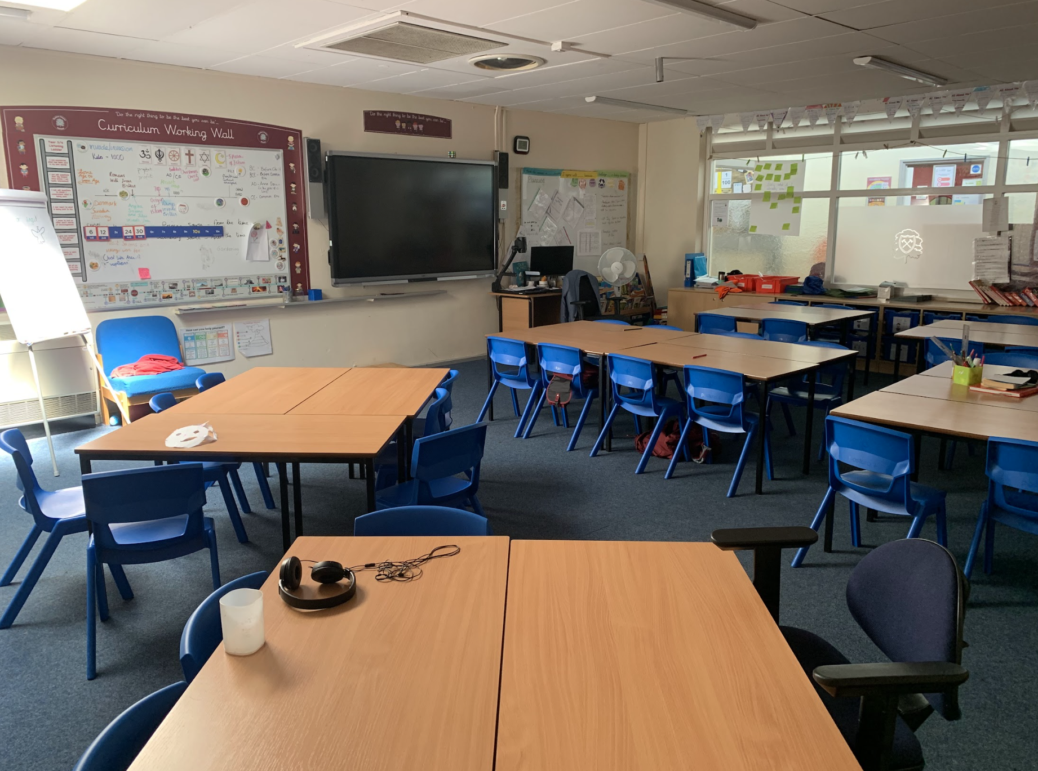
After the summer holidays, I will be in a new classroom.
This will be my new classroom:

Slide 4
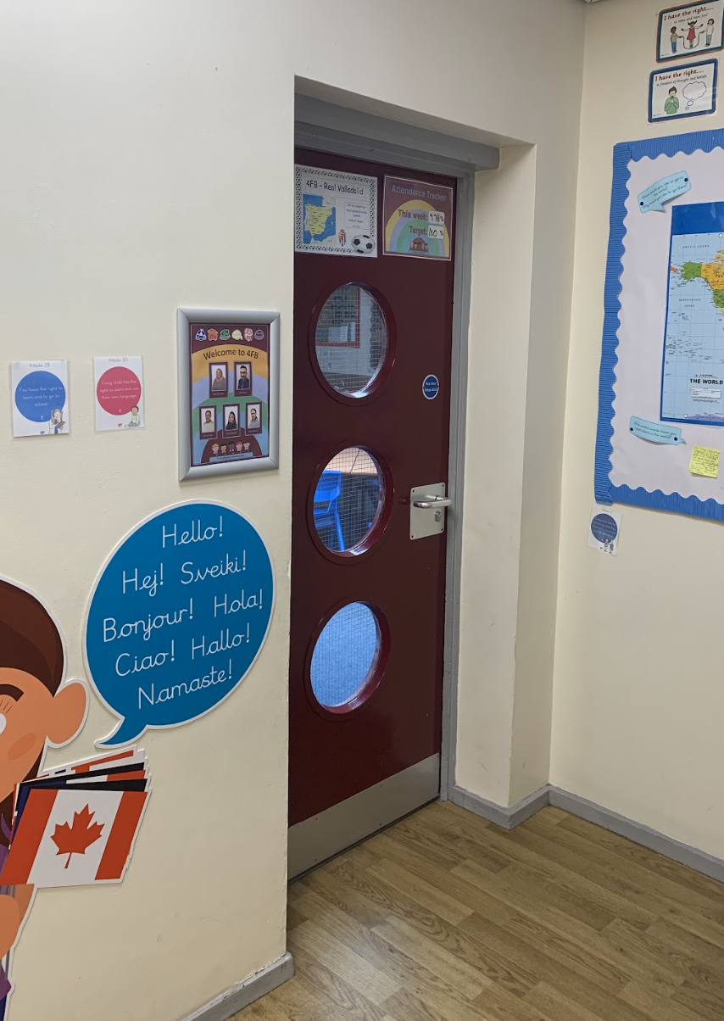
This will be my new classroom door:

Slide 5
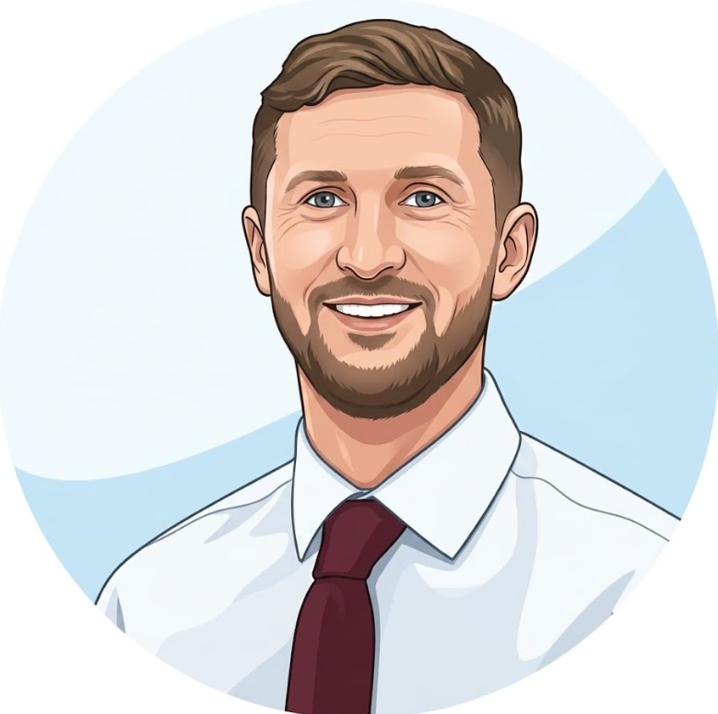
This is my new teacher, Mr Moon
My new class is called 4M.

Slide 6
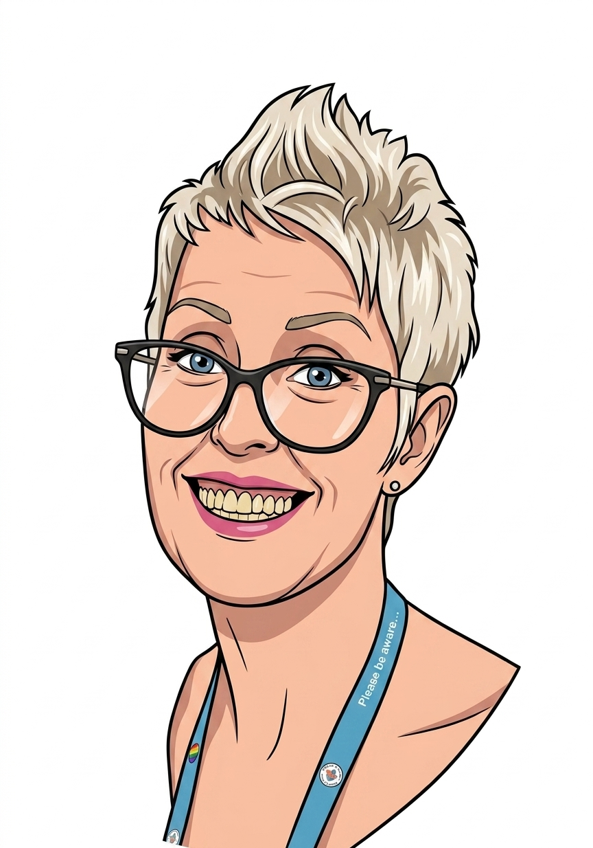
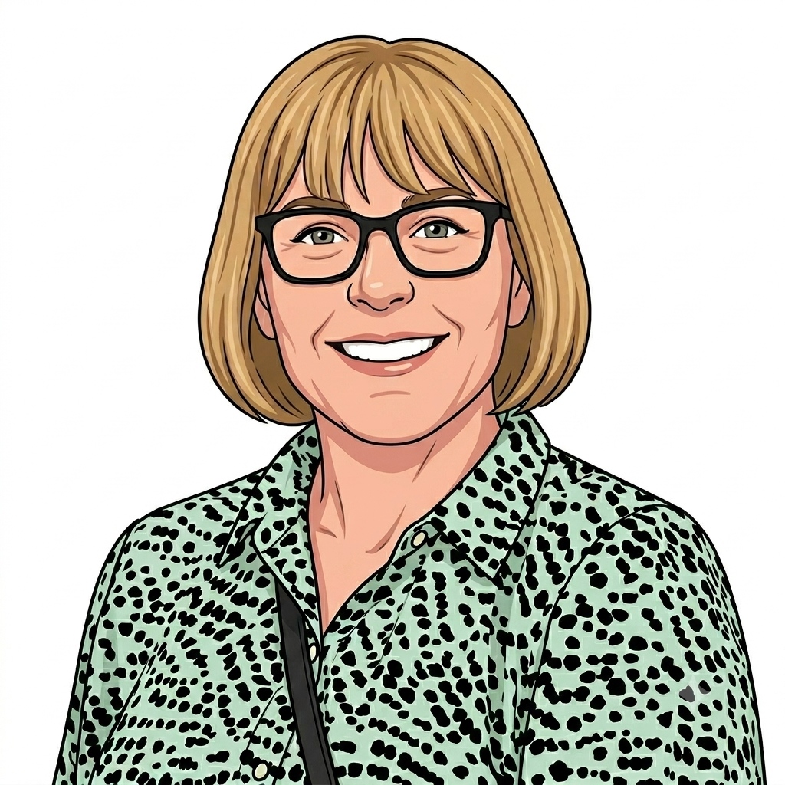
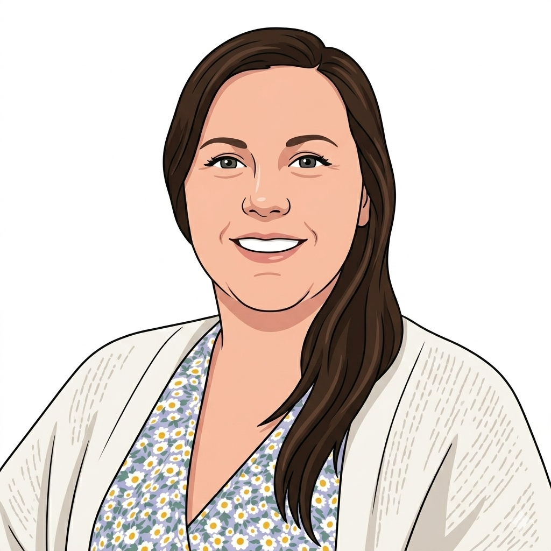
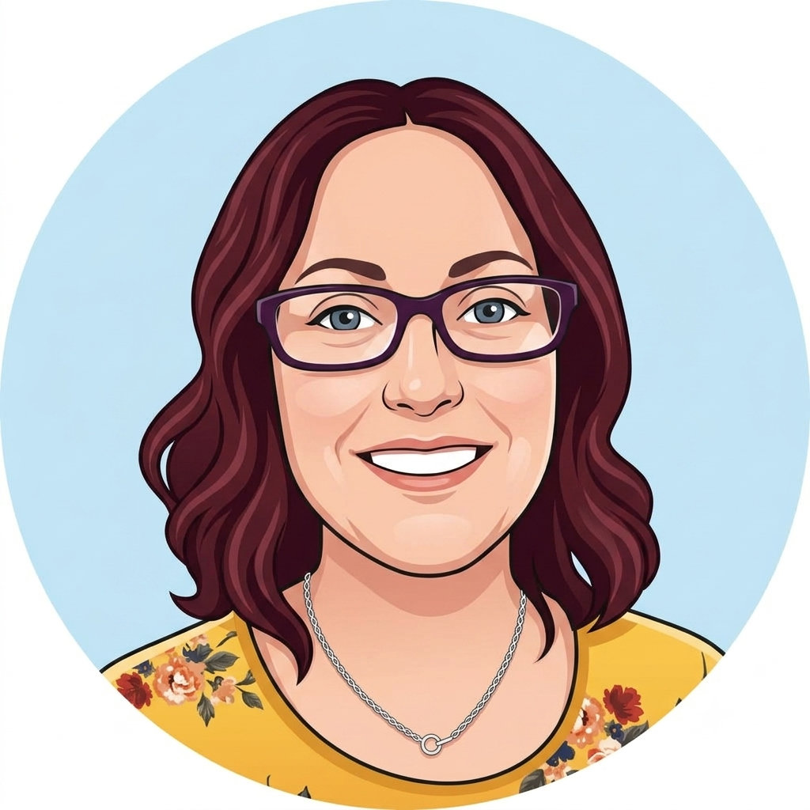
I will have some new teaching assistants.
These are my Year 4 teaching assistants:
Mrs Reed
Mrs Sargent
Mrs Griffiths
Mrs Webster

Slide 7
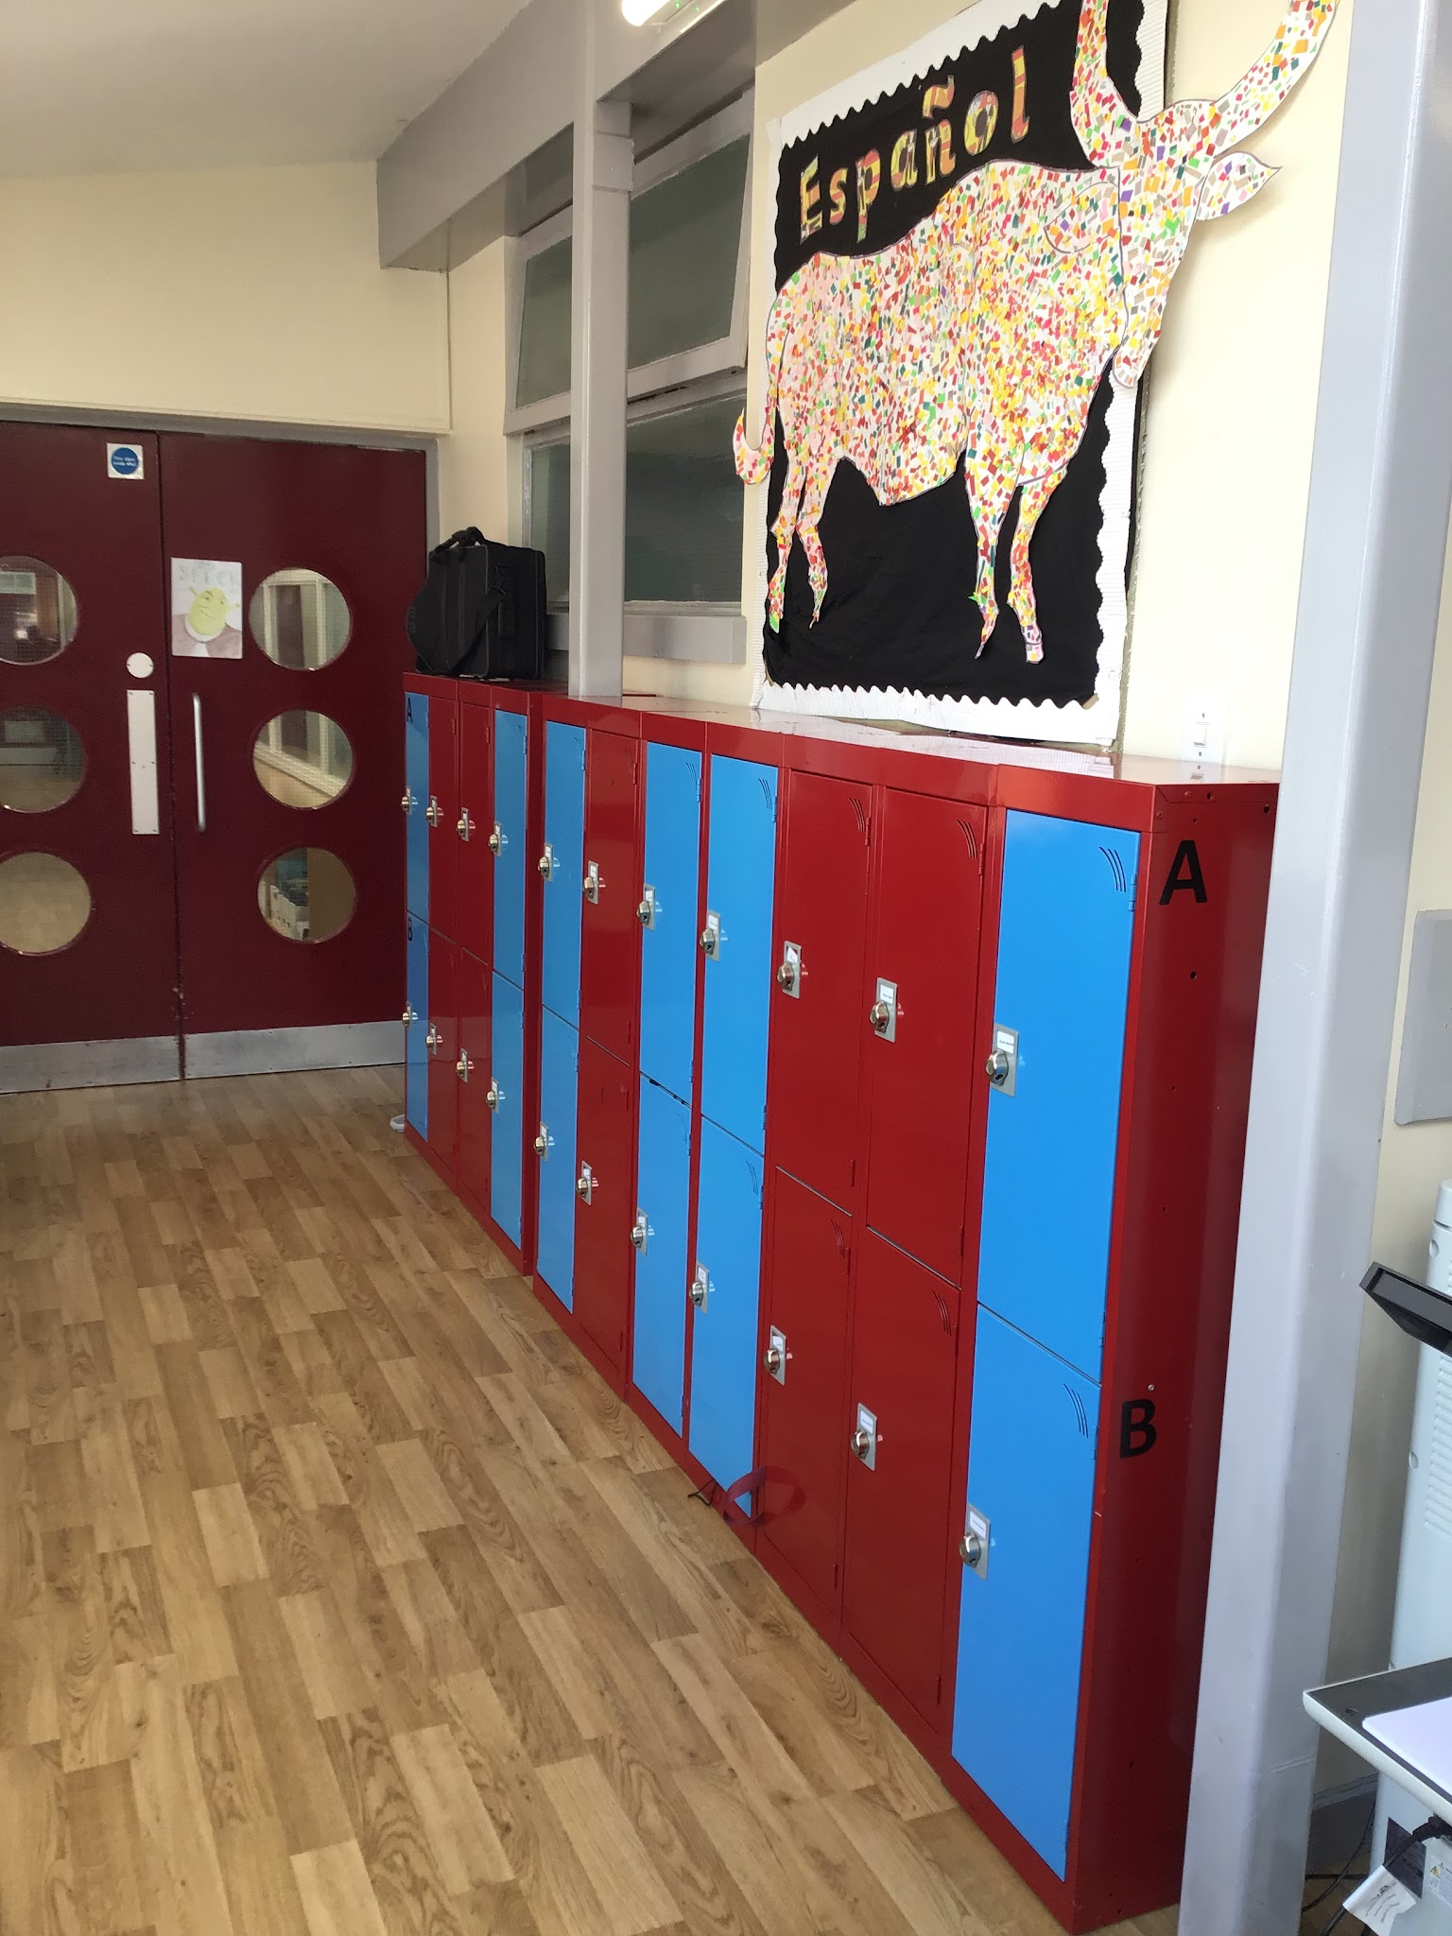
I will have a new locker.
This is where my locker will be:

Slide 8
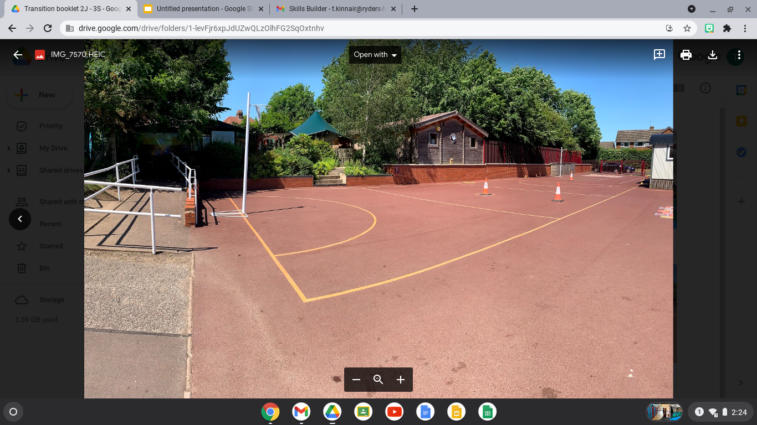
I will have playtimes and lunchtimes in the KS2 playground:

Slide 9
My playtime is at 10:30am
My lunchtime is at 12:00pm
I will have playtimes and lunchtimes in the KS2 playground:

Slide 10
I will leave school at the end of the day through this exit/gate:
I finish school at - 3:30pm

Slide 11
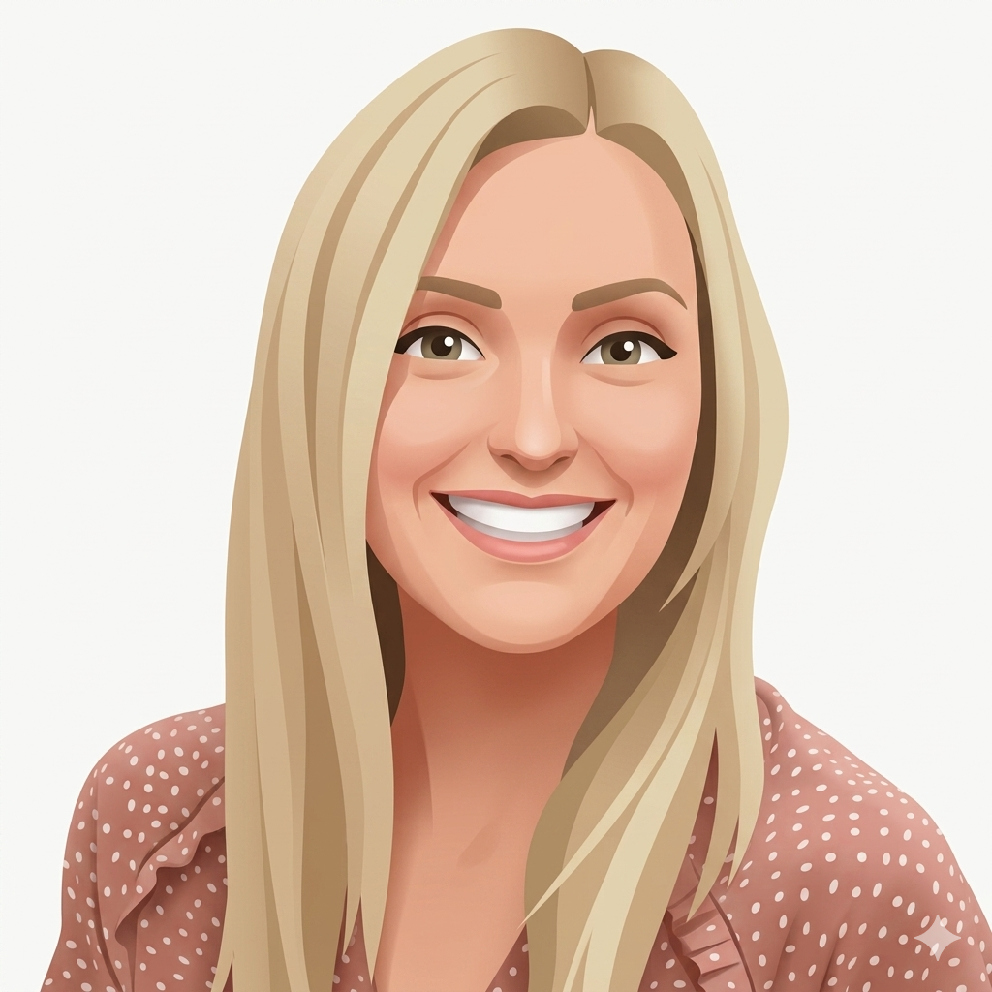
Other staff that will teach me through the week are -
Senora Holmes for Spanish on Fridays
Walsall Football Club for PE on Fridays

Slide 12


I will have lots of fun and learn new things in 4M!

