Slide 1
Year 4 Induction Evening
2021

Slide 2
This meeting will be recorded
Please stay on mute throughout the presentation.
Ask any questions at the end of the presentation either in the chat or by raising your hand

Slide 3
Learning at Ryders Hayes…
Learning begins with the first steps onto the playground in a morning and is a seamless, stimulating, deep and challenging experience for everyone, driven through continuous provision; thirst for knowledge, and children’s curiosity throughout the day, continuing long after. the home-time bell.

Slide 4
Ryders Hayes Vision and Values 2021
1.Mission Statement:
2. Vision: To nurture and facilitate the growth of our pupils and their learning; equipping them with the skills and attributes to embrace the challenges of a rapidly changing world. To enjoy success for today and be prepared for tomorrow, by instilling the values of:
Character: qualities of the individual essential for being personally effective in a complex world including: grit, tenacity, perseverance, resilience, independence, reliability and honesty.
Citizenship: upholding British Values, thinking like global citizens, considering global issues based on deep understanding of diverse values with genuine interest in engaging with others to solve complex problems that impact human and environmental sustainability
Collaboration: the capacity to work interdependently and synergistically in teams with strong interpersonal and team-related skills including effective management of team dynamics, making substantive decisions together, and learning from and contributing to the learning of others.
Communication: entailing mastery of three fluencies: digital, writing and speaking tailored for a range of audiences, through early, high-quality back and forth interaction.
Creativity: having an ‘entrepreneurial eye’ for economic and social opportunities, asking the right questions to generate novel ideas and explore possibilities, demonstrating leadership to pursue those ideas into practice.
Critical Thinking: critically evaluating information and arguments, reflecting upon them, seeing patterns and connections, constructing meaningful knowledge and applying it in the real world.

Slide 5
Our curriculum is evolving !
We have designed a bespoke curriculum specifically for our children.
In order to store information in long term memory children need to revisit the same key skills, concepts and vocabulary through a range of key experiences.
We have grouped our subjects into three categories – Sciences, Arts and Life skills

Slide 6
Our curriculum is evolving !
Our curriculum drivers are
explore / build / create possibilities, resilience and independence

Slide 7
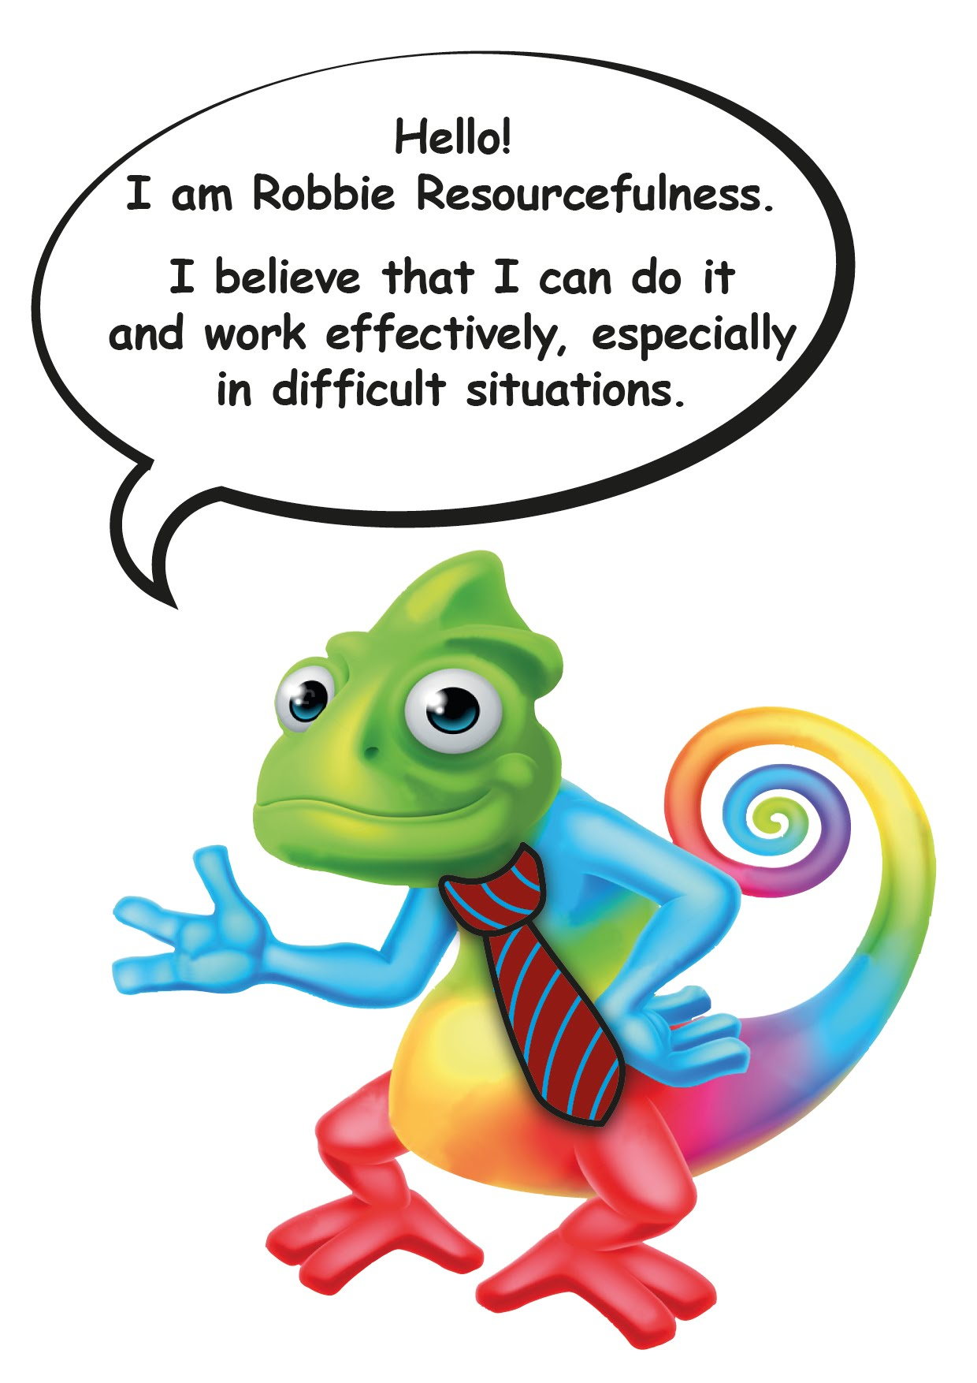
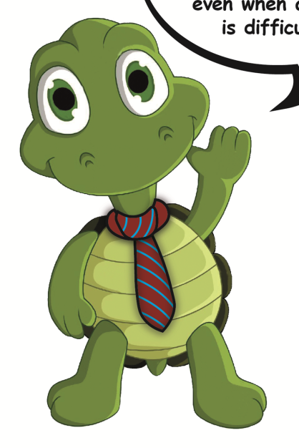
Learning Characters

Slide 8
3. A Good Learner at Ryders Hayes will be able to use:
The 4 Rs - characteristics of learning:
Reciprocity: Listening; empathy; collaboration; inter/intra-dependence; thinking and communicating; imitation | Resilience: Perseverance; taking risks; managing distractions; finding humour; responding with wonderment and awe; absorption; noticing
Resourcefulness: Creating; imagining; innovating; making links; reasoning; questioning; applying past; capitalising; knowledge; gather data through all senses | Reflectiveness: Planning; meta-learning; distilling; revising; thinking about thinking; applying past knowledge to new situations; striving for accuracy – check, measure and exactness

Slide 9
4. Extended vision - Continuous provision:
‘Every day is a learning day…’

Slide 10
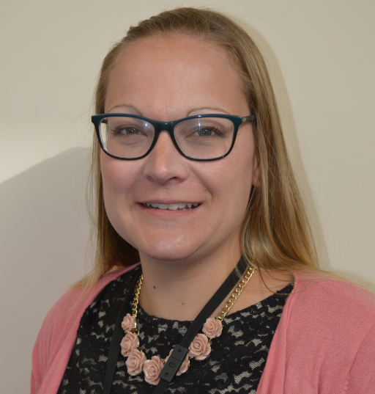
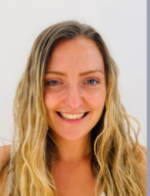
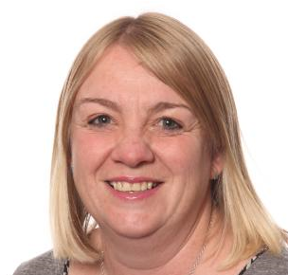
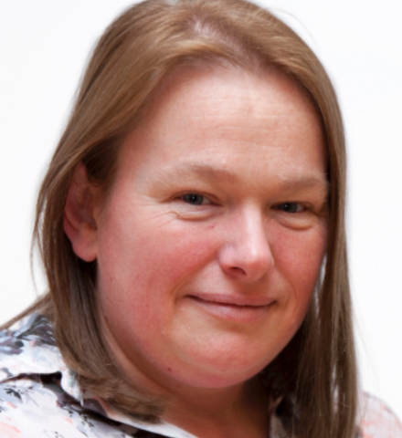
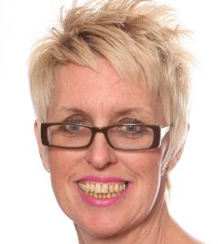
Meet the Team
Mrs Bowyer 4B
Mrs Garbett 4G
Monday to Thursday
Miss Dunn
Mrs Sargent
Mrs Holmes
Friday 4G

Slide 11
The Classroom
https://drive.google.com/file/d/1a0F6muiQ4tW5T9vHxArTFdxZGo60c1https://drive.google.com/file/d/1a0F6muiQ4tW5T9vHxAdxZGo60c1tI/view?usp=sharingtI/view?usp=sharing

Slide 12
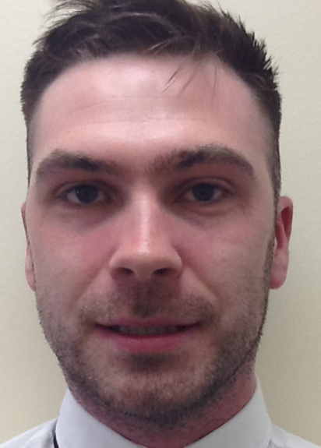
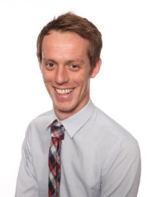
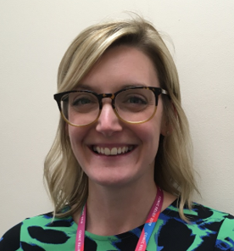
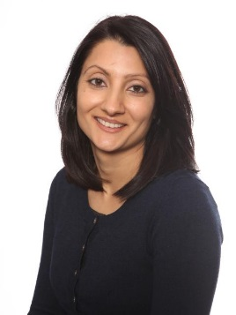
Who to see
Class teachers
Team leader
3. Phase leader
4. Deputy Head Teacher
5. Headteacher

Slide 13
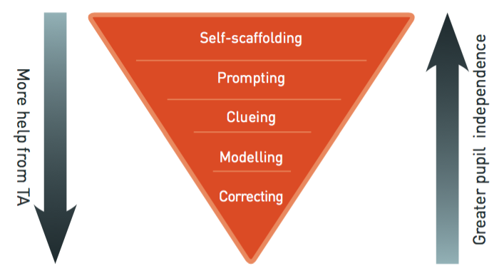
MITA
How TAs will be working with your child

Slide 14
HOME-SCHOOL PROMISE 2019/20
The Family promises to:
Ensure children come to school ready to learn; providing
uniform, PE KIT
Ensure children attend regularly and on time and inform school of absence on the first day.
Fully support the School’s Policies, and any sanctions required as part of the Behaviour Policy.
Read the Safeguarding Policy on the school website.
Support the child with readings, spellings and tables, as well as ensuring that set home-learning is completed and returned on time.
Read and respond to school communications, and attend meetings to discuss pupil progress.
Support their child’s learning and progress through attendance at every Parents’ Evening and specific year group workshops.
Treat staff with respect and refrain from any abusive, threatening or violent behaviour.
Refrain from making any reference to school or school staff on social media sites.
Signed ………………………………………………………………… (Parent/Carer)

Slide 15
Home Learning
Reading together - Daily
Google classroom x Tables and spellings
Topic based challenges
Maths skills – numbers bonds, times tables, telling the time
Practise spellings

Slide 16
PE
PE will be on ...
Friday
Pupils MUST have PE kit with them, must not be wearing earrings.
Please ensure PE kits are left in school as some weeks we do extra PE

Slide 17
Topics –Knowledge Mats
Autumn
Anglo Saxons / East Anglia
Electricity making a light up home
Spring
Vikings / Local Geography
Making Pencil cases / Digestion and teeth
Summer
Mayans / Italy including volcanoes and earthquakes . Making chocolates. Habitats

Slide 18
MIMW

Slide 19
TRIPS
Woodland outdoor adventurous day
Friday 5th November. 4 activities for team building during the day. Approx £35.00
Day in school on Thursday 4th November
Local walks out into Pelsall.

Slide 21
Parent Meetings
Parents Evenings will be online again this coming year. October 2021 and February 2022 dates.
We will be inviting parents in to school to work with children during a learning Showcase afternoon.
These will be at various points through the year.

Slide 22
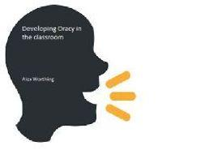
Oracy
There will be a big focus on improving the oracy skills (oral communication) of learners at Ryders Hayes over the coming months.
We will be working with 'School 21' which is a flagship school in London who are at the forefront of developing the spoken communication skills of children.
Watch this space!

Slide 23
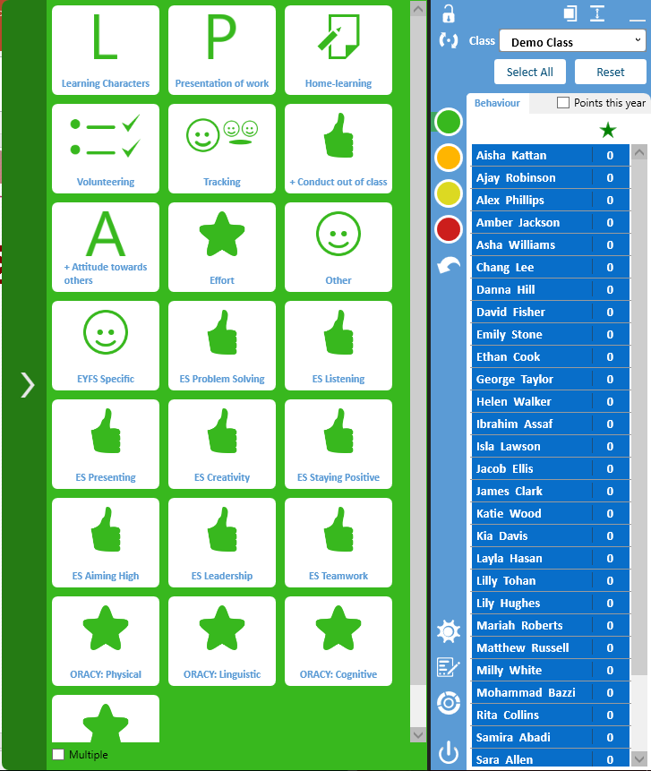
Rewards in School
Trackit Points
Rewards-Golden time, stamps, praise assembly
Starting on white. Green reward points. Yellow – red cards.
Parents will be informed if red cards have been given and why.

Slide 24
E Safety
The children will all be taught about E-Safety throughout the year. This is part of our computing curriculum as well as Me in My World studies.
At school we always take part in Safer Internet Day, held during
February each year.
Parental Concerns:
If you have any concerns about E-Safety and your child, particularly cyberbullying or accessing content they shouldn’t; then please contact school and we can help you.

Slide 25
Pupil Premium
A child is entitled to this if they are eligible to free school dinners. Forces and ‘children who are looked after’ (CLA) once we have been informed. If you think you may be entitled to this please ask Mrs Heaton via the office for advice on applying.
Your child will get
One free trip a year (or contribution to a residential)
One after school club or musical tuition free
Other extra support according to their needs within school

Slide 26
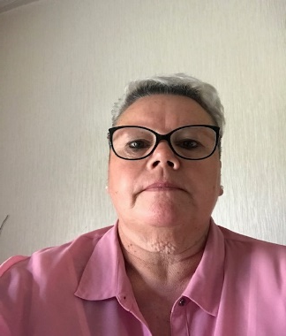
Attendance
We would like to take this opportunity to introduce to you, Dawn Thompson our Attendance Consultant who will be working very closely with the School and our families, to raise attendance and offer support.
As you will be aware the school are working very hard to improve both attendance and punctuality and her role will be to meet with parents and discuss any concerns regarding attendance levels or lateness.
She will carry out home visits on behalf of the school to discuss reasons for absence and offer support to assist with any issues that may be preventing your child from attending on a regular basis or on time.
Dawn has a wealth of knowledge around attendance and you will see her regularly in school monitoring punctuality.

Slide 27
Punctuality
Arriving on time sets your child up for the rest of the day.
Arriving late interrupts not only your child’s learning but those around them.
Children arriving late after the bell has sounded will have a ‘L’ Late code applied to their registration document.
Children arriving 20 minutes or more without a valid reason will have a code ‘U’ applied which counts as an unauthorised absence even though they are in school so will effect their overall attendance figure over the year.
Parents are to sign in their child if late using the new signing in machine in reception.
Leave of Absence
A leave of absence form must be completed at least two weeks prior to any leave taking place and can be obtained online or at the office.
As a school we do not authorise any leave of absence and all leave will be coded as ‘G’ which means leave taken but not authorised by the school.
The local authority look at leave of absence along with Dawn Thompson our attendance consultant and can issue penalty notices which can be £60 per child, per adult.
We encourage all leave to be taken during holiday periods where possible as this does effect your child’s learning

Slide 28
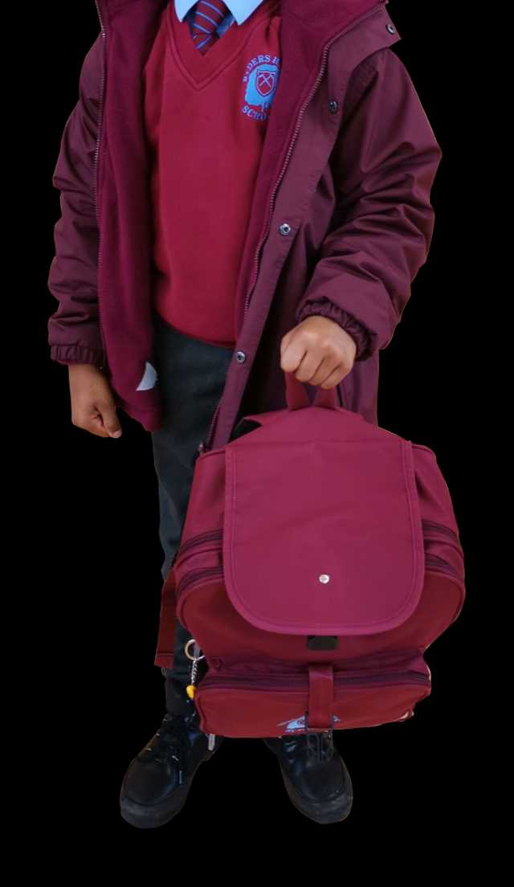
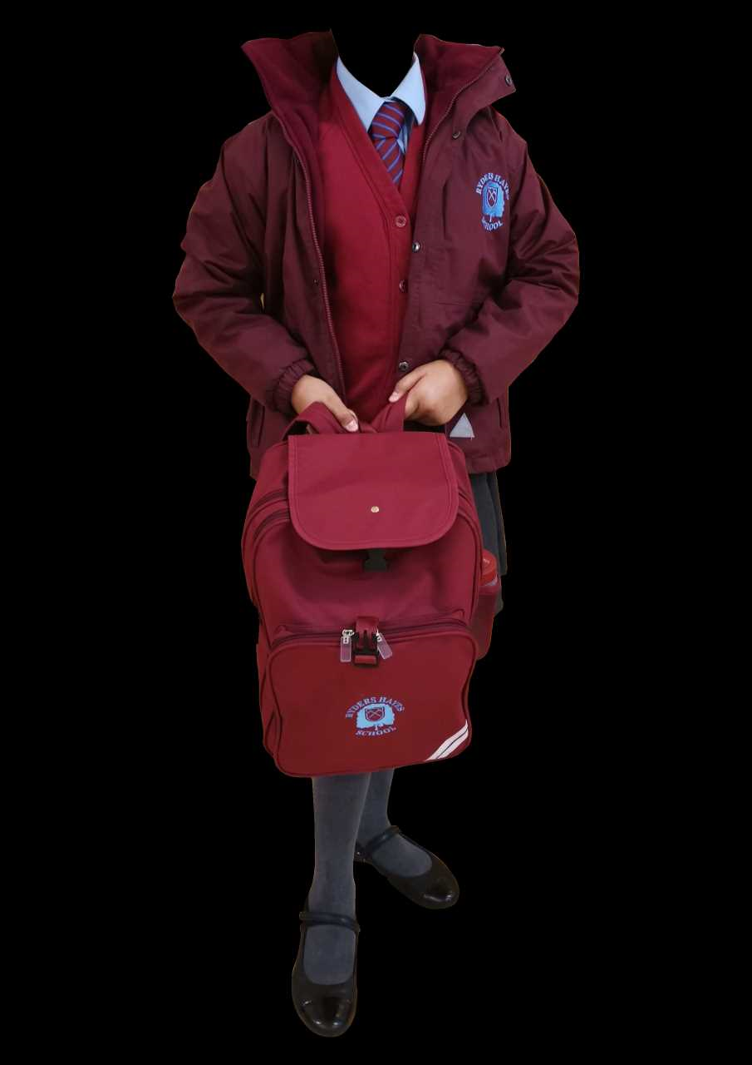
Winter Uniform

Slide 29
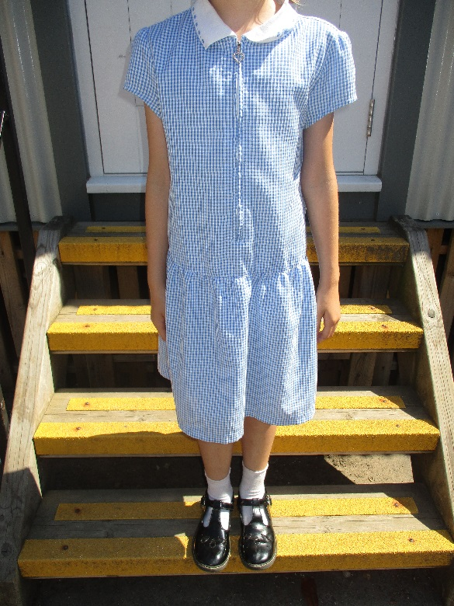
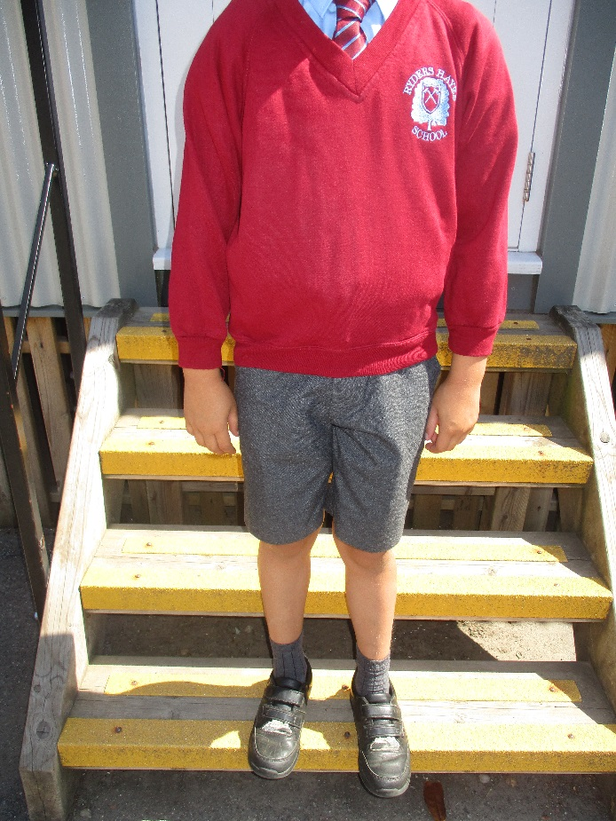
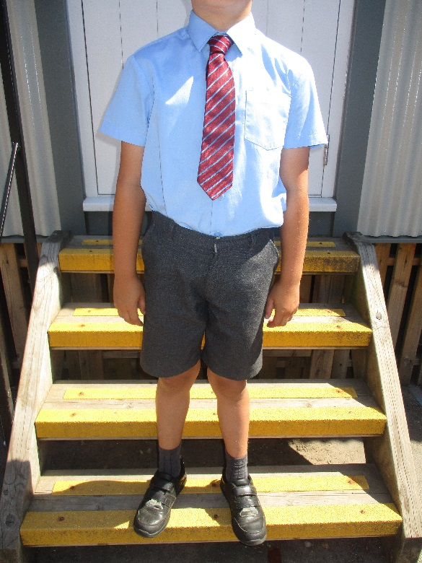
Summer Uniform

Slide 30
Friends of Ryders Hayes
We are currently a small group of parents who get together to raise funds and have fun activities for our all children at Ryders Hayes school. We would love for more parents/carers/grandparents/friends and family to get involved and help out.
What we do
We organise the Halloween disco, Christmas Market, Sumner fayre and support the school in events such as parent evening, Christmas plays, end of year plays and more by supplying refreshments and a raffle . We hold meetings to discuss future plans and events.
Where do the funds go?
Money raised all goes towards children in school and all member of friends of Ryders Hayes are asked their views.
There is no need for commitment to all events or meetings.
If you can spare some time for even just an hour at one of the events, it is all greatly appreciated.
If you would like to know more about how you can help please get in touch via
Facebook @FriendsOfRydersHayes, email postbox@ryders-hayes.co.uk , passing your details to the office or let one of the members know you would like to be involved

Slide 31
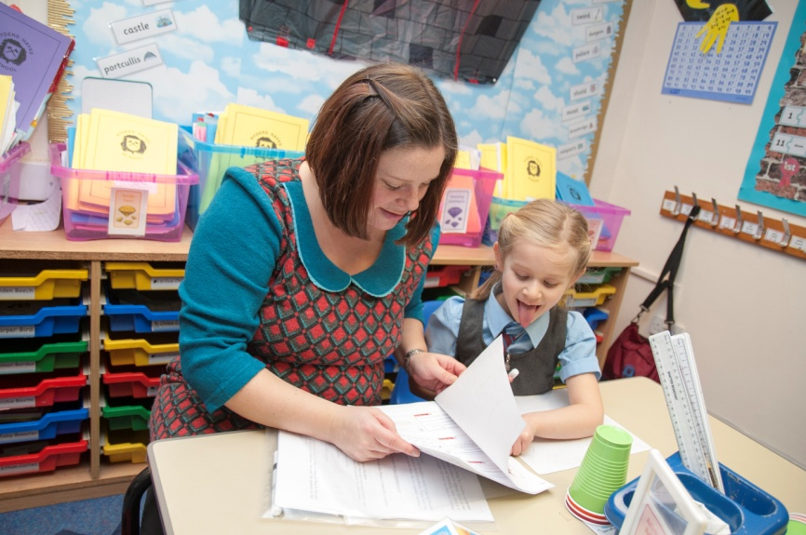
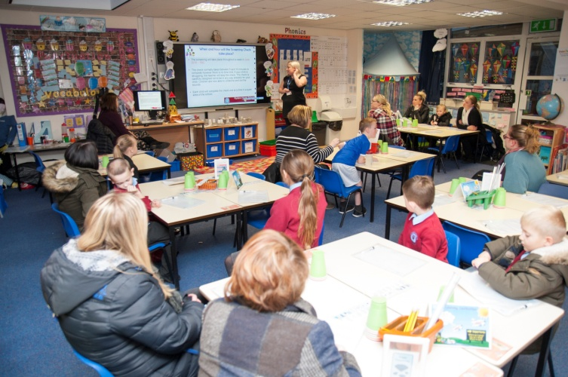
Family Learning
As part of Family Learning at Ryders Hayes during the next school year you will be invited in to work alongside your child in the classroom.
We look forward to this partnership with parents.
Look out for dates in September.

Slide 32
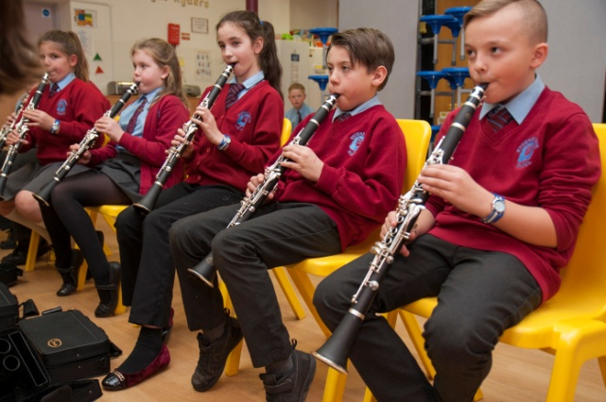
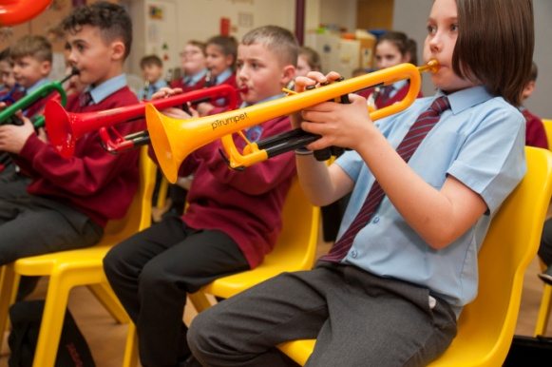
Music at Ryders
All children from Reception to Year 6 have a weekly lesson where they learn about music through listening, composing and performing whilst developing skills in singing and playing instruments. All year 5 pupils learn trumpet, trombone or clarinet as part of their music lesson.
There is a whole school Singing Assembly each week and two school choirs that are open to everyone.
Pupils in Y3-Y6 also have the option to learn a wind or string instrument in addition to their curriculum music lesson. We currently offer flute, clarinet, saxophone, trumpet, trombone and violin lessons.
We have the following Music Clubs at Ryders Hayes, all of which are free of charge.
· KS2 Choir
· School Band
· KS1 Choir fter school

Slide 33
ParentMail / Parent Pay
What do we use it for?
To send letters.
To set up payments (for trips, clubs or even school dinners.)
To send reply slips & get responses.
To send SMS messages (texts.)
To set up bookings for Parents Evenings.
Please speak to a member of the office team if you have not yet signed up for parent mail

Slide 34
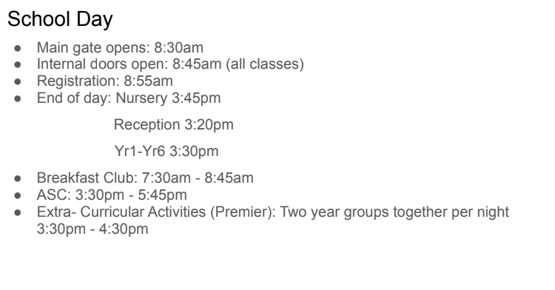

Slide 35
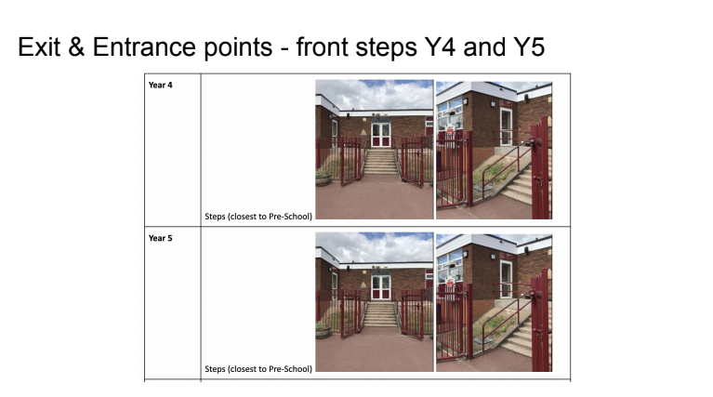

Slide 36
Thank you for attending!

